Slide 1
GCE Geography (from 2016)
AO3: Developing data analysis skills

Slide 2
https://resources.eduqas.co.uk/
This resource helps students understand how to describe and analyse patterns, trends and relationships effectively and offers advice on how to think critically about different data presentation techniques.
It supports candidates as they prepare for their examinations and as they consider different data presentation skills for their NEA.

Slide 3
AO3
Use a variety of relevant quantitative, qualitative and fieldwork skills to:
• investigate geographical questions and issues
• interpret, analyse and evaluate data and evidence
• construct arguments and draw conclusions
Notes:
Although nearly half of the AO3 marks available are designated to the NEA, there are a significant number of Eduqas AO3 marks available for using skills and for analysing and interpreting data and evidence in Component 1 and 2. The same is true of Units 1-3 in WJEC qualifications.

Slide 4
https://resources.eduqas.co.uk/
Notes:
The resource takes you through 5 different challenges involved with the analysis and interpretation of data. The aim is to assist students to develop a skills bank that can be applied to any resource seen in an examination setting and can also be used to assist in making decisions concerning data presentation methods and analysis as part of their NEA. Each can form a lesson in their own right or can be set as individual or group tasks for students. All resources used are printable and extension activities are also available. The following is a selection of tasks from the resource as a whole but please take time to look through each section as there are a number of different tasks in each.

Slide 5
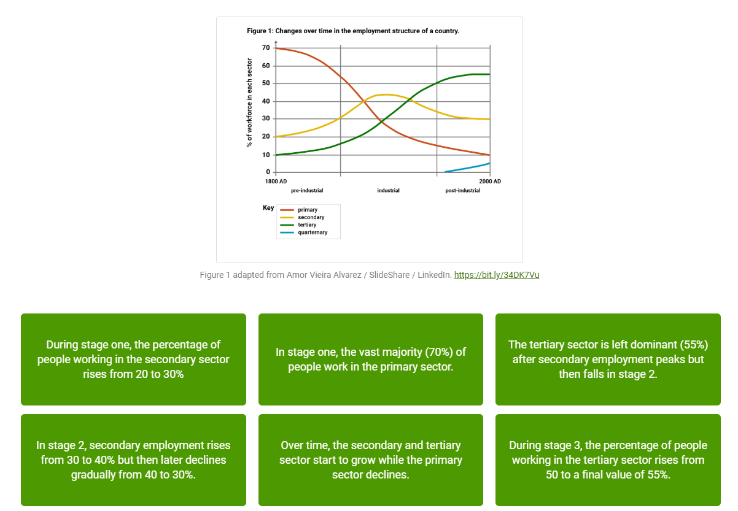
Describing and analysing trends
Notes:
The resource asks for the three analytical statements that best summarise this graph’s overall story. Beware selection of purely descriptive statements (although, you might not want to give this fact away before your audience starts to think!).

Slide 6
Describing and analysing trends
Notes:
The resource asks for the three analytical statements that best summarise this graph’s overall story. Remaining statements simply ‘lift’ from the resource and tend to look at only one sector in isolation rather than the ‘overall’ analysis.

Slide 7
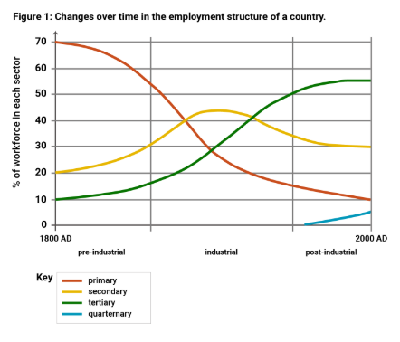
Identifying elements of a good AO3 response
AO3 question (5 marks):
Describe the trends for primary and tertiary employment shown in Figure 1.
Can you see how this answer clearly clearly communicates change over time?
Response A: Total tertiary employment begins at a very low level of 10%. In stage one there is little increase prior to rapid increase in the percentage during stage two. Tertiary employment continues to rise in stage 3 but at a decreasing rate before levelling out at around 80%. In contrast, primary employment begins at a stationary high level of 70 per cent before falling rapidly in stage 2. The rate of decline slows down for three and primary employment levels off at 10 per cent.
Notes:
Describing trends accurately and comprehensively can be challenging: care is needed when communicating the dimensions of change over time.
One particular area of difficulty can be distinguishing between (i) low and high percentages and (ii) low and high rates of change. Which of the following two responses that follow has done this best?
Response A: This analysis is clear and unambiguous. The differences in the changing percentage of employment (high or low) and the rates of change (high/fast or low/slow) are very clear.

Slide 8
Identifying elements of a good AO3 response
AO3 question (5 marks):
Describe the trends for primary and tertiary employment shown in Figure 1.
Response B: At the beginning, very little happens. There is low growth, and tertiary is always lower than primary. In stage two fast changes occur for both primary and tertiary employment and as one falls the other rises. After these fast changes, both trends are low again in stage 3.
Notes:
Response B: This analysis is unclear. The phrase 'tertiary is always lower than primary' could mean that tertiary employment has a lower growth rate than primary employment. It could also mean that tertiary employment has a lower growth rate overall. As a result, it is hard to know exactly what is going on. The account of stage three is also unclear. Can you see why?

Slide 9
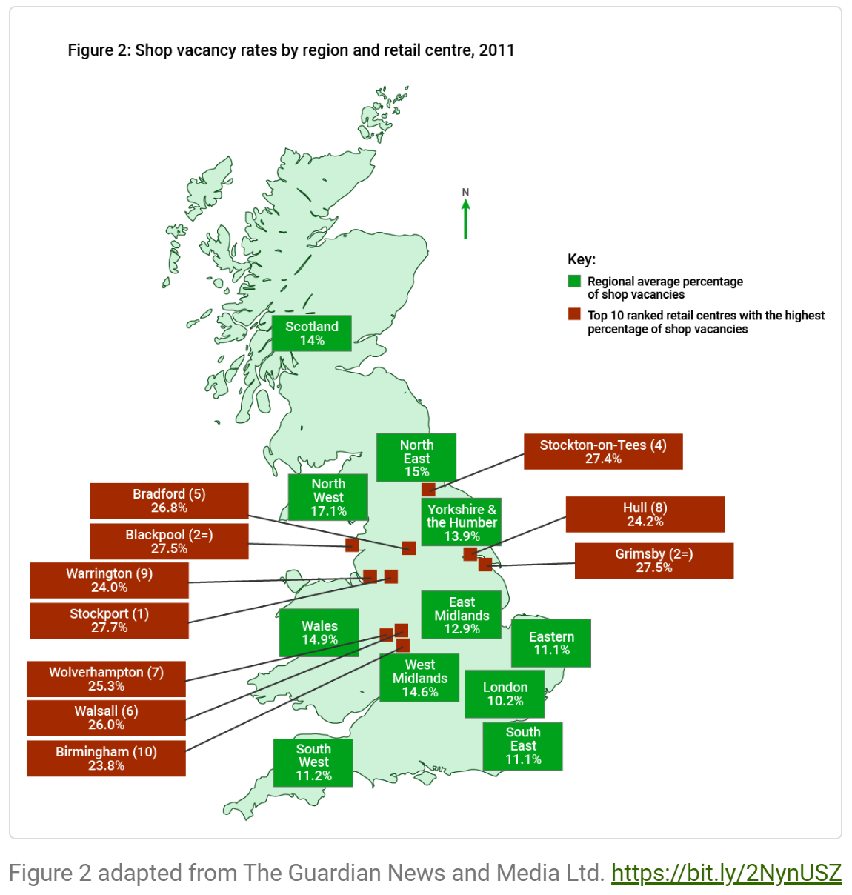
Analysing patterns and distributions
AO3 question ( 5 marks):
Using Figure 2, analyse the distribution of the Top 10 ranked retail centres with the highest percentage of shop vacancies.
Notes:
This part of the resource asks you to adapt a response that is given. We’ll show this response on the next slide. Read it and assess its strengths and weaknesses.

Slide 10
Identifying elements of a good AO3 response
Using Figure 2, analyse the distribution of the Top 10 ranked retail centres with the highest percentage of shop vacancies.
In total there are the 10 regional centres with high vacancies. Walsall, Wolverhampton and Birmingham have between 23.8 and 26 per cent shop vacancies. At the coast you have Stockton on Tees, Hull and Grimsby with between 24.2 and 27.5 per cent. Bradford is on its own with 26.8%. Blackpool and Warrington are also on a coast and have high scores.
Notes:
This response has not used spatial vocabulary very well. Previous sections of the resource will assist students to develop this vocabulary in order to truly analyse this geographical distribution. The resource also offers an improved response (next slide).

Slide 11
Identifying elements of a good AO3 response
Using Figure 2, analyse the distribution of the Top 10 ranked retail centres with the highest percentage of shop vacancies.
The 10 regional centres with high vacancies are all in the Midlands and northern England. Walsall, Wolverhampton and Birmingham have between 23.8 and 26 per cent shop vacancies and form a cluster in the south of this area. Along the east coast you have a linear distribution made up of Stockton on Tees, Hull and Grimsby with between 24.2 and 27.5 per cent. At the west coast, Blackpool and Warrington also have high scores. Bradford is found on its own equidistant between these two coasts and has 26.8%.
Notes:
Note the use of spatial vocabulary in order to truly analyse this geographical distribution.

Slide 12
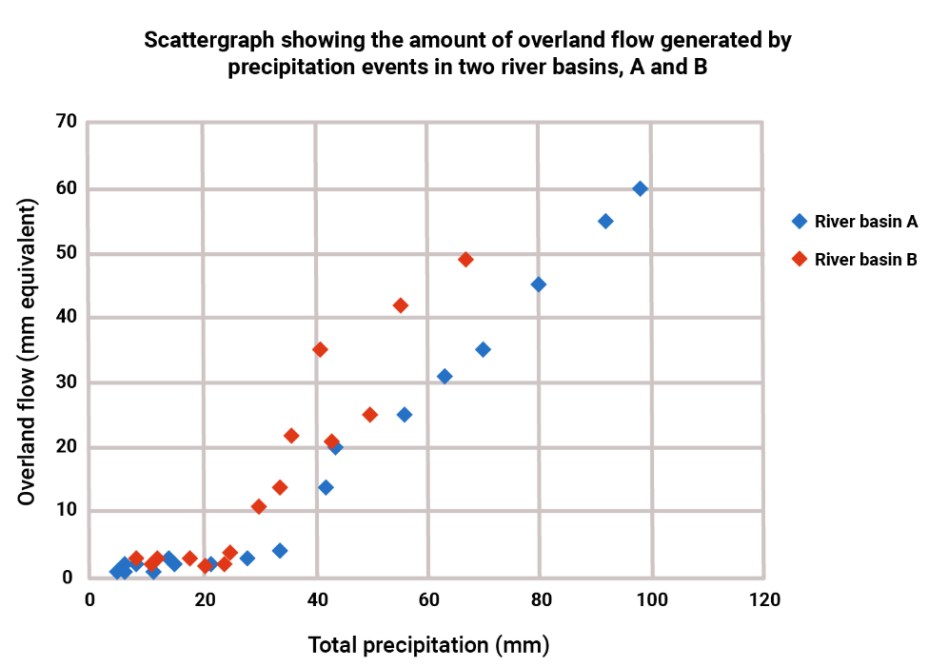
Analysing relationships
Notes:
The resource asks for the three analytical statements that best summarise this graph’s overall story. Beware selection of purely descriptive statements or those which do not look at the relationship between the two.

Slide 13
Analysing relationships
Notes:
The resource asks for the three analytical statements that best summarise this graph’s overall story. The first one is wrong as this is not a negative relationship!! Others do not identify the relationship effectively and tend to make isolated descriptive statements.

Slide 14
Identifying elements of a good AO3 response
How could this response be improved?
AO3 question (5 marks):
Analyse the relationship between precipitation and runoff for the two river basins shown in the graph.
In river basin A, overland flow starts off very low when precipitation is also low. For example, 20 millimetres of precipitation result in just 2 millimetres of overland flow. The same is also true of river basin B, for example, when precipitation is about 25 millimetres the overland flow value is only 3 millimetres. Later on, there is an increase in overland flow when precipitation increases. The maximum overland flow for river B is 50 millimetres and for river A it is 60 millimetres. No precipitation value greater than 100 millimetres is recorded for either river.
Notes:
Examiner commentary: Although this answer makes plentiful use of data, a clear picture of the relationship between precipitation and overland flow is lacking. There is an absence of important terminology (such as the strength and direction of any correlation). Some of the information provided is superfluous and does not help analyse the relationship. For example, little is gained by telling us that precipitation never exceeds 100mm. Could they improve on this response? Maybe give them time to do this. We would be looking for statements such as positive correlation, but only when precip exceeds 20-30mm. For higher values, there is a strong linear relationship. In basin B, the correlation appears a little weaker. The resource helps them develop this vocabulary.

Slide 15
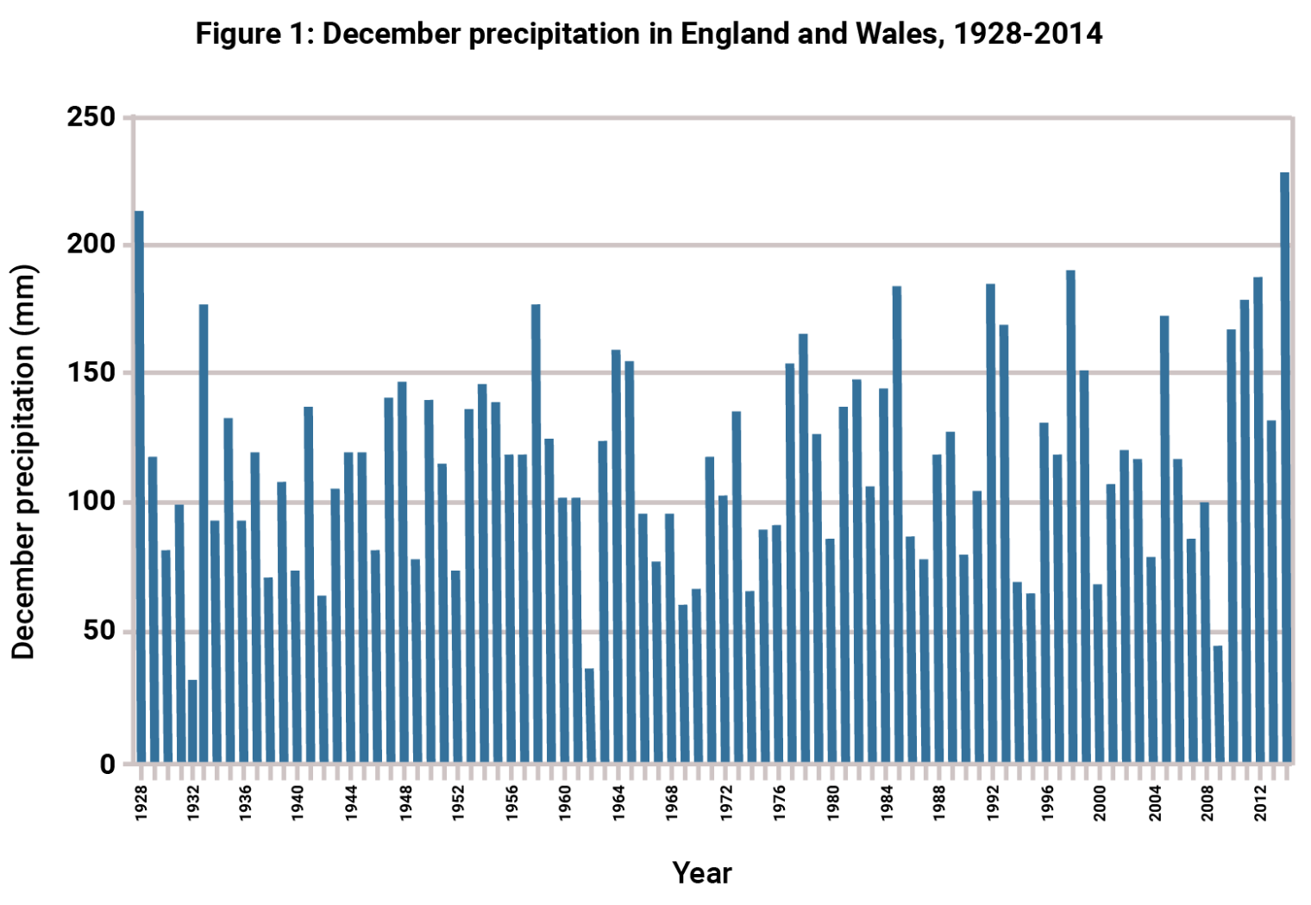
Analysing and interpreting data critically
AO3 question (5 marks):
Use the graph to analyse long-term changes in December precipitation in England and Wales.
Notes:
This graph was used as the basis for a 5 mark AO3 question in the Eduqas A level Component 2 paper in 2018. Overall mean scores were relatively low as few students were able to critically analyse this resource when looking for a long-term trend for December precipitation. Give students some time to study this alongside the question! The demands of this question show clear progression from GCSE. Resources will not always show an ‘obvious’ or ‘clear’ trend at this level. Here, students needed to think critically about the pattern they see.

Slide 16
Analysing and interpreting data critically
Notes:
Which statements best summarise the overall story told by this graph?

Slide 17
Analysing and interpreting data critically
Notes:
Which statements best summarise the overall story told by this graph? The three remaining statements do not focus on long-term trends.

Slide 18
Analysing and interpreting data critically
Response B:
It is possible that December precipitation has increased slightly in recent decades. The value has exceeded 150 mm 11 times since 1976 but only 5 times before then. This could indicate a long-term trend towards higher precipitation. 2014 had the highest precipitation for the entire period (230mm). However things are made complicated by what could be a cycle (every 3-5 years) of an unusually low amount of precipitation in some years, most recently in 2009 (48mm). Moreover, very high values were recorded in the past in 1928 and 1933. Therefore while there is some evidence of a long-term increase, it is far from certain that a significant change is happening.
Response A:
Overall the trend is unclear and there seems to be no permanent change. The maximum value is about 230 mm in 2014 and the lowest was 30 mm in 1932. There are many other highs and lows meaning that there is no long-term trend that I can see. For example, there is a low amount in 1962. There is a high amount of precipitation in 1958.
Notes:
Examiner Commentary on Response A: Although this answer correctly identifies the maximum and minimum, it is a shame that no effort is made to analyse the trend in high values (above 150mm) and acknowledge there is possible evidence of an increase. Overall, this is a poor answer to the question asked.
Examiner Commentary on Response B: This is an excellent answer which uses the data to analyse possible evidence for a long-term change. Part of the challenge of this question is thinking critically about the strength of the evidence shown. This answer acknowledges that while there may be a possible trend, it is far from being compelling evidence. In contrast, Response A dismissed any possibility out of hand without offering a detailed analysis of the data. Response B also analyses the evidence for cyclical trends, or cycles, of higher and lower precipitation - good!

Slide 19
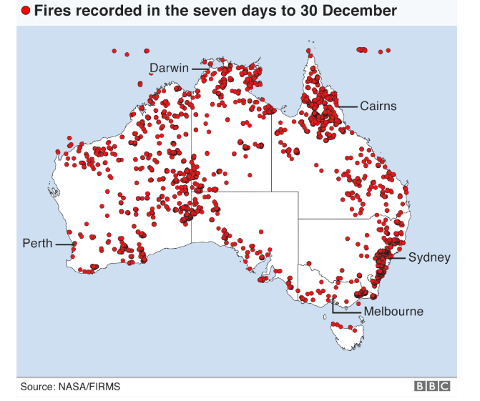
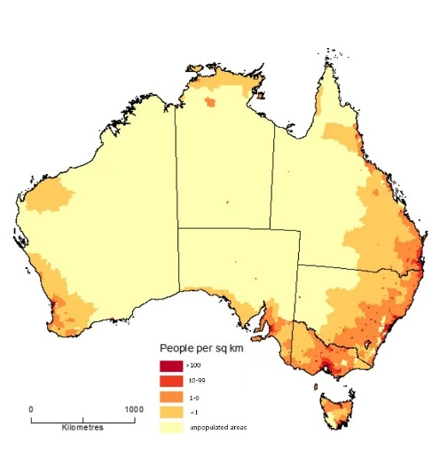
21st Century Challenges
In Section C of Component 2, 10 AO3 marks are available for analysing and interpreting the resources available and for drawing conclusions. Candidates should aim for well-developed analysis that makes links and connections between the resources in the context of the question.
Question: Evaluate the view that some local communities in Australia face an increasingly unsustainable future. (Figures seen are based on data from December 2019)
N
N
Source:www.bbc.co.uk/news/world-australia-50956318
Source: www.businessinsider.com.au
Notes:
The synoptic questions in Section C of Component 2 carry 30 marks and examine each of the three AOs. A third of the marks are reserved for AO3 skills (including the ability to draw conclusions). Many students would be able to see and make links between the two resources seen here and would be able to identify that challenges to sustainability might vary across Australia, linked to variations in population density and/or location of bushfires in late 2019. These Figures are all from 2019 and will be used in an upcoming AO2 resource, published over the summer break.

Slide 20
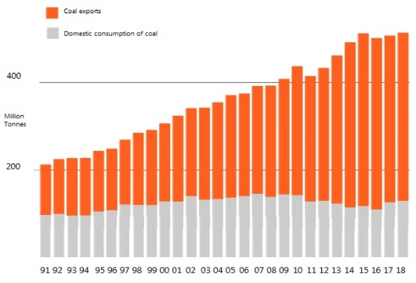
21st Century Challenges
A third resource might offer a different pattern for anlaysis. Could students make links between all three resources?
Evaluate the view that some local communities in Australia face an increasingly unsustainable future.
This figure shows the domestic consumption of coal and coal exports for Australia in millions of tonnes (1991 – 2018)
Adapted from: researchgate.net
Arguments identified could link to recently increasing domestic consumption of coal and impacts of anthropogenic climate change on some communities. Another approach could analyse the potential impacts of a future decrease in coal exports for some communities. All arguments could link back to the first two resources.
Notes:
There are many different arguments relating to sustainability that could be raised but students should attempt to link these back to the spatial issue of some communities identified by the question or to the time dimension identified in the question by increasingly unsustainable. Teachers could source similarly linked resources for students to analyse and interpret, identifying potential links between them. Being able to identify changes or changing relationships/patterns over time and space are very useful tools! Practise is vital and this resource is an excellent place to start. This resource can, of course, be worked through independently by students for revision purposes too!

Slide 21
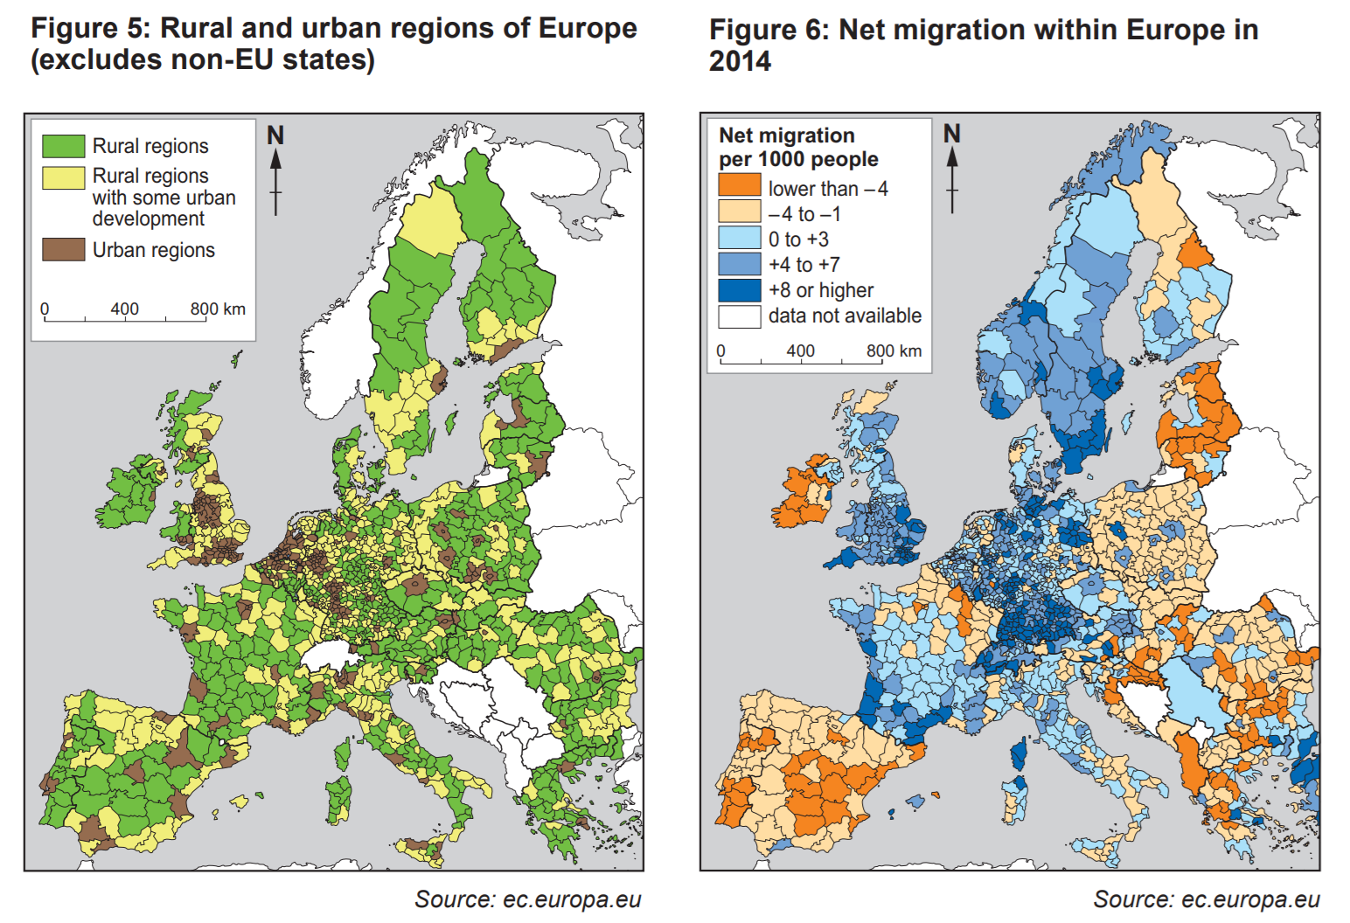
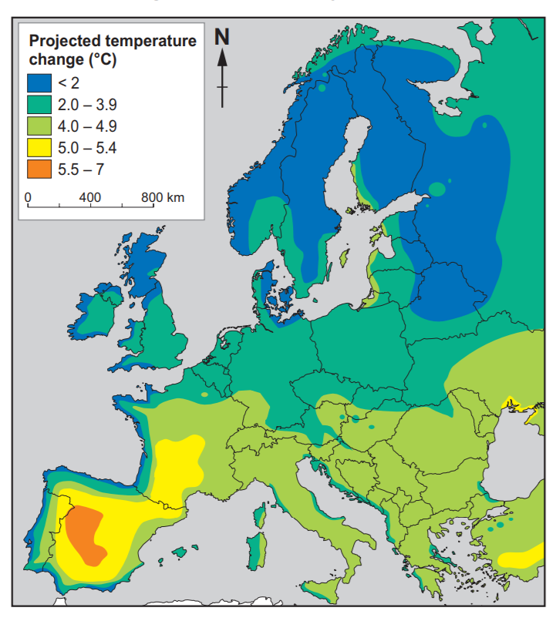
21st Century Challenges
Take another look at these resources from a 2018 examination question:
Question: To what extent can change be prevented in rural areas?
Notes:
This would provide excellent practise for students. There is much to analyse here and there are clear links that could be made between these resources in the context of the question e.g. there are certain rural areas where net migration is +8 or higher e.g. southern Sweden, Corsica OR some rural areas will see the highest temperature rises e.g. central Spain. This type of change is more difficult to control and requires international co-operation. To what extent will climate change drive future population movements etc. etc. There is literally so much to be said about these three figures, individually and collectively!

Slide 22
Any Questions?
AS/A Subject Officer: Erin Roberts
AS/A Support Officer: Robert Williams
Email: GCEGeography@eduqas.co.uk

