Slide 1
Eduqas GCE Geography
Guidance for Teachers: Assessment at AS/A level

Slide 2
This presentation is designed to guide teachers of Eduqas AS and A level courses through the structure of the examined assessments
Further support and guidance will be published on the Eduqas website to support delivery and assessment of the non-examined assessment (NEA) component at A level
Notes:
General introduction to presentation

Slide 3
Content: | Slide(s)
Key aspects of the assessment structure | 4
Summary of A level Geography | 5-7
Summary of AS Geography | 8-9
The Assessment Objectives (AO) | 10
The AOs and associated Command Words | 11-32

Slide 4
Key aspects of assessment structure…
Linear assessment at the end of two years for A level (from 2018) with AS (from 2017)
The full A level contains four components, one of which is non-examined (NEA). The AS has two examined components
Mark schemes contain explicit reference to the three assessment objectives (AO)
Assessment objectives can target a single AO or multiple AOs within a question. Multiple AO questions can provide ‘stretch and challenge’ and are often higher tariff
Candidates will need to be fully aware of the demands of differing command words and how they associate with larger tariff questions that target multiple AOs
Notes:
General introduction to presentation

Slide 5
Summary of A level Geography…
Component 1 (20.5%)
Changing Landscapes - Coasts or Glaciers
Changing Places
Component 2 (27.5%)
Global Systems and Global
Governance
Water and Carbon Cycles
Migration and Oceans
21st Century Challenges
Component 3 (32%)
Contemporary Themes in
Geography
Choice of four themes – two to be selected
Tectonic Hazards
Component 4 (20%)
INDEPENDENT INVESTIGATION (NEA)

Slide 6
Summary of A level Geography…
Component 1 |  |  |  | TOTAL MARKS = 82
Section A | AO1 | AO2 | AO3
Landscapes | 18 | 13 | 10 | 41
Section B | AO1 | AO2 | AO3
Places | 18 | 13 | 10 | 41
Component 2 |  |  |  | TOTAL MARKS = 110
Section A | AO1 | AO2 | AO3
Cycles | 15 | 15 | 10 | 40
Section B | AO1 | AO2 | AO3
Global Gov. | 15 | 15 | 10 | 40
Section C | AO1 | AO2 | AO3
21st CC | 8 | 12 | 10 | 30
Notes:
Total marks for sections (highlighted in orange) will remain constant throughout life of the qualification.

Slide 7
Summary of A level Geography…
Component 3 |  |  |  | TOTAL MARKS = 128
Section A | AO1 | AO2 | AO3
Tectonics | 14 | 20 | 4 | 38
Section B | AO1 | AO2 | AO3
Option 1 | 20 | 20 | 5 | 45
Option 2 | 20 | 20 | 5 | 45
Total marks for sections (in orange) will remain constant through each series of examinations
Component 4 |  |  |  | TOTAL MARKS = 80
 | AO1 | AO2 | AO3
Indiv. Investig. | 10 | 20 | 50 | 80

Slide 8
Summary of AS Geography…
Component 1 (60%)
Changing Landscapes
Coastal or Glaciated
Tectonic Hazards
Challenges in the 21st Century
Component 2 (40%)
Changing Places
75 out of a total 120 marks awarded on Tectonics in C1
Fieldwork
Not submitted but examined
in Component 2
exam paper only

Slide 9
Summary of AS Geography…
Component 1 |  |  |  | TOTAL MARKS = 120
Section A | AO1 | AO2 | AO3
Landscapes | 14 | 11 | 10 | 35
Section B | AO1 | AO2 | AO3
Tectonics | 33 | 22 | 20 | 75
Synoptic Qu. | - | 10 | - | 10
Total marks for sections (in orange) will remain constant through each series of examinations
Component 2 |  |  |  | TOTAL MARKS = 80
Section A | AO1 | AO2 | AO3
Places | 17 | 13 | 10 | 40
Section B | AO1 | AO2 | AO3
Fieldwork | 5 | 15 | 20 | 40
Notes:
Total marks for sections (highlighted in orange) will remain constant throughout life of the qualification.
2 components at AS – two days fieldwork required and fieldwork skills examined in Component 2. Many teachers do not realise that the marks for each section of QP are constant – 35 marks for coasts/glaciation and 75 marks for tectonics. 40 marks for Changing Places and 40 for Field work question in C2.

Slide 10
The three assessment objectives…..
Assessment Objective (AO) + weighting at (AS/A level) | Definition
AO1 (34.5/34.5%) | Demonstrate knowledge and understanding of places, environments, concepts, processes, interactions and change, at a variety of scales.
AO2 (35.5/37%) | Apply knowledge and understanding in different contexts to interpret, analyse and evaluate geographical information and issues. There are three distinct elements to this AO – analysis (AO2.1a), interpretation (AO2.1b) and evaluation (AO2.1c).
AO3 (30/28.5%) | Use a variety of relevant quantitative, qualitative and fieldwork skills. There are three separate strands to this AO: investigate geographical questions and issues (AO3.1) interpret, analyse and evaluate data and evidence (AO3.2) construct arguments and draw conclusions (AO3.3)
Notes:
Adapted from 2015 Ofqual Document ‘GCE Subject Level Guidance for Geography’.

Slide 11
AOs and associated command words
Command words on examination papers elicit certain responses from candidates. Command words such as ‘describe’ or ‘outline’ allow for assessment of knowledge and understanding of the specification content.
Other command words may take the candidate beyond what is spelt out in the specification – these might require a candidate to synthesise knowledge and understanding or apply it to a novel context. Examples of such commands are ‘assess’ or ‘evaluate’.
The following slides will give further guidance on the use of command words and their relation to the three assessment objectives in Eduqas assessments.
Notes:
The following slides are relevant to both AS and A level. Both assessments are marked to an equal standard with an AS qualification constituting 50% of a full A level.

Slide 12
AO1
AO1 | Demonstrate knowledge and understanding of places, environments, concepts, processes, interactions and change, at a variety of scales
Command Words: | Define, Identify, State, Describe, Distinguish, Explain how, ‘Give an example…’, Outline
AS SAMs example
The command words that are used in conjunction with each AO are detailed on pages 5-7 within the Teacher Guidance document. A full Command Word Glossary is included on pages 8-9.

Slide 13
AO2…..some elaboration
AO2 | Apply knowledge and understanding in different contexts to analyse, interpret and evaluate geographical information and issues. There are 3 distinct elements to this AO. Each element has a specific set of command words to draw upon.
different contexts | situations or circumstances not clearly indicated in the spec. i.e. applying knowledge to an unfamiliar situation or synthesising knowledge in order to think critically
analyse | e.g. find connections or causes/effects
interpret | ascribe meaning
evaluate | Appraising and judging usefulness and come to rational conclusions based on evidence
Notes:
Adapted from 2015 Ofqual Document ‘GCE Subject Level Guidance for Geography’. The three distinct elements are application of knowledge through analysis (1), interpretation (2) and evaluation (3).

Slide 14
AO2.1a – application through analysis
AO2.1 a | Apply knowledge and understanding in different contexts to analyse, interpret and evaluate geographical information and issues
Command Words: | Analyse, Compare, Contrast, ‘Explain why…’
AS SAMs example
Notes:
Therefore, questions which examine the ability of the candidate to apply knowledge and understanding through analysis will use one of the command words specified above.

Slide 15
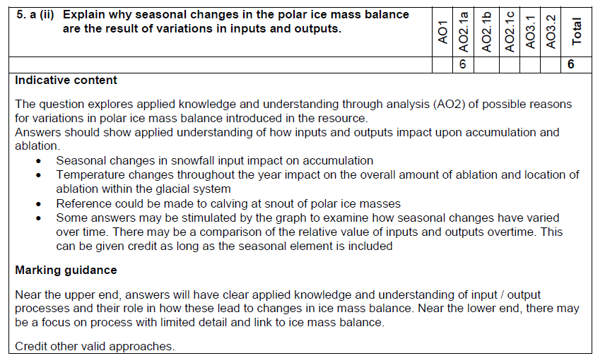
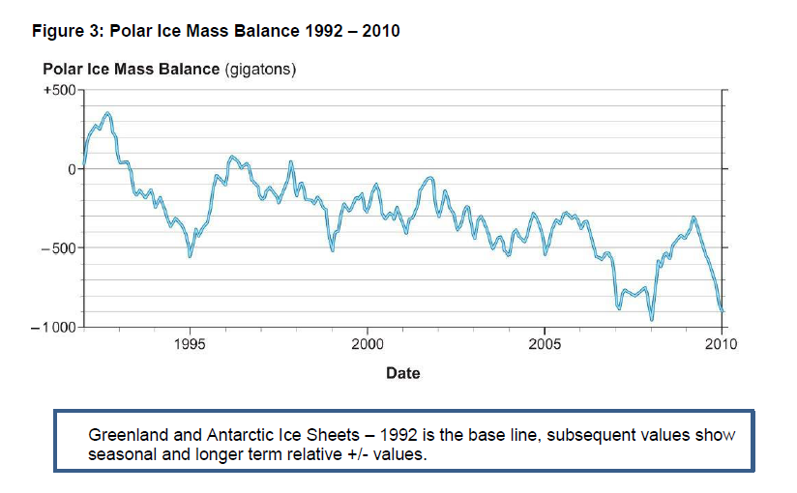
AO2.1a – application through analysis
Asking for reasons for these changes means learners will have to apply their knowledge
Notes:
This question is asking the learner to find causes by applying their knowledge to the Figure in 5 a) i).

Slide 16
AO2.1b – application through interpretation
AO2.1 b | Apply knowledge and understanding in different contexts to analyse, interpret and evaluate geographical information and issues
Command Words: | Suggest, Interpret
AS SAMs example
Notes:
There are only two command words used to examine AO21.b.

Slide 17
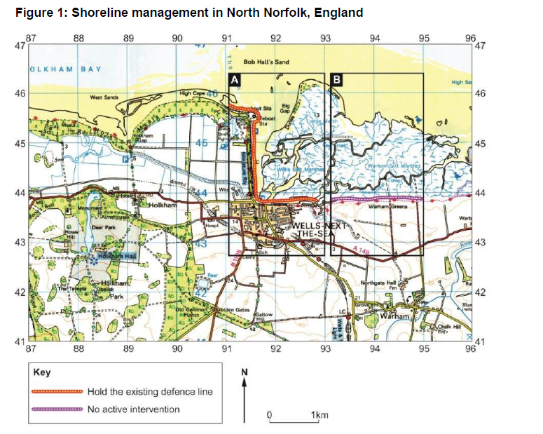
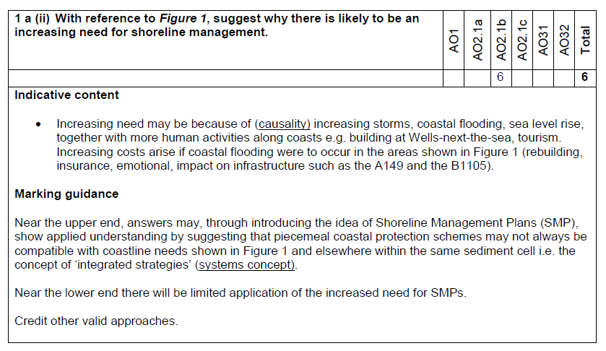
AO2.1b – application through interpretation
Learners will have to apply their knowledge to suggest why the need for management will increase

Slide 18
AO2.1c – application through evaluation
AO2.1 c | Apply knowledge and understanding in different contexts to analyse, interpret and evaluate geographical information and issues
Command Words: | Assess, Examine, Discuss, Evaluate, Justify, ‘To what extent…..’

Slide 19
AO2.1c – application through evaluation
Higher tariff questions on AS and A level papers will cover more than one AO in a single question i.e. a proportion of the marks will be given for knowledge and understanding of process etc. (AO1) and a proportion given for application of this knowledge to a context or for developing it further (AO2).
The command word will give the steer as to what is required from this AO2 element. Where AO2.1c command words are used, they will require the candidate to evaluate their knowledge and understanding in some way. AO2 weightings will vary across questions and papers, use of differing AO2.1c command words will reflect this weighting change.
Notes:
So far – we have looked at AO’s examined in isolation (as at GCSE). As tariffs increase at AS and at A level, questions will begin to examine more than one AO at a time.
These distinct AO2 elements will be explicit in Eduqas mark schemes and split AO marks noted clearly on student scripts. Centres can request electronic or hard copies of student scripts after results are published.

Slide 20
AO2.1c – application through evaluation
AO2.1 c | Apply knowledge and understanding in different contexts to interpret, analyse and evaluate geographical information and issues
Command Words: | Assess, Examine (used on split AO questions where AO1/recall weighting is greater e.g. 7 AO1 +3 AO2). Discuss, Evaluate, Justify, ‘To what extent…..’(used where weighting is equal or towards AO2 or AO3 e.g. 7 AO1 + 8 AO2 ). The demands of these command words require significant development of critical thinking skills. These questions that target AO2 will provide greater stretch and challenge for the candidate.
Notes:
Discuss, Evaluate, Jusitfy and ‘To what extent…’ will feature more heavily as AO2 weightings increase from C1 to C2 and C3 or on AO3 weighted fieldwork questions.
Please refer to Command Word Glossary on pages 8-9 of Guidance for Teaching for further details on requirements of command words.

Slide 21
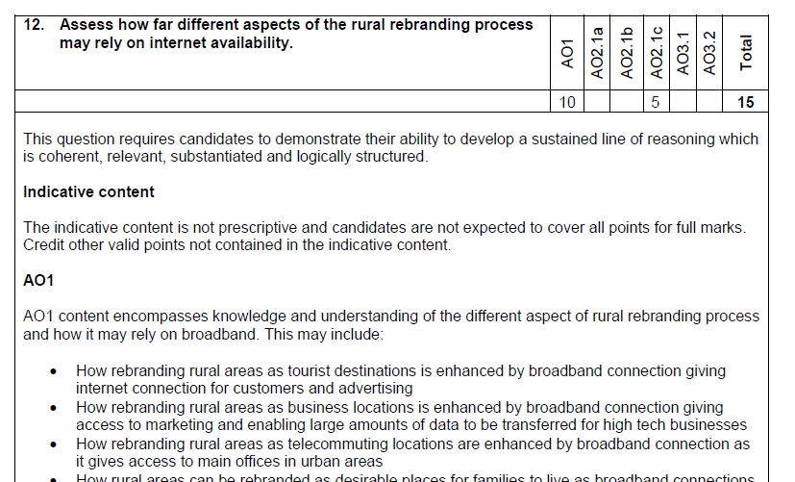
AO2.1 c – application through evaluation
AS SAMs example
Greater emphasis on AO1 - ‘Assess’ used as command word…

Slide 22
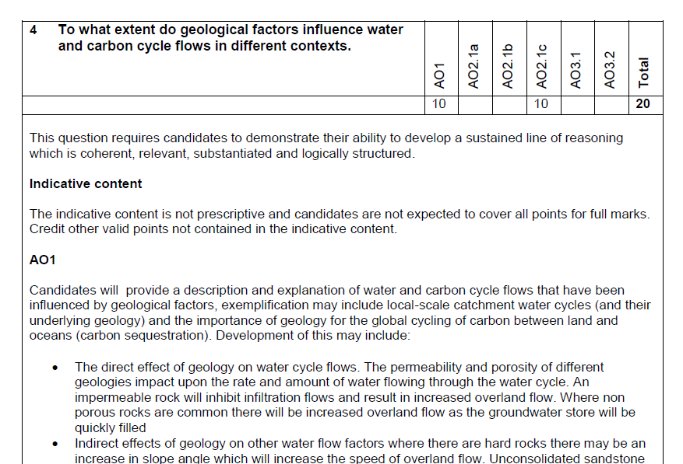
AO2.1 c – application through evaluation
A level SAMs example
Greater emphasis on AO2 - ‘To what extent…’ used as command…

Slide 23
AO2.1 c – application through evaluation
C3 essays assess all three AOs but with greater weighting (or equal) towards AO2. ‘Discuss…’ used as command.
A level SAMs example

Slide 24
Deconstructing SAMs questions (AS example)
Assess = AO2
7 (AO1) + 3 (AO2)
Notes:
Can you suggest the AOs that are being assessed in this AS SAMs question?
Assess is used as a command- therefore the greater emphasis here will be on knowledge and understanding of biotic processes in the formation of sand dunes (AO1) with element of AO2 introduced by the requirement to assess the importance of biotic processes in relation to other factors.

Slide 25
Read and assess (7 AO1 + 3 AO2)
1) b) Biotic processes are important in the formation of sand dunes such as Ainsdale sand dunes, North West England which is over 580 hectares. A sand dune requires a strong prevailing wind, small fine sediment (sand) and a low tide level. Aeolian processes (wind) blows sand onto the coast. Obstacle (wood, plants, rocks etc) catch the sediment and starts to create an embryo sand dune. The fluid threshold velocity has to be met by the wind to move the fine sand particles. The sand particles move by surface creep (rolling along), suspension (lifted up) and saltation (bounced). As more sand particles get stuck behind obstacles, the obstacle becomes larger so catches even more sediment. Marram grass starts to grow which stabilises the sand dune due to the roots holding the sand particles together and the grass tips catching even more sand particles making the sand dunes grow. As sand dunes grow, dune slacks occur which are sheltered parts of the sand dune leading to further vegetation to grow such as pine trees in Formby. These have deeper roots to hold the sand dune together further but also catches further sand to build the sand dune.
Therefore, biotic processes are important in the creation of sand dunes but so are aeolian processes because there needs to be a strong prevailing wind for the sand to be able to be transported. Furthermore, lithological geology is vital because sand dunes require soft fine sand which is easy to transport to allow for sand dunes to be created.
Overall, biotic processes are important in the formation of sand dunes in the longer term to stabilise and grow a sand dune, however Aeolian processes and lithological geology is more important in the formation of sand dunes in the short term.
Notes:
Student answer. Mark scheme and guidance can be found in AS SAMS for Component 1 on the Eduqas website. Examiner comments included on next slide. http://www.eduqas.co.uk/qualifications/geography/as-a-level/

Slide 26
Read and assess (7 AO1 + 3 AO2)
C1 AS Examiner Comments:
AO1 (Band 3 – Upper)
Demonstrates detailed and accurate knowledge and understanding of the link between biotic processes and the formation of sand dunes. Discussion is well supported by evidence and a located example.
AO2 (Band 3)
Applies knowledge and understanding to produce a thorough and coherent assessment of the importance of biological processes in the context of both aeolian and lithological factors. Good use is made of the concept of scale (time scales) to inform the response.

Slide 27
AO3
AO3 strands | Use a variety of relevant quantitative, qualitative and fieldwork skills to:
AO3.1 | investigate geographical questions and issues
AO3.2 | interpret, analyse and evaluate data and evidence
AO3.3 | construct arguments and draw conclusions
AO3 is used to test the learner’s knowledge and understanding of data skills and fieldwork techniques. All techniques in the skills list in the specification should be covered and four days fieldwork (two at AS) undertaken to develop these skills in both physical and human contexts.
Notes:
AO3 will essentially assess knowledge and understanding of data skills and fieldwork. These questions will need to address a wide range of possibilites – from selecting a technique to evaluating conclusions of fieldwork days. A wide range of command words is required to cover the full range – all detailed on pages 5-7 of Teachers Guide.

Slide 28
AO3 Command Words
AO3 strands | Command Words:
AO3.1 | investigate geographical questions and issues Calculate, Describe (patterns/variations), Draw, Identify, Label, State, Select, Estimate
AO3.2 | interpret, analyse and evaluate data and evidence Explain, Compare, Suggest
AO3.3 | construct arguments and draw conclusions Analyse, ‘To what extent…’, Assess, Discuss, Evaluate

Slide 29
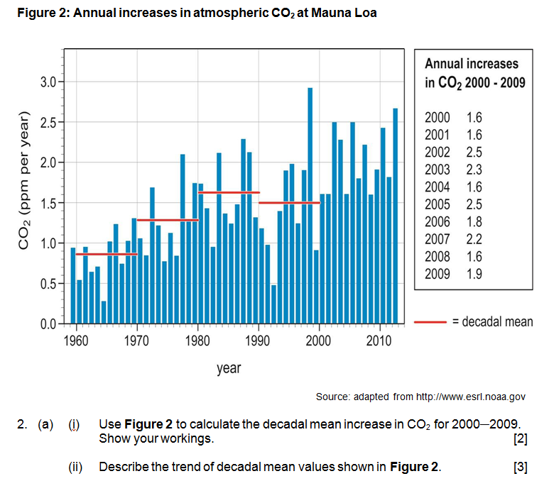
AO3.1…..investigate
A level SAMs example

Slide 30
AO3.2…interpret, analyse, evaluate
A level SAMs example

Slide 31
AO3.3…draw conclusions
Constructing arguments and drawing conclusions
means to:
draw conclusions from evidence and data
make a decision and justify the choice, for example, of a data processing or sampling technique
this strand features heavily in the assessment of the learner’s individual investigation

Slide 32
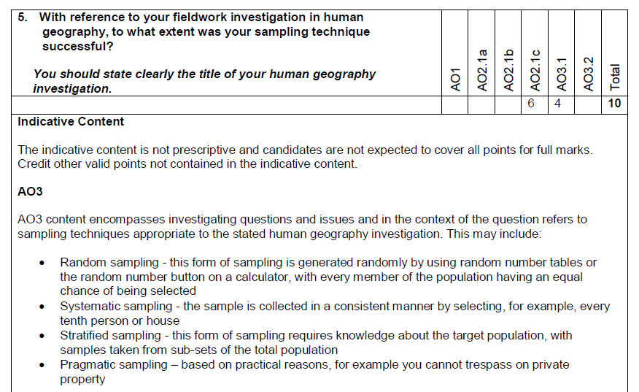
AO3 – fieldwork examination question
AS SAMs example
Notes:
This fieldwork question will draw on the pupils knowledge of the six stages of enquiry. It combines AO2 and AO3 i.e. AO3 is the knowledge of the sampling technique and the AO2 element is the discussion of the extent to which it was successful.

Slide 33
Any questions? Please contact us…..
AS/A Subject Officer: Erin Roberts
Email: Erin.Roberts@Eduqas.co.uk
Tel: 02920265158
AS/A Support Officer: Steve James
Email: Steve.James@Eduqas.co.uk
Tel: 02920265029

