Slide 1
We’re building something special
Introduction to the Generation 2
T Level in Building Services Engineering

Slide 2
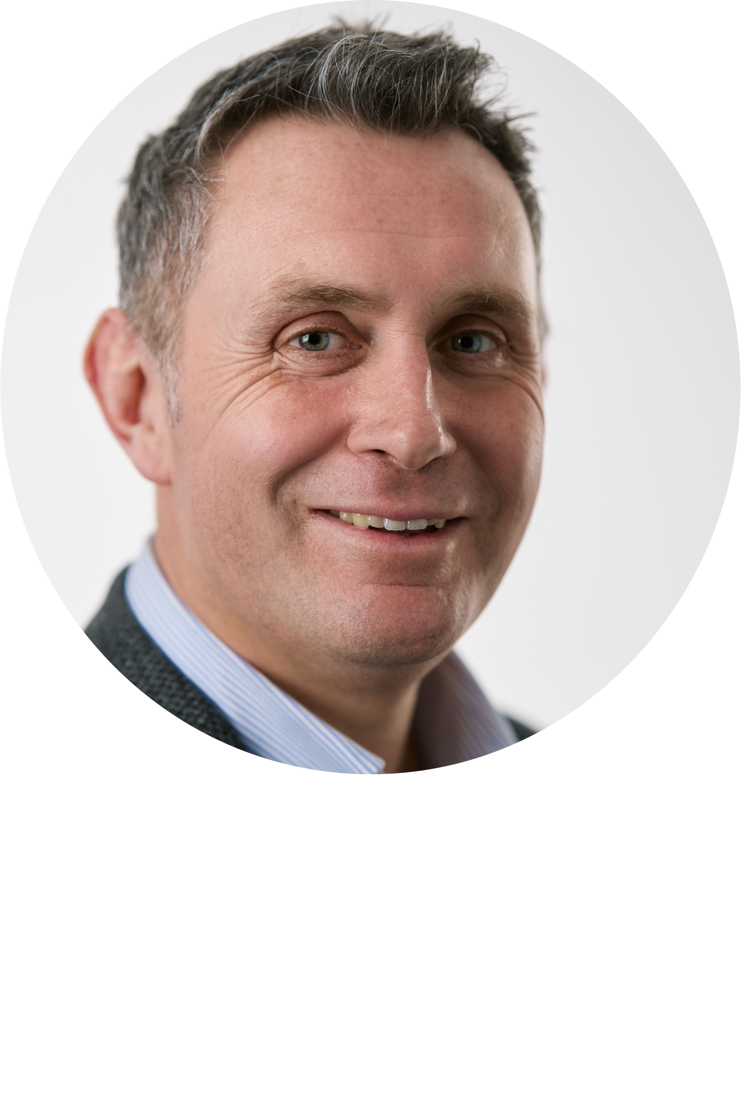
Welcome from Chair of the panel
What we will cover during the session:
Welcome
Meet the panel
Video messages
Working together: How we will support you
Development updates: Timelines/changes
FAQs / Questions
Steffan Edwards
Executive Director: Commercial Strategy

Slide 3
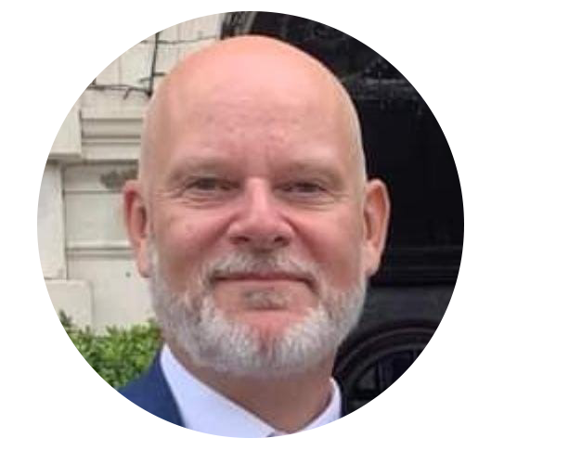
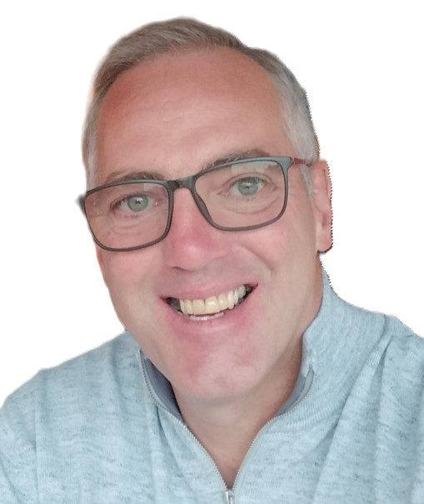
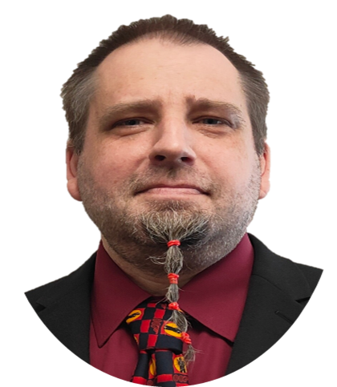
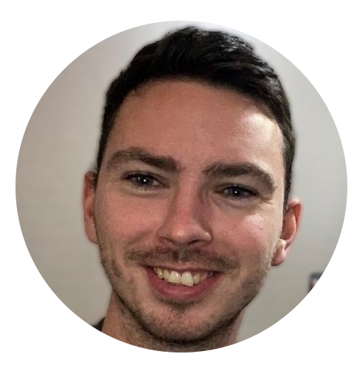
Meet the panel
Kristian Ball
Head of Marketing and Communications, Eduqas
David Pye
Lead BSE Advisor, EAL
David.Pye@eal.org.uk
Andrew Beresford
Lead BSE Technical Advisor, EAL
Andrew.Beresford@eal.org.uk
Chauvan Harding
T Levels Regional Representative, Eduqas
Julie Rees
Qualification Development Officer, Eduqas
Julie.Rees@eduqas.co.uk
Joe Wilson
Qualification Development Officer, Eduqas
Joe.Wilson@eduqas.co.uk

Slide 4
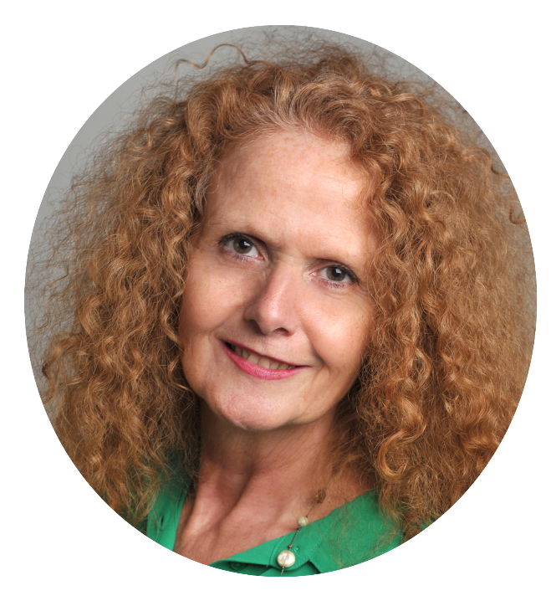
Welcome
Ian Morgan
Chief Executive, Eduqas
Alison Parkes
Managing Director, EAL

Slide 5
Welcome: Video Messages

Slide 6
Working together:
How we are going to support you
Kristian Ball, Head of Communications, Eduqas

Slide 7
Our shared commitment
Working together we will:
Ensure a smooth transition for existing providers
Develop a qualification that continues to be engaging, accessible, and fit for the future
Provide learners with clear progression routes and potential next steps
Celebrate success and champion advocacy for T levels
Ensure you feel informed, supported, and confident to deliver
Notes:
Some changes on a qualification level

Slide 8
Working together: we're here to support you
Supporting you as you prepare for delivery
Supporting you throughout
the process
Ensuring smooth transition​
Guidance and information ​
Dedicated provider support teams​
T Level Advisor support
Subject Officer support to be in place​
Regional Support​
Support package – CPD and Resources
Welcome Pack
We're building
something special​ - engagement is key
Ongoing stakeholder engagement
Qualification Development Advisory Group established
Opportunities to inform what we do
Ensuring you feel informed
Regular email updates​
New webpages ​developed ​
Networks and Roadshows
Events – visit us at AoC​
Webinars and face-to-face opportunities
If you have any queries, please do contact the team via Tlevels@eduqas.co.uk

Slide 10
Regional Support you can rely on
Support, when and where you need it
Experienced former teachers who understand the challenges
We operate across England
Available to help you deliver our qualifications with confidence
Access support for free online or in-person at a time and place that suits you
Your Regional Representative
Chauvan Harding
TLevels@eduqas.co.uk

Slide 11
Meet your T Level Advisors
What support do we deliver for providers?
Advisors are available to offer providers delivery, assessment and general support.
David Pye – Lead Advisor for BSE
Time served plumbing and heating technician, 14 years industry experience, 10 years FE experience managing across BSE/T&L and over 12 years working for Assessment Organisations creating content, working with stakeholders and providing delivery support. As a qualified tutor, assessor, IQA and EQA David is delighted to be able to continue his support of education through this new partnership.
Andy Beresford – BSE Advisor
Began as a gas apprentice and worked his way up to plumbing and heating engineer. Entered into teaching in 2001 and held many positions from NVQ Assessor up to Head of Construction & BSE. Joined EAL as an EQA in 2018 and is now a Technical Advisor where he can put his tutor, assessor, IQA and EQA skills to good use by providing support to Centres ofthrough this partnership with Eduqas

Slide 12
How we will support you
EAL / Enginuity
Webinars/Online video calls
Quality Assurance Activities
Smooth Transition
Roadshows and Networks

Slide 13
Development update:
Expected Changes & Timeline

Slide 14
Introduction to our Qualification Development Team
Julie Rees – Qualification Development Officer
With 18 years of experience in the education sector with WJEC Eduqas, Julie manages the development of a portfolio of new and reformed qualifications to meet external stakeholder needs.
Julie has a detailed understanding of qualifications policy, assessment, design rules, quality standards and process requirements, which enables her to successfully co-ordinate and monitor production of the draft specification, SAMs and assessment strategy in line with Eduqas’ policies and processes.
Joe Wilson – Qualification Development Officer
Joe has 8 years of experience within the education sector, first as a lecturer before working for another awarding organisation, gaining experience in T Levels, as well as Level 3, 4 and 5 vocational qualification development before joining Eduqas. Joe has previously worked on T Levels in a number of roles in both the development and live delivery of a range of T Level qualifications across Waves 1, 2 and 4.

Slide 15
Changes from Gen 1
The following changes are being made:
the Electrical and Electronic Equipment Engineering OS is being removed
the Ventilation OS is being removed; as a result, students will not be able to undertake the combination of Heating engineering and Ventilation OS. Heating is not being removed
Air conditioning engineering and Refrigeration engineering is still available as a combination
Intention for the Heating Engineering and Plumbing Engineering OS will be fully combined into one Heating and Plumbing Engineering OS
a new Low Carbon Heating Technician as a new Occupational Specialism is being introduced from September 2026

Slide 16
New structure
All learners will complete:
Building services engineering Core
Options
Learners will choose one of the following options:
Electrotechnical engineering
Protection systems engineering
Gas engineering
Plumbing and Heating engineering
Low Carbon Heating engineering
Air conditioning engineering and Refrigeration engineering
Notes:
JW

Slide 17
Timeline
August 2024 |  | Development began
Early 2025 |  | Draft specification content published (subject to Ofqual/IfATE feedback)
Late spring 2025 |  | Final specification and specimen assessment materials to be published
September 2025 |  | First teaching
Summer 2026 |  | First assessment opportunity for the Core component (exams and ESP)
Summer 2027 |  | First assessment opportunity for the OS components

Slide 18
What changes can be expected?
Summary of the proposed changes:
Core
Updated specification format and guidance to provide clarity on the range and depth that content must be taught
Reviewed where there is repetition of content and consulted on where that content is best taught to remove duplication
All decisions have been consulted with providers, subject specialists and employers to ensure that proposed changes are meaningful and will support learning and delivery
No planned changes to assessment approach, but we will be developing new Sample Assessment Materials in line with any changes to the content
Occupational Specialism
Also a change in specification format and guidance, similar to the core component
Making clearer the links to the core, where the OS content will build upon the content already learned in the core
No planned changes to assessment approach. But we will be developing new sample assessments and GSEM materials in line with any changes to the content

Slide 19
eduqas.co.uk/tlevels
Tlevels@eduqas.co.uk
linkedin.com/eduqas
facebook.com/eduqas
x.com/eduqas

Slide 20
Thank you

