Slide 1
Welcome to our online meeting
GCSE Religious Studies
ROUTE A
New Centre Introduction
#eduqasrepteam

Slide 2
Welcome
Thank you for attending the Eduqas regional team online session today.Please remember to turn your audio and video off.
If you have questions, please use the Chat function or, if this is not available on your device, email us on hugh.lester@wjec.co.uk . We will answer as many as we can in the second half.
Sessions on a variety of qualifications and topics continue until December. Follow the Twitter hashtag #eduqasrepteam to find out more.
Eduqas regional team: here to support you
Email hugh.lester@wjec.co.uk to be put in touch with the rep for your area.

Slide 3
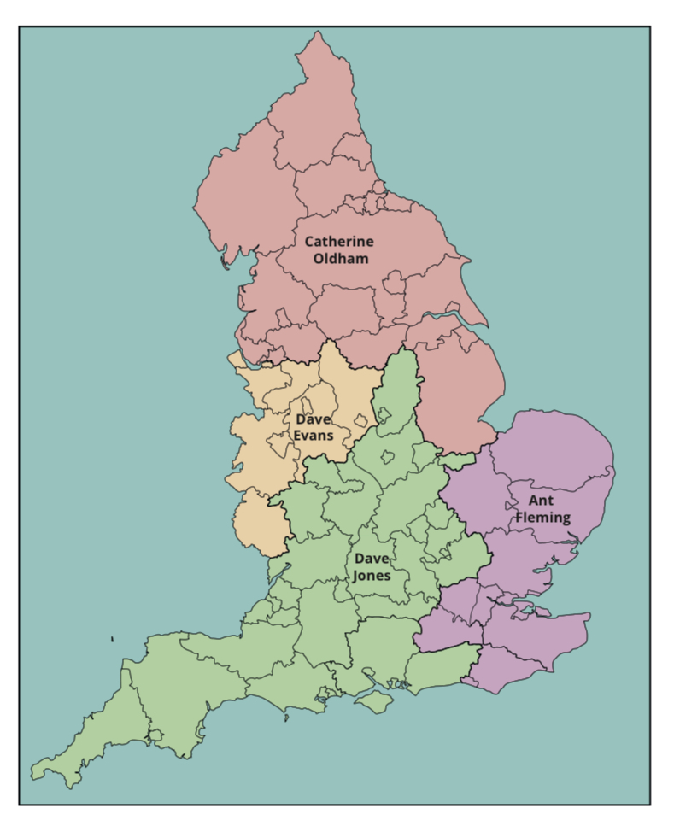

Slide 5
Full Course: Summary of assessment
Component 1:Religious, Philosophical and Ethical Studies in the Modern World
Written examination: 2 hours 50% of qualification
Candidates will study the following four themes. All questions are compulsory.
Theme 1:Issues of Relationships
Theme 2:Issues of Life and Death
Theme 3:Issues of Good and Evil
Theme 4:Issues of Human Rights
This component will be assessed by compulsory questions focusing on knowledge, understanding and evaluation of the identified themes.

Slide 6
Full Course: Summary of assessment
Component 2: Study of Christianity
Written examination: 1 hour 25% of qualification
Candidates will study the following two themes. All questions are compulsory.
Theme 1: Beliefs & Teachings
Theme 2: Practices
This component will be assessed by compulsory questions focusing on knowledge, understanding and evaluation of the subject content.

Slide 7
Full Course: Summary of assessment
Component 3: Study of a World Faith
Written examination: 1 hour 25% of qualification
Candidates will study the following two themes. All questions are compulsory.
Theme 1: Beliefs & Teachings
Theme 2: Practices
These Themes will be studied for one world faith from the following list:
Option 1: Buddhism
Option 2: Hinduism
Option 3: Islam
Option 4: Judaism
Option 5: Sikhism
This component will be assessed by compulsory questions focusing on knowledge, understanding and evaluation of the subject content.

Slide 8
Full Course: Summary of assessment
Spelling, Punctuation & Grammar (SPaG)
The qualification has twelve marks for SPaG
Six in Component 1. Always in Question 1 (d) Theme 1:Issues of Relationships
Six in Component 2. Always in Question 1 (d) Theme 1: Beliefs & Teachings
There are no marks awarded for for SPaG in Component 3

Slide 9
Short Course: Summary of assessment
Component 1:Religious, Philosophical and Ethical Studies in the Modern World
Written examination: 60 minutes 50% of qualification
Candidates will study the following two themes. All questions are compulsory.
Theme 1:Issues of Relationships
Theme 2:Issues of Life and Death
This component will be assessed by compulsory questions focusing on knowledge, understanding and evaluation of the identified themes.

Slide 10
Short Course: Summary of assessment
Component 2: Study of Christianity
Written examination: 35 minutes 25% of qualification
Candidates will study the following theme. All questions are compulsory.
Theme 1: Beliefs & Teachings
This component will be assessed by compulsory questions focusing on knowledge, understanding and evaluation of the subject content.

Slide 11
Short Course: Summary of assessment
Component 3: Study of a World Faith
Written examination: 35 minutes 25% of qualification
Candidates will study the following theme. All questions are compulsory.
Theme 1: Beliefs & Teachings
This Theme will be studied for one world faith from the following list:
Option 1: Buddhism
Option 2: Hinduism
Option 3: Islam
Option 4: Judaism
Option 5: Sikhism
This component will be assessed by compulsory questions focusing on knowledge, understanding and evaluation of the subject content.

Slide 12
Short Course: Summary of assessment
Spelling, Punctuation & Grammar (SPaG)
The qualification has six marks for SPaG
Three in Component 1. Always in Question 1 (d) Theme 1:Issues of Relationships
Three in Component 2. Always in Question 1 (d) Theme 1: Beliefs & Teachings
There are no marks awarded for for SPaG in Component 3

Slide 13
Breakdown of the questions
This qualification has a very simple structure.
Each Component is split into compulsory questions, one per Theme, each with four parts:
2 marks AO1 - Define
5 marks AO1 - Describe
8 marks AO1 - Explain
15 marks AO2 - Discuss
Component 1 has four questions
Components 2 & 3 each have two questions
This works out at one content mark per minute

Slide 14
Command words
 | Meaning
Part (a) Question: What is meant by… Define…. AO1 | Definition of a key term linked to one of the eight key terms. (These are listed in the Specification as bullets at the end of each Theme)

Slide 15
Command words
 | Meaning
Part (a) Question: What is meant by… Define…. AO1 | Example questions: Component 1: What is meant by ‘commitment’? (2 marks) Component 2 & 3: What do Christians mean by ‘incarnation’? (2 marks) For all (a) questions, credit 1 mark for a very simple definition and 2 marks for a developed definition and/or an example.

Slide 16
Command words
 | Meaning
Part (b) Question Describe… AO1 | Demonstrate knowledge and understanding by describing a belief, teaching, practice, event etc. Example questions: Component 1: (b) Describe the purpose of sex for religious believers. (5 marks) Component 2 & 3: (b) Describe the significance of Mika’il to Muslims. (5 marks)

Slide 17
Command words
 | Meaning
Part (c) Question Explain…. AO1 | Demonstrate knowledge and understanding of a topic by explaining the statements made with reasoning and/or evidence e.g. Explain why .. Explain the main features of .. Explain the importance/significance of .. Explain teachings/beliefs/attitudes about.. Example question: Component 1: (c) Explain from either two religions or two religious traditions, teachings about forgiveness. (8 marks) Explain questions for qu.(c) in Component 1 ONLY, ask for TWO RELIGIOUS perspectives The two views can come from traditions WITHIN a religion OR from two different religions. Non-religious beliefs are NOT appropriate here. Candidates will not gain available marks if they do not offer TWO RELIGIOUS responses to these questions.

Slide 18
Command words
 | Meaning
Part (c) Question Explain…. AO1 | Demonstrate knowledge and understanding of a topic by explaining the statements made with reasoning and/or evidence e.g. Explain why .. Explain the main features of .. Explain the importance/significance of .. Explain teachings/beliefs/attitudes about.. Example question: Component 2 & 3: (c) Explain why the synagogue is important in Judaism. (8 marks)

Slide 19
Command words
 | Meaning
Part (c) Question Explain…. AO1

Slide 20
Command words
 | Meaning
Part (d) Question Discuss… AO2 | Discuss this statement showing that you have considered more than one point of view (you must refer to religion and belief in your answer). Evaluation of a view from more than one perspective. These perspectives can all be ‘for’ the statement, all be ‘against’ the statement or be a mixture of both ‘for’ and ‘against’. N.B: ‘Belief’ can also mean non-religious belief and non-religious beliefs can be (but don’t have to be) included in all (d) questions that lend themselves to such a response – so, for example, non-religious beliefs may be relevant to a question such as ‘Marriage should be a lifetime commitment’’, but they would not be appropriate for a specific question like ‘You have to go to Church to be a Christian’, where the focus is narrower and very specific to that religion. HOWEVER, Qu. 2(d) in Route A of Component 1 ONLY (Life and Death) demands that specific non-religious beliefs are included. Candidates will not gain available marks if they do not include non-religious beliefs in their response to this question Across all d. questions, personal responses per se (i.e. unsubstantiated/unsupported personal views) will not be credited but personal responses that link to one or more of the banding criteria WILL be credited.

Slide 21
Command Words
 | Meaning
Part (d) Question Discuss… AO2 | Example questions: Component 1 Theme 3: (similar bracketed instructions for Themes 1 & 4) : (d) ‘Reform is the main aim of punishment.’ Discuss this statement showing that you have considered more than one point of view. (15 marks) (You must refer to religion and belief in your answer.) Component 1 Theme 2: (d) ‘Belief in life after death is the most important belief.’ Discuss this statement showing that you have considered more than one point of view. (15 marks) (You must refer to religious and non-religious beliefs, such as those held by Humanists and Atheists, in your answer.) Component 2 & 3: (d) ‘All Hindus should worship in the mandir.’ Discuss this statement showing that you have considered more than one point of view. (15 marks) (You must refer to religion and belief in your answer.)

Slide 22
Command words
 | Meaning
Part (d) Question Discuss… AO2

Slide 23
Expectations
This is an example of a 2/2 (a) response:
This is a very detailed explanation of the term ‘Trinity’. It has the correct definition of the term with clear exposition of the three parts of the Trinity. Additional term ‘paraclete’ is correctly used for the Holy Spirit. 2 marks.

Slide 24
Expectations
This is an example of a 5/5 (b) response:
Response begins by selecting one of the main importance of marriage ceremony. In the description candidate refers to sacrament; blessing , expression of vows, power of holy spirit in Orthodox weddings and importance of a ritual in a Jewish wedding. To gain full marks the response did not need to include reference to Judaism . A wide and competent use of religious language as hi-lighted

Slide 25
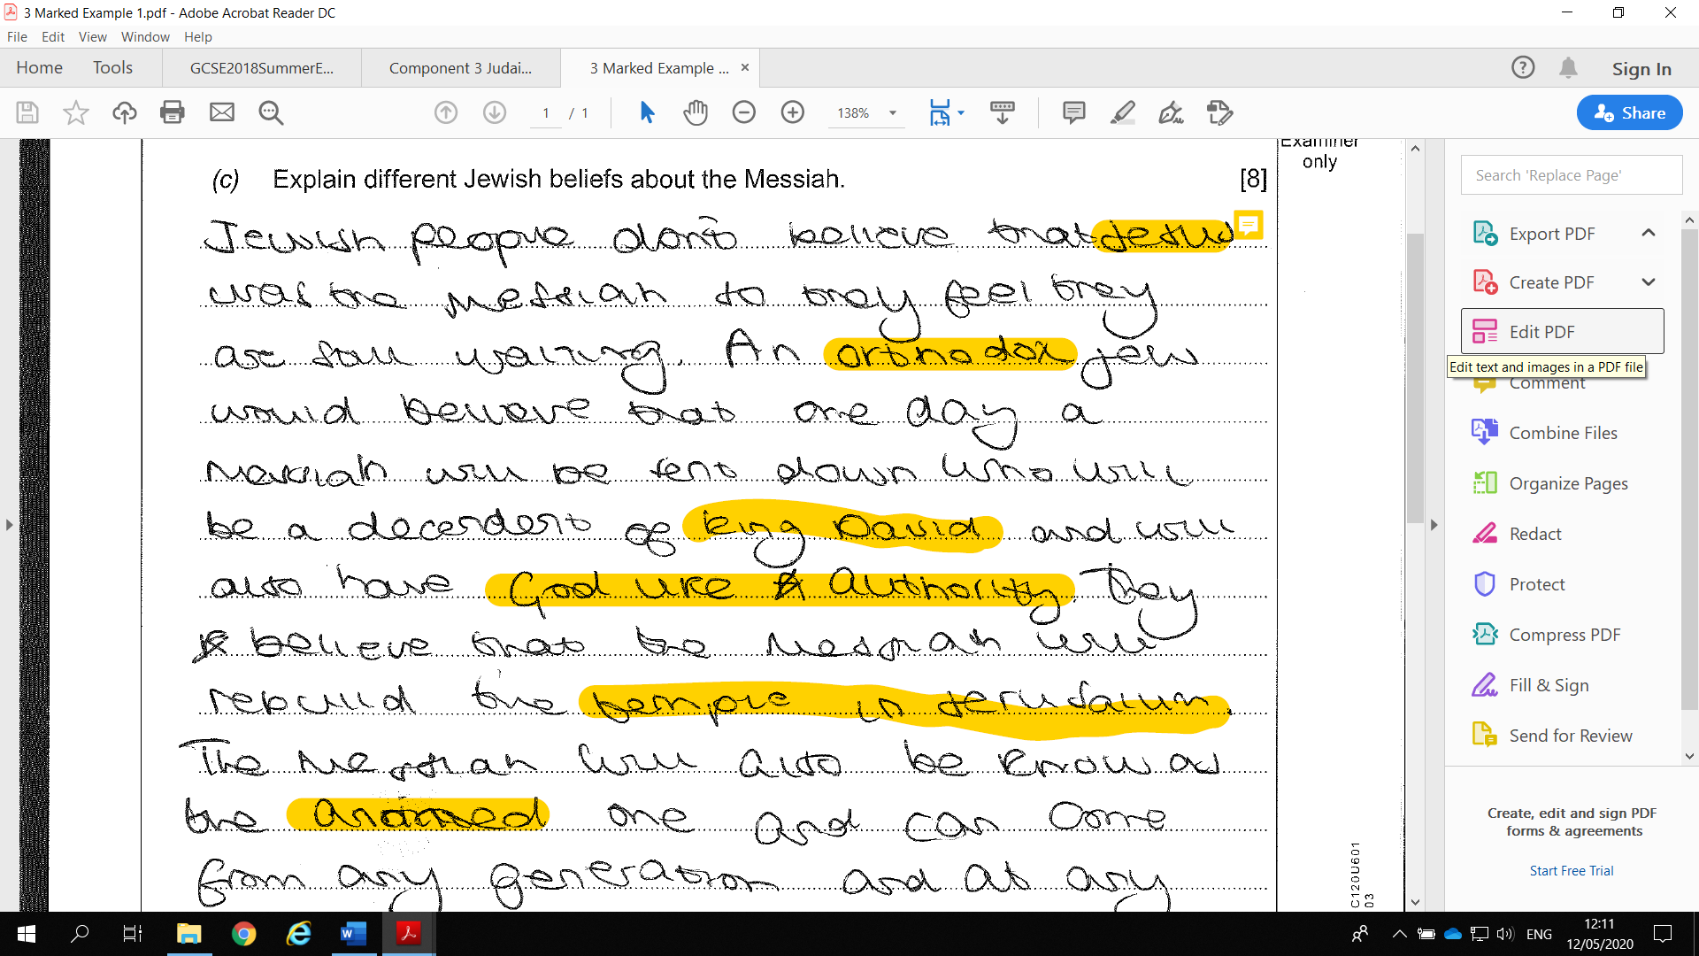
Expectations
This is an example of a 8/8 (c) response:

Slide 26
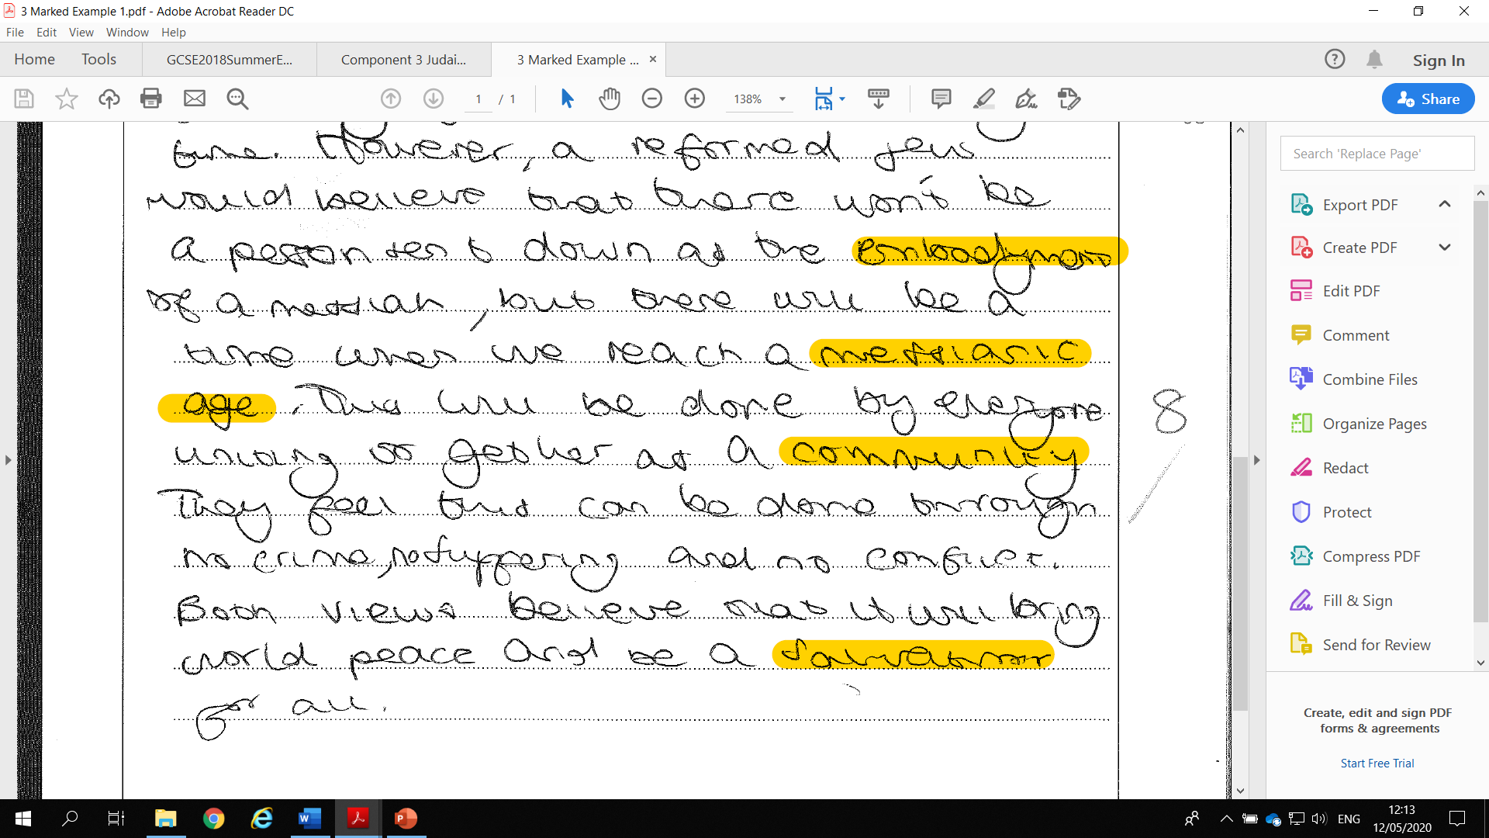
Expectations
The response makes explicit different Jewish beliefs incorporating a range of relevant detail and confidently explores the difference between Messiah and Messianic Age. An extensive use of relevant religious language which is often contextualised . Reform Jew not reformed Jew.

Slide 27
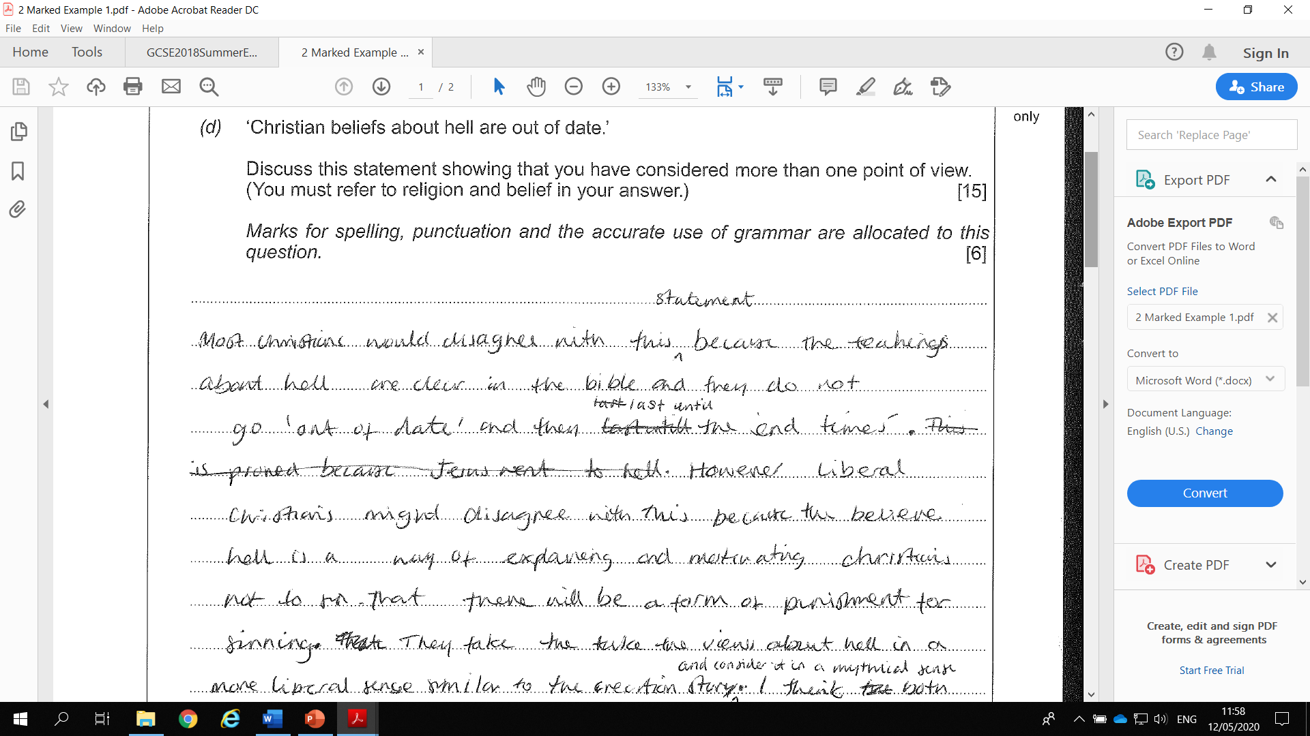
Expectations
This is an example of a 15/15 (d) response:

Slide 28
Expectations

Slide 29
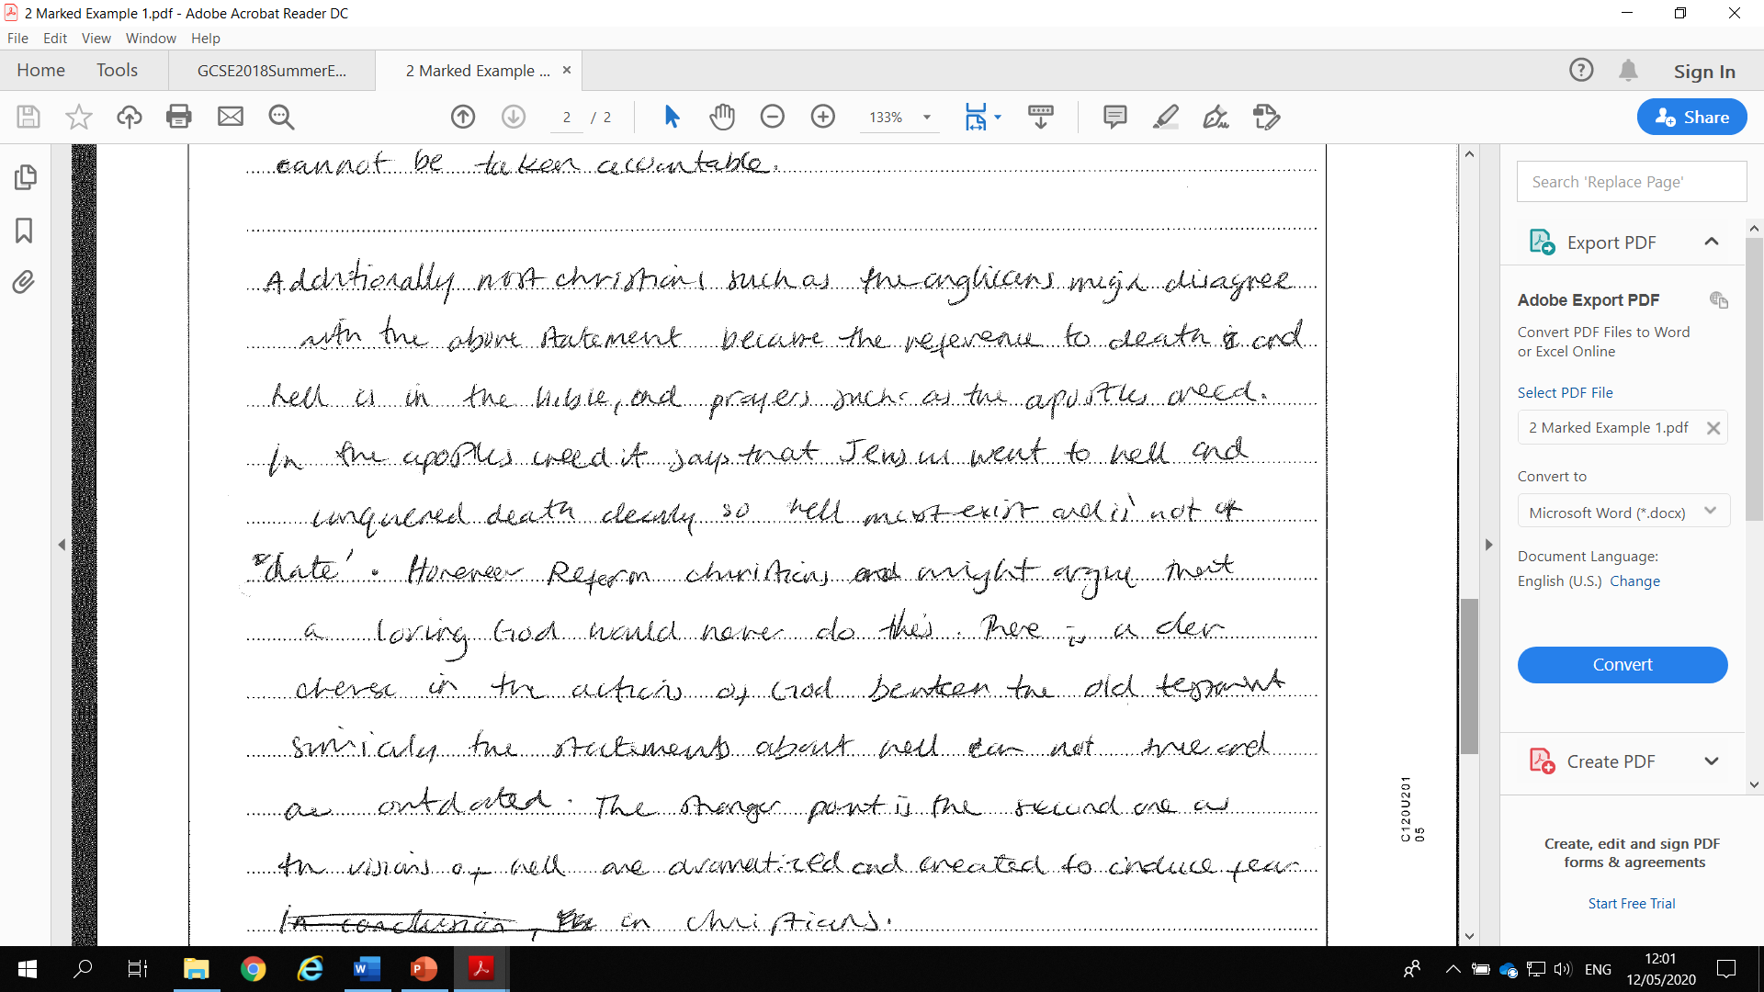
Expectations

Slide 30
Expectations
Lots of very good content and developed arguments throughout the answer: ‘out of date’, ‘end times’, motivating Christians not to sin, punishment for sinning, in a mythical sense like the Creation story and making a connection between Old and New Testament. Clear reference to different Christian traditions and the importance of beliefs in the Apostle’s Creed. (Full marks awarded for SPaG). Band 5. 15 marks.

Slide 31
Summary
1 | The a. questions will relate only to the eight key concepts | TRUE
2 | The b. questions will be ‘describe’ type questions | TRUE
3 | The c. questions are ‘explain’ type questions and Component 1 c. questions ONLY will directly ask for TWO religions/religious traditions. TWO IS ENOUGH, anymore may lead to lack of sufficient depth | TRUE
4 | The c. questions of Component 1 are not appropriate for non-religious responses because the questions ask for TWO RELIGIOUS views. | TRUE
5 | Any relevant content of the Component 3 religion studied may be used by candidates in Components 1 and 2 where it is appropriate to do so e.g. in the c. questions of Component 1 which ask for two perspectives and also in certain d. questions of Components 1 and 2 where relevant i.e. where the questions lends themselves to including perspectives from other religions | TRUE
6 | Question d. is the only question that targets Assessment Objective 2 (analyse and evaluate) | TRUE
7 | ONLY Question 2d. of Component 1 in Route A (i.e. Life and Death) demands the inclusion of non-religious beliefs | TRUE
8 | All d. questions can include non-religious beliefs (‘religion AND belief…’) as long as it is appropriate to the question asked | TRUE
9 | The d. questions must show evaluation and reach judgements about the statement and not just be like a Component 1 c. response i.e. two explanations | TRUE
10 | Personal responses that ALSO fulfil one or more of the criteria in the marking bands will be credited. | TRUE
11 | Responses that offer no personal opinion will be credited as long as the evaluation is clear to see. | TRUE

Slide 32
Summary
12 | Sources of wisdom and authority include figures of authority as well as references to sacred and important texts. Relevant and accurate references to sources of wisdom and authority that do NOT appear in the specification content will also be credited. | TRUE
13 | References to specific passages (e.g. John 1:14) are not necessary and will not gain extra credit. | TRUE
14 | Teachings and texts do not need to be quoted directly, an accurate paraphrase, used appropriately, will be equally credit-worthy. | TRUE
15 | The lines do not have to be filled; quality always matters more than quantity or including a prescribed number of points. Black pen should be used, but blue will also be accepted. | TRUE
16 | Positive marking will be employed. This means that completely incorrect or irrelevant content in candidates’ responses will be ignored rather than penalised. | TRUE
17 | No exam board can predict grade boundaries or equate levels to grades before the first examinations series. The Ofqual website provides some guidance. | TRUE
18 | Further SAMs questions cannot be produced because it will limit the questions we can use in ‘live’ papers. Eduqas suggests ‘tweaking’ past paper questions. | TRUE
19 | The criteria of the marking bands is all that will be used to reach judgements. A ‘best fit’ approach will be employed. | TRUE
20 | SPaG marks will be applied to the first d. questions of Components 1 and 2 only (6×2=12 marks). One or two minor errors could still be awarded full SPaG marks but completely irrelevant and/or completely inaccurate content cannot be awarded SPaG marks. Slight differences in spelling of non-English words will still be credited e.g. Hebrew words | TRUE

Slide 33
Website & Resources
Here are some useful links
GCSE RS website: https://www.eduqas.co.uk/qualifications/religious-studies-gcse/#tab_overview
Free on-line resources: https://resources.eduqas.co.uk/Pages/ResourceByArgs.aspx?subId=26&lvlId=2
On-line exam review (OER): https://oer.eduqas.co.uk/Pages/ProjectByArgs.aspx?subId=57&lvlId=2
Guidance for Teaching: https://www.eduqas.co.uk/media/jj5ottgk/wjec-eduqas-gcse-9-1-religious-studies-a-guidance-for-teaching.pdf
Past Papers & Mark Schemes: https://www.eduqas.co.uk/qualifications/religious-studies-gcse/#tab_pastpapers

Slide 34
Regional representatives:
Dave Jones (South, South West and Midlands)
davidr.jones@eduqas.co.uk
Catherine Oldham (North)
catherine.oldham@eduqas.co.uk
Ant Fleming (South East)
anthony.fleming@eduqas.co.uk
Dave Evans (North West)
david.evans@wjec.co.uk
Eduqas GCSE Religious Studies team:
GCSEReligiousStudies@eduqas.co.uk

Slide 35
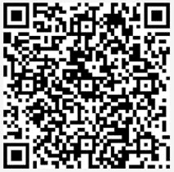
Thank you
Thank you for attending the Eduqas regional team online session today. It would be very helpful if you could let us know your thoughts on the event by responding to the very brief survey here:
Find out about future sessions by following the Twitter hashtag #eduqasrepteam
Eduqas regional team: here to support you
Email hugh.lester@wjec.co.uk to be put in touch with the rep for your area

