Slide 1



GCSE History (9-1)
Tackling the Historic Environment Study with particular reference to Changes in Health and Medicine in Britain, c.500 to the present day
“The British sector of the Western Front, 1914-1918 and the treatment and care of the wounded”

Slide 2
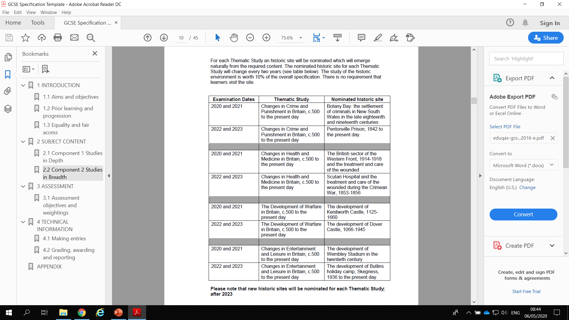

Slide 3
The Specification
In studying the named historic site, learners should consider the key historic features of the historic site, the significance of the historic site on a local, regional and national level, and how the historic site contributes to a wider understanding of changes in health and medicine in Britain, c.500 to the present day.

Slide 4
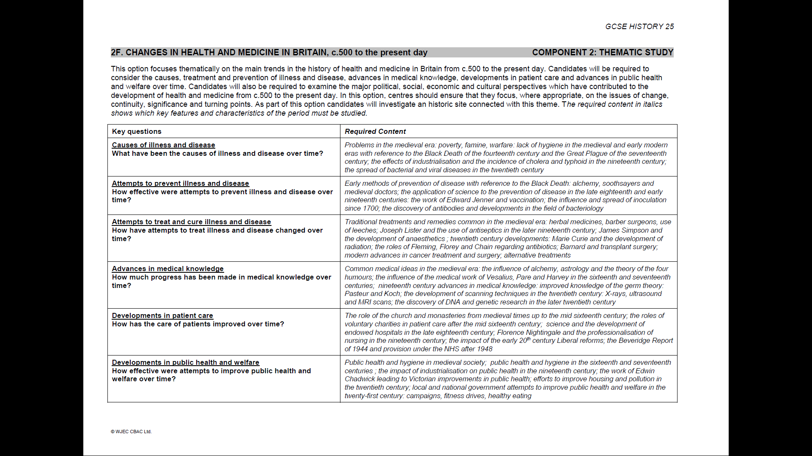
The Specification

Slide 5
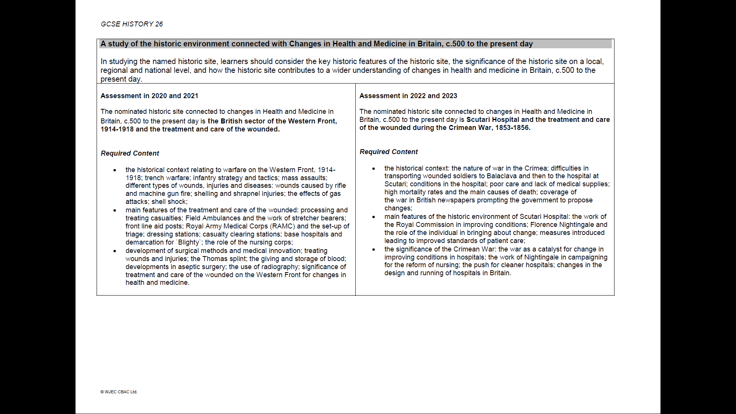
The Specification

Slide 6
Required content
The historical context relating to warfare on the Western Front, 1914-1918;
trench warfare; infantry strategy and tactics; mass assaults;
different types of wounds, injuries and diseases: wounds caused by rifle and machine gun fire; shelling and shrapnel injuries; the effects of gas
attacks; shell shock
Main features of the treatment and care of the wounded: processing and treating casualties;
Field Ambulances and the work of stretcher bearers; front line aid posts;
Royal Army Medical Corps (RAMC) and the set-up of
triage; dressing stations; casualty clearing stations; base hospitals and demarcation for `Blighty`; the role of the nursing corps
Development of surgical methods and medical innovation;
treating wounds and injuries; the Thomas splint; the giving and storage of blood;
developments in aseptic surgery; the use of radiography;
significance of treatment and care of the wounded on the Western Front for changes in health and medicine

Slide 7
Key Messages
Thematic Study should take 40-45 hours of teaching [18-20 weeks]
The site study should take at least around 1/3 of this time…
When delivering this aspect of the course, consider the context of the site in order that the students have a firm understanding of why it is where it is and why it is like it is
It helps to get them to think in terms of narrative/cause & effect: x leads to y which results in z… Help them to develop chains of reasoning
Don’t under-estimate the power of images. Contemporary drawings/photographs (where they exist) are particularly powerful (particularly when it comes to embedding the detail required for 6(a)). Furthermore, you can practice/embed the generic source skills needed elsewhere in the course…

Slide 8
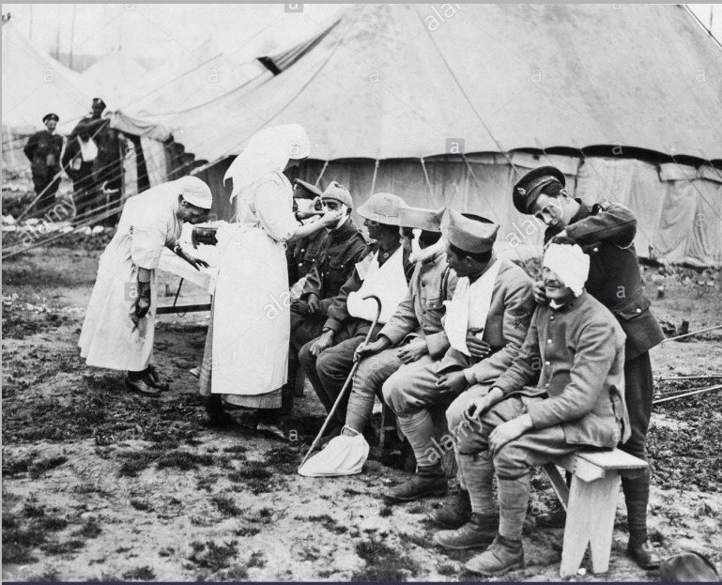
What is pictured here?
What is happening?
Who is in the image?
What did they do?
Injuries?
Where in chain of evacuation?
Are there any links to medical developments?

Slide 9
It is important to teach your historic site with a tight focus on the Theme.
In the case of the Western Front, this topic needs to be studied in relation to Changes in Health & Medicine.
As such, any contextual information (in this case on tactics, ordnance, etc) must all be considered in terms of its impact on the particular theme being studied (in this case, health and medicine: the treatment and care of the wounded)

Slide 10
So in terms of the Western Front…
Students will need to demonstrate an understanding of the key issues, which are:
What caused the wounds to British soldiers fighting on the Western Front?
How were wounded British soldiers on the Western Front treated?
How did medical treatment change as a result of the treatment of British soldiers on the Western Front?

Slide 11
Approaches to teaching
There are a number of ways to teach the content for this aspect of the course, but what is essential is that candidates never lose sight of why they are covering a particular topic:
How it will be assessed
Relevance/connections to other areas of the Component
Consider:
Causes
Impacts
Developments
The following slides will consider this from a Changes in Health & Medicine: The Western Front perspective

Slide 12
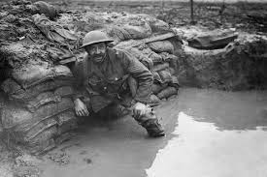
Causes
Trench Warfare:
Enormous scale
Attritional warfare
Trenches very hard to capture
Regular, often failed, advances
Coupled with:
Development of more destructive weapons:
Artillery
Machine guns
High-velocity rifles
Gas
Further compounded by:
Poor living conditions:
Cold & damp
Manure and fertilizers in the soils
Poor hygiene
Poor diet

Slide 13
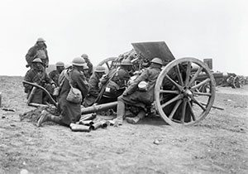
Impacts
Trench Warfare:
High casualty rate
Mass casualties
Continuous flow of casualties
Poor morale
Development of more destructive weapons:
Very large scale casualties in short time-span
Major trauma: disfigurement & dismemberment, massive blood loss, shattered bones, eye and respiratory damage; shell shock
Need for effective casualty recovery & evacuation (see next slide)
Poor living conditions:
Low morale; rats; fleas & lice; tetanus; typhus; gangrene; trench foot; trench fever; frostbite

Slide 14
Evacuation (Chain of Evacuation)
Initially collected by stretcher bearers: often under-fire
          …then to
Regimental Aid Post: basic treatment; bandaging & morphine
          …then to
Dressing Stations: just behind front line; initial triage; treat some wounds further, or pass on for more intensive treatment. Moved on by horse-drawn or motorised ambulances
          …then to
Casualty Clearing Stations: able to operate on, X-ray and house up to 50 men – often dealt with far more. Sort into three groups:
    Less severe: straight on train to base hospital (see next slide)
    Severely wounded but with chance of survival: amputations, major surgery, treatment of severe infection, then to base hospital
    Beyond help: to moribund ward. Essentially palliative care

Slide 15
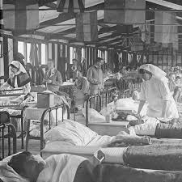
Evacuation (cont.)
Base Hospitals: civilian hospitals or converted buildings near rail links. Contained:
      X-ray equipment
      Operating theatres
      Laboratories to diagnose infection
Either:
      Recover and back to the Front
      Train to the port & returned home to “Blighty”

Slide 16
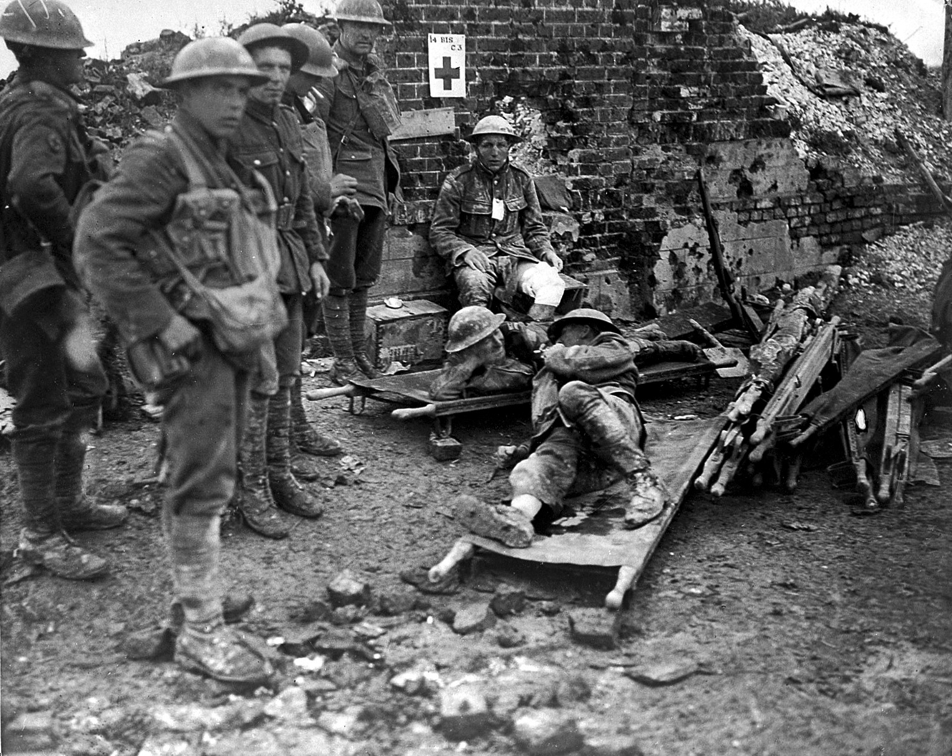
Treatment
There were numerous types of injury/problem. One of the biggest challenges was the sheer scale in terms of numbers; many hundreds all in one go.
Broken/shattered bones
Mutilated limbs
Severe blood loss
Severe trauma to torso
Severe head trauma
Respiratory damage
Burns
Eye injuries
Infection
Disease

Slide 17
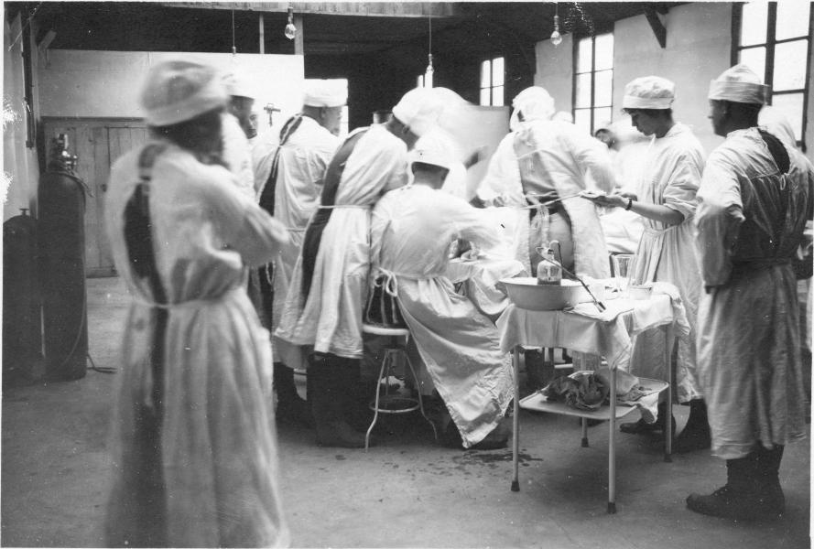
Treatment (cont.)
These are some of the methods that were employed:
Splinting
Suturing
Irrigating
Amputation
Blood transfusions
Plastic surgery
Skin grafts
Also further prevention/preparation:
Vaccinations
Health checks
Gas masks

Slide 18
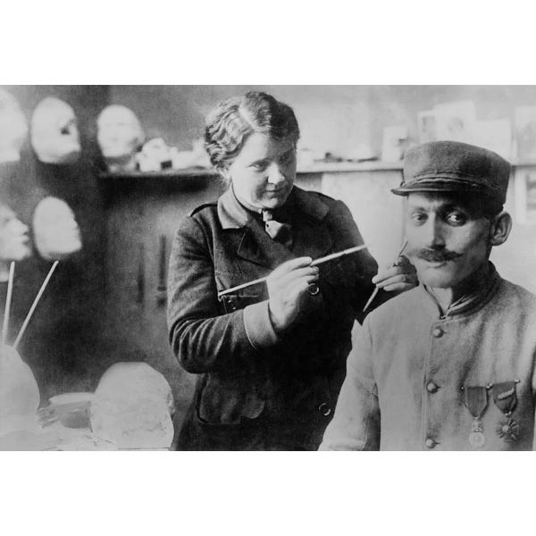
Developments
Scale and severity of casualties necessitated the rapid development of techniques, these fed back into civilian and battlefield medicine moving forwards. These included:
Efficient evacuation systems
Triage
Aseptic surgery
Portable X-ray machines
Blood banks
Improved splinting
Plastic surgery further perfected
Skin grafts further perfected
Major surgical techniques developed
Vaccination development
Better gas masks

Slide 19
The questions
There will always be two questions set on the Historic Environment in the Component 2 Thematic Study paper.
Question 6(a) 8 marks
Question 6(b) 12 marks

Slide 20
The questions: SAMs
a) Describe two main features of life for a convict in Botany Bay in the late eighteenth and early nineteenth centuries.
b) Explain why the establishment of Botany Bay was a significant change in the
punishment of criminals in the late eighteenth and early nineteenth centuries.
a)Describe two main features of the Great Plague in Eyam in 1665.
b) Explain why the environment of Eyam during the Great Plague was significant in showing changes in attempts to combat disease in the seventeenth century.
a) Describe two main features of the bombing of London during the Second World War.
b) Explain why the bombing of London during the Second World War was significant in showing changes in the development of warfare in the twentieth century.
a) Describe two types of entertainment available in Blackpool in the late nineteenth and early twentieth centuries.
b) Explain why the development of Blackpool shows changes in holiday patterns in the late nineteenth and early twentieth centuries.

Slide 21
The questions: 2018
a) Describe two main features of life in the East End of London which led to crime in the late 19th century.
b) Explain why increased crime in the East End of London led to changes in policing in the late 19th century.
a) Describe two main characteristics of the Great Plague in Eyam in 1665.
b) Explain why events at Eyam during the Great Plague of 1665 were significant in changing attitudes towards the prevention of disease in the 17th century.
a) Describe two main aspects of the bombing of London during the Second World War.
b) Explain why the bombing of London during the Second World War was important in demonstrating developments in warfare in the 20th century.
a) Describe two main forms of entertainment for visitors to Blackpool in the late 19th and early 20th centuries.
b) Explain why the decline of Blackpool as a resort is important in showing changes in holiday patterns in the second half of the 20th century.

Slide 22
The questions: 2019
a) Describe two main features of policing in the East End of London in the late 19th century.
b) Explain why conditions in the East End of London in the late 19th century led to high levels of crime.
a) Describe two main aspects of the Great Plague in Eyam.
b) Explain why events in Eyam were important in demonstrating the effectiveness of ways of combating disease in the late 17th century.
a) Describe two main characteristics of the bombing of London during the Second World War.
b) Explain why the bombing of London during the Second World War was important in demonstrating the changing nature of warfare in the 20th century.
a) Describe two examples of popular entertainment in Blackpool in the late 19th and early 20th centuries.
b) Explain why Blackpool is a good example of the decline of the traditional British seaside holiday in the second half of the 20th century.

Slide 23
Question 6(a)
This question will always be out of 8 marks; it targets AO1(a).
It will ask candidates to describe two features of an historic site.
The focus of this question is being able to demonstrate detailed and accurate knowledge of the historic site set in its context.
Candidates will always need to identify two distinct features and use their knowledge to provide a detailed and accurate description of the features.
The emphasis is purely on description. No analysis of the significance of the given features is required.

Slide 24
Question 6(a) Mark Scheme
AO1(a) 8 marks
BAND 3
Offers detailed knowledge to fully describe two main features of the historic site set within its appropriate historical context.
6-8
BAND 2
Offers some knowledge to describe two main features of the historic site set within its historical context.
3-5
BAND 1
Offers a generalised description with limited knowledge of two main features of the historic site.
1-2
Use 0 for incorrect or irrelevant answers.

Slide 25
Approaches to Question 6(a)
The time allocated to this paper is 75 minutes
Total marks 64, of which 4 are SPaG, leaving 60 content marks to be allocated across 75 minutes.
This means that students should be spending a good 10 minutes to this question.
It is purely descriptive, so the more confident they are in their knowledge, the more efficiently they will approach this.
Remember, they will only need to describe two relevant features in their response; any more will not gain additional credit

Slide 26
Question 6(b)
This question will always be out of 12 marks; it targets AO2.
It will ask candidates to provide a reasoned, well supported explanation and analysis of the way in which the historic site demonstrates continuity and/or change in a particular theme over time. For example how a particular site demonstrates changes in the treatment of patients.
Responses need to be set within the relevant historical context.
This means demonstrating knowledge of the key characteristics of the period under discussion.
The emphasis in this question is on explaining how an historic site demonstrates change over time in a particular theme and period in history. In doing this candidates will
demonstrate the significance of the historic site.

Slide 27
Question 6(b) Mark Scheme
AO2 12 marks
BAND 4 Offers a sophisticated and reasoned explanation and analysis of the historic site and its relationship with historic events and developments. The answer fully addresses the position of the historic site in showing changes in health and medicine set within the appropriate historical context.
10-12
BAND 3 Offers a reasoned explanation and analysis of the historic site in showing
changes in health and medicine set within the appropriate historical context.
6-8
BAND 2
Offers some explanation and analysis of the historic site in showing changes in
health and medicine set within the appropriate historical context.
3-5
BAND 1
Offers a generalised explanation and analysis of the historic site with limited
reference to changes in health and medicine.
1-2
Use 0 for incorrect or irrelevant answers.

Slide 28
Approaches to Question 6(b)
The time allocated to this paper is 75 minutes
Total marks 64, of which 4 are SPaG, leaving 60 content marks to be allocated across 75 minutes.
This means that students should be spending a good 15 minutes to this question.
As it is often the last question they tackle, they must ensure that they leave sufficient time.
In fact, some centres advise candidates to tackle question 6(a) and 6(b) first, as they carry a high tariff.

Slide 29
OER responses (1)
Scale and
Provides clear and accurate knowledge to fully describe two features set in context, (in this case, the nature of the disease & attempts to contain the disease). Both clearly & accurately described in detail.

Slide 30
OER responses (2)
Scale

Slide 31
OER responses (2)
Scale
This is a very strong response The candidate offers a well-reasoned explanation with relevant supporting detail.
There is a clear attempt to consider how attitudes towards the prevention of disease changed (with the first three points clearly linked to the development of medicine)
The final two points, although valid, failed to clearly make
this connection, hence 10/12

Slide 32
Useful resources: general
History website: https://www.eduqas.co.uk/qualifications/history-gcse/#tab_overview
The Guidance for Teaching booklet https://www.eduqas.co.uk/media/ysvp4vlr/eduqas-gcse-history-guidance-for-teaching.pdf
The On line Exam Review (OER) https://oer.eduqas.co.uk/Pages/ProjectByArgs.aspx?subId=34&lvlId=2 contains examples of candidate responses with examiners’ comments
Digital Resources: https://resources.eduqas.co.uk/Pages/ResourceByArgs.aspx?subId=17&lvlId=2
File sharing (not endorsed): https://www.eduqas.co.uk/media/psbpltnh/file-sharing-for-gcse-history.pdf
Endorsed book:
My Revision Notes: WJEC Eduqas GCSE (9-1) History ISBN 9781510403826 contains a succinct and useful summary of the key information on each topic

Slide 33
Useful resources: Health & Medicine
Health & Medicine resource: https://resources.eduqas.co.uk/Pages/ResourceSingle.aspx?rIid=760
Endorsed Books:
WJEC Eduqas GCSE History: Changes in Health and Medicine, c500 to the present day
ISBN 9781471868177 has an excellent chapter on the The British sector of the Western Front, 1914-1918 and the treatment and care of the wounded

Slide 34
Useful resources: Crime & Punishment
Crime & Punishment resource:
https://resources.eduqas.co.uk/Pages/ResourceSingle.aspx?rIid=981
Botany Bay:
https://resources.eduqas.co.uk/Pages/ResourceSingle.aspx?rIid=1277

Slide 35
Useful resources: Development of Warfare
Development of Warfare resource: https://resources.eduqas.co.uk/Pages/ResourceSingle.aspx?rIid=893
The Development of Kenilworth Castle:
https://resources.eduqas.co.uk/Pages/ResourceSingle.aspx?rIid=1278

Slide 36
Useful resources: Changes in Entertainment & Leisure
Entertainment & Leisure Resource: https://resources.eduqas.co.uk/Pages/ResourceSingle.aspx?rIid=805
Development of Wembley Stadium:
https://resources.eduqas.co.uk/Pages/ResourceSingle.aspx?rIid=1279

Slide 37
Any questions?
I’ll do my best today, but any I can’t address, email me or the subject team we’ll ensure that we get a response to you as soon as possible.
Thank you & stay safe

Slide 38
Dave Jones (Regional Representative)
davidr.jones@wjec.co.uk
Eduqas GCSE History team:
GCSEHistory@eduqas.co.uk

