Slide 1


Component 1:
Food related causes of ill-health.
Unit 4: The science of food - Food spoilage
Unit 3: Diet & Good health - Food allergies
Unit 3: Diet & Good health - Food intolerance
Unit 6: Cooking and food preparation - Food labelling

Slide 2
Food related causes of ill health
In this topic, learners will gain knowledge and understanding of the following areas:
Food poisoning causes
Food allergies
Food intolerances
Visible and non-visible symptoms of food-induced ill health
Food labelling laws

Slide 3
Food related causes of ill health
Microbes
The word ‘microbe’ is short for micro-organisms, which are very small life forms that are only clearly visible under a microscope.
In the right conditions, micro-organisms can multiply and cause food spoilage. Some of them have the potential to be harmful to humans.

Slide 4
Food related causes of ill health
Bacteria
Bacteria are small, single-celled organisms that are found almost everywhere. Most bacteria are harmless. However, some types of bacteria are bad and cause food poisoning. These are called pathogenic bacteria.
Food poisoning can make you extremely ill and, in some cases, can be fatal. People with weakened immune systems, pregnant people, newborn babies and older adults may face additional complications.

Slide 5




Food related causes of ill health
Bacteria
Food
Moisture
Warmth
Time
?
What are the ideal conditions necessary for bacteria to grow and cause food poisoning?

Slide 6
Food related causes of ill health: bacteria
A supply of food
Bacteria need a supply of nutrients and energy from food to enable them to multiply.
If food is not available to bacteria, they cannot grow and multiply.

Slide 7
Food related causes of ill health: bacteria
A supply of moisture
Bacteria need water for all their biological processes.
If moisture is not available to bacteria, they cannot grow and multiply.

Slide 8
Food related causes of ill health: bacteria
Warm temperature
Bacteria grow and multiply fastest in warm temperatures: their optimum (best) temperature is 37ºC.
If it is too hot, the bacteria will be destroyed.
If it is too cold, the bacteria will grow and reproduce very slowly, until they become dormant (‘asleep’), which means they are still alive but not active.

Slide 9
Food related causes of ill health: bacteria
Time
It takes time for bacteria to grow and multiply, and the more suitable the conditions, the faster they will do so.

Slide 10
Food related causes of ill health: bacteria
Under the ideal conditions, a single bacterium can multiply to create millions of bacteria in just a few hours!
The single-celled bacterium divides into two identical daughter cells. This process is called binary fission.

Slide 11
Food related causes of ill health: bacteria
High risk foods
Foods are grouped according to whether there is a low risk or high risk of allowing pathogenic bacteria to grow and multiply.
Foods with a high level of moisture
Foods with a high level of protein
\
ACTIVITY
………………………………………………………………………………………......................................
Make a list of foods that you think would be high risk.

Slide 12
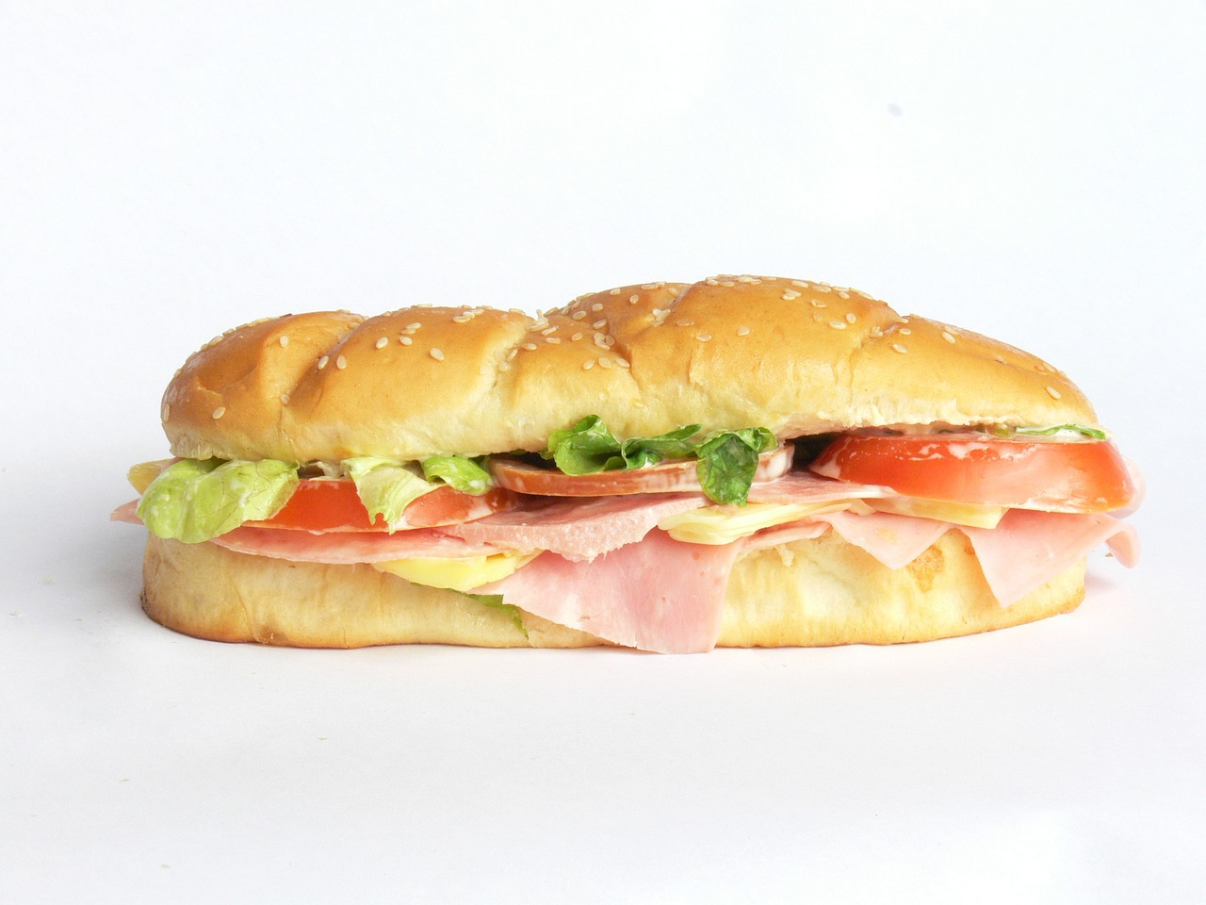
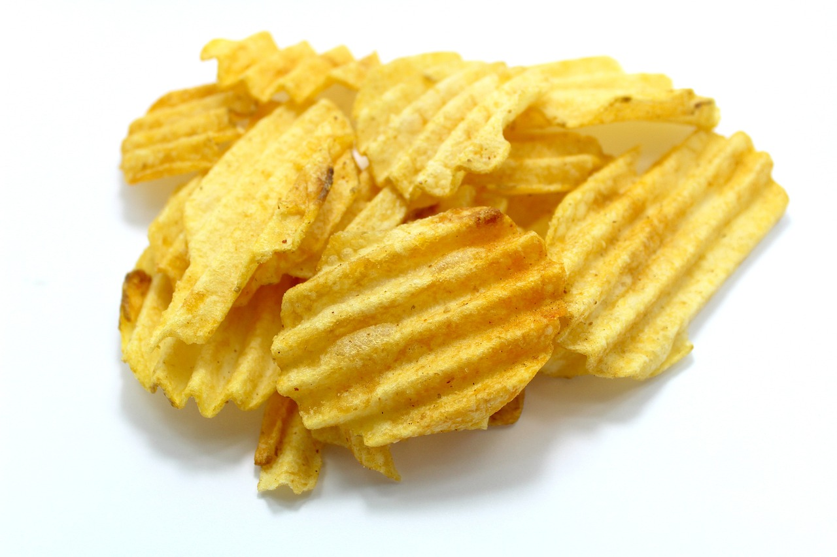
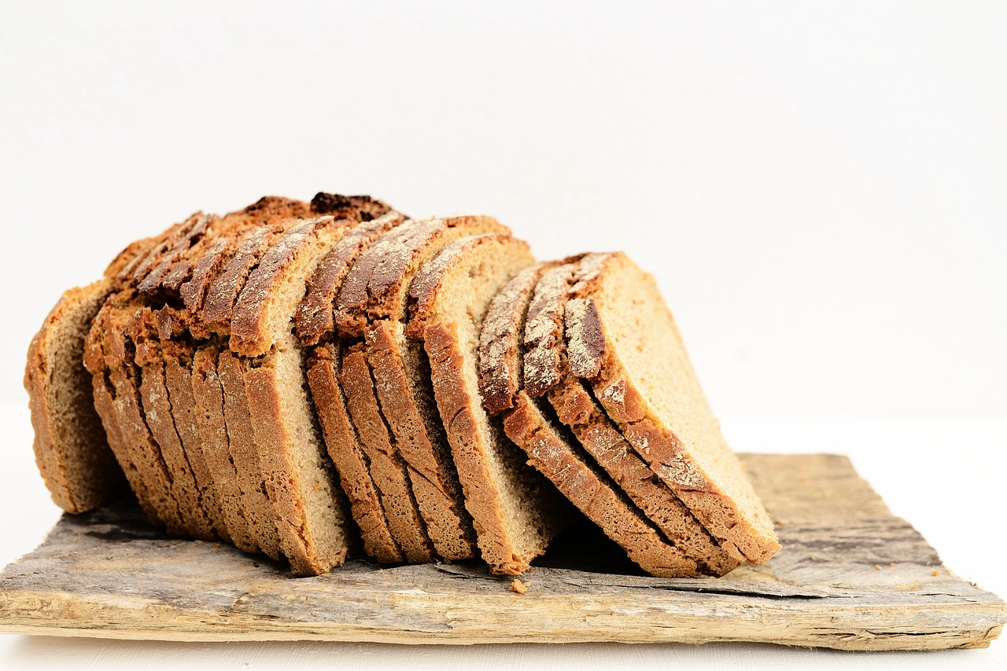

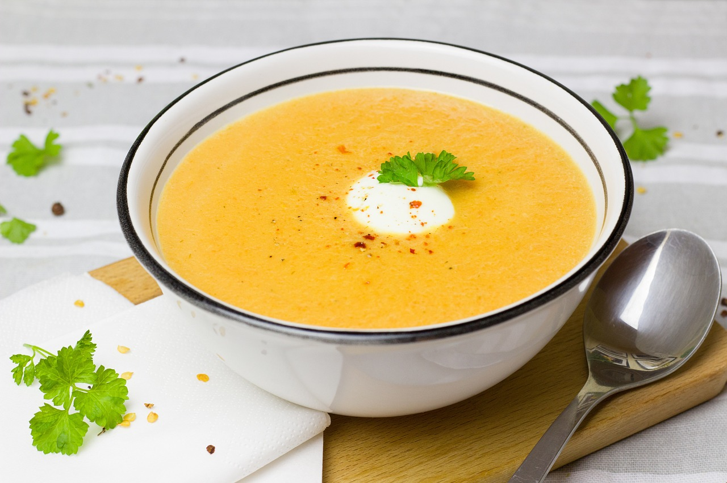
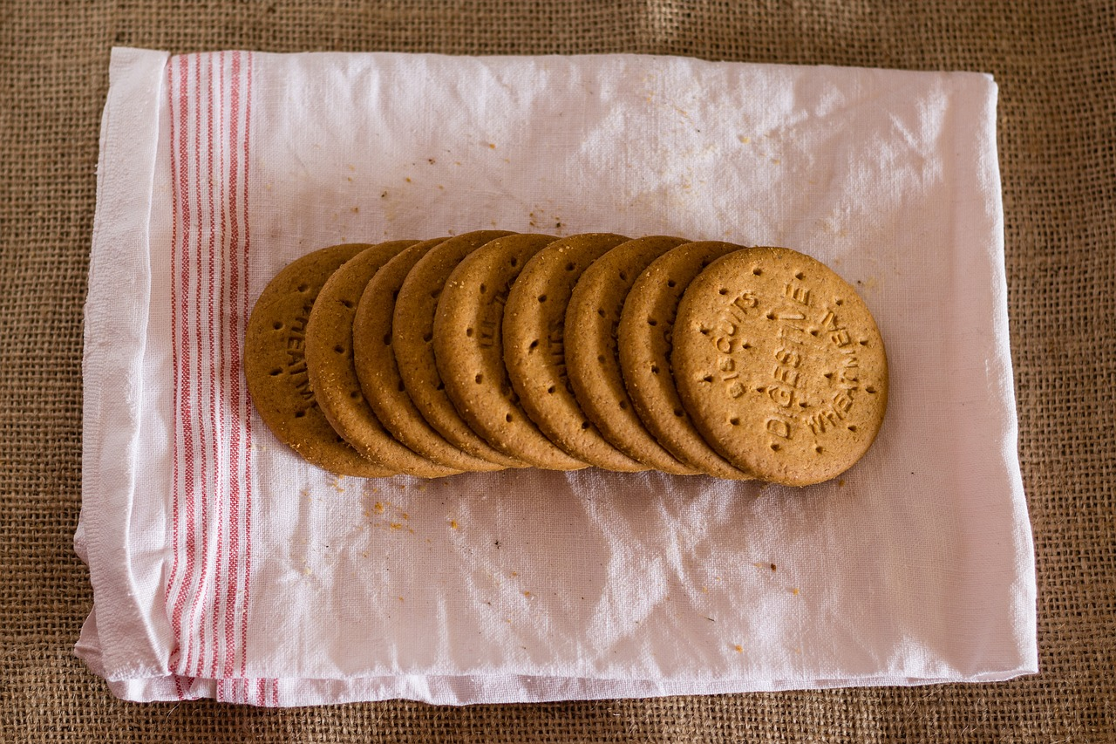

Food related causes of ill health: bacteria
High risk foods
ACTIVITY
…………………………………………………………………………………………………………………………………………………….….…….……..………………....
Identify which of these foods are high risk foods and justify your answers.

Slide 13


Symptoms and signs of food-induced ill health
ACTIVITY
…………………………………………………………………………………………………………………………………………………….……………………………………………………………...………….……..…
Brainstorm the main visible symptoms and non-visible symptoms of food poisoning.
Visible symptoms
Non-visible symptoms
Bloating
Vomiting
Aches and pains
Feeling sick
Chills
Sweating
Nausea
Cramps
Diarrhoea
Fatigue
Stomach- ache
Fever and chills

Slide 14
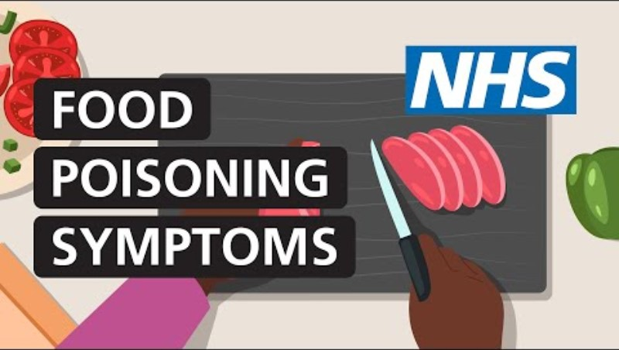
How to tell if you have food poisoning (symptoms) | NHS (youtube.com)

Slide 15
Food related causes and symptoms of ill health
ACTIVITY
…………………………..…………………………………………………………………………………………………………………………….…………………………………………………………………………………………………………….……..…
Using the internet, research visible and non-visible signs and symptoms and sources of different types of pathogenic bacteria.
Food poisoning bacteria | Non-visible symptoms and signs | Visible symptoms and signs | Found in
Salmonella | Cramps, abdominal pain, aches and pains. | Diarrhoea and fever. | Meat, poultry, eggs, unpasteurised milk, meat pie and leftovers.
Clostridium perfringens
Staphylococcus aureus
Campylobacter
E. coli
Listeria
Bacillus cereus

Slide 16
Food related causes and symptoms of ill health
Salmonella fact file
Non-visible symptoms
Visible symptoms
Cramps, abdominal pain, aches and pains
Diarrhoea and fever
Salmonella is found in:
raw eggs and undercooked poultry
processed foods
unpasteurised milk and dairy products
pets
poor sanitation.
Component 1 Principles of Food Preparation and Nutrition

Slide 17
Food related causes and symptoms of ill health
Campylobacter fact file
Non-visible symptoms
Visible symptoms
Cramps, abdominal pain and fatigue
Diarrhoea and vomiting
Campylobacter is found in:
the intestines of animals and poultry
raw and undercooked meats
unpasteurised milk
contaminated water.

Slide 18
Food related causes and symptoms of ill health
Bacillus cereus fact file
Non-visible symptoms
Visible symptoms
Cramps and nausea
Diarrhoea and vomiting
Bacillus cereus is found in:
reheated rice and dried goods: cereal, sauces, herbs and spices
raw meats: beef, turkey and seafood.
Component 1 Principles of Food Preparation and Nutrition

Slide 19
Food related causes and symptoms of ill health
E. coli fact file
Non-visible symptoms
Visible symptoms
Cramps and fever
Diarrhoea and vomiting
E. coli is found in:
raw and undercooked meats and poultry
unpasteurised milk and dairy products
contaminated water.

Slide 20
Food related causes and symptoms of ill health
Listeria fact file
Non-visible symptoms
Visible symptoms
Aches and pains
Diarrhoea and fever
Listeria is found in:
ready to eat foods, prepacked sandwiches, pâté and delicatessen foods
unpasteurised milk and dairy products, and soft cheeses
soil, sewage and contaminated water.

Slide 21
Food related causes and symptoms of ill health
Staphylococcus aureus fact file
Non-visible symptoms
Visible symptoms
Nausea
Diarrhoea, lumps and sores on the skin
Staphylococcus aureus is found:
in unpasteurised milk and dairy products
on the skin and in the nose.

Slide 22
Food related causes and symptoms of ill health
Clostridium perfringens fact file
Non-visible symptoms
Visible symptoms
Cramps
Diarrhoea
Clostridium perfringens is found in:
raw meats, poultry and food cooked in large batches
soil on root vegetables
intestines of animals.
Component 1 Principles of Food Preparation and Nutrition

Slide 23
Food related causes of ill health
Food intolerance
A food intolerance is when the body has a chemical reaction as a result of eating or drinking a certain food, making it difficult to digest.
Food intolerance can sometimes cause painful reactions when eating food. It can cause nausea, bloating, wind, stomach cramps and diarrhoea.

Slide 24
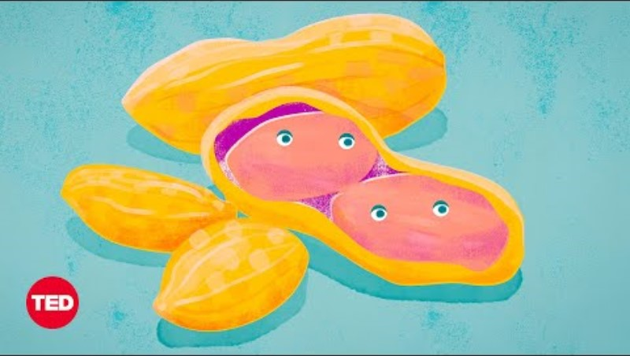
What's a Food Allergy -- and What's Not? | Body Stuff with Dr. Jen Gunter | TED (youtube.com)

Slide 25
1.4.1 Food related causes of ill health
Common food intolerances
Fruits:
Strawberries, citrus fruits and tomatoes
Flavour enhancers such as MSG:
Found in some Chinese foods, instant noodles, dried soup mix, some processed meats and canned vegetables
Aspartame:
Some sugar free products
Wine:
Particularly red wine
Eggs:
Particularly egg whites
Gluten:
Wheat, barley and rye
Lactose:
Dairy products, including milk, cheese and yoghurt
ACTIVITY
………………………………………………………………………………………………………………………………………………………………….…………………………………………………………………………………………………………….……..…
Jamie has recently been diagnosed with a food intolerance. Create a suitable leaflet/poster to give to Jamie detailing the condition and how to manage it.

Slide 26

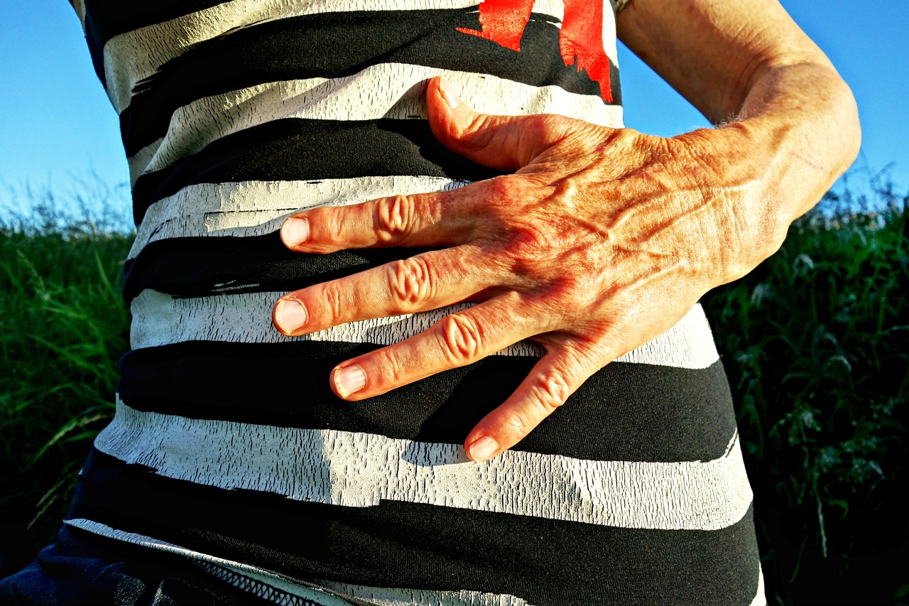

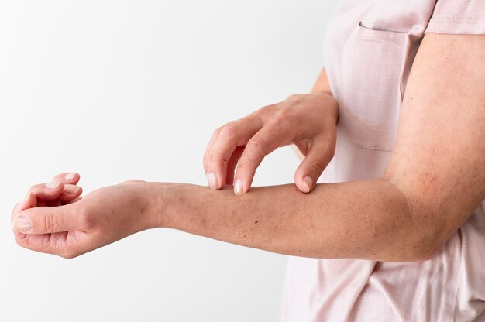
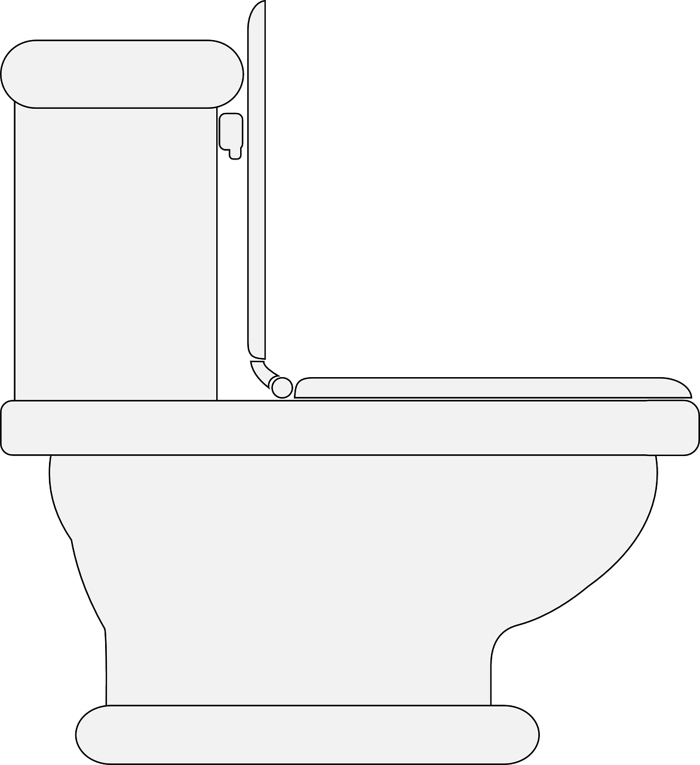



Constant tiredness and weakness
Pain and bloating in the abdomen
Staff area
Service area
Storage area
Nausea
Food related causes of ill health
Symptoms of food intolerances
Eczema and dry skin conditions
Preparation and cooking area
Food intolerance is difficult for a doctor to diagnose, but it can make people feel unwell most of the time.
Symptoms of a food intolerance could include one or more of the following:
Diarrhoea
Muscle and joint aches and pains
Wash and clean area
Headache

Slide 27
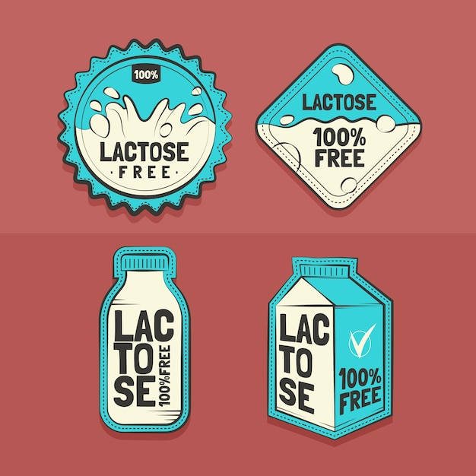
Food related causes of ill health
Food intolerance: lactose
Inability to digest lactose, a type of sugar found in milk. This causes diarrhoea, wind and bloating after eating or drinking it.
People with lactose intolerance must manage their condition by avoiding drinking milk and eating dairy products such as yoghurt, cheese, butter and cream.
They must look at food labels to see if milk has been used as an ingredient in food products.
It is possible to buy dairy products with reduced lactose or no lactose, for example milk and yoghurt.

Slide 28
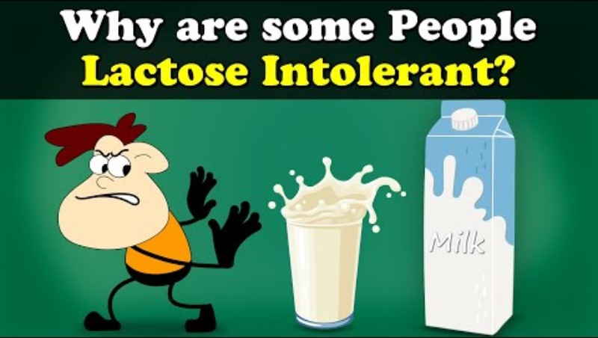
Why are some People Lactose Intolerant? (youtube.com)

Slide 29

Food related causes of ill health
Food intolerance: coeliac disease
Coeliac disease is a reaction to gluten; when gluten is digested, the immune system will attack, damaging the gut and limiting nutrient absorption.
Coeliac disease can cause a variety of symptoms; weight loss, constipation, abdominal pain, bloating, diarrhoea, wind, rash and painful joints.
Gluten is found in many food products and comes from wheat, barley and rye.
Individuals with coeliac disease must avoid eating any foods that contain gluten, such as wheat flour that is used to make bread, cakes and biscuits.
There are many gluten-free food products available in food shops.

Slide 30
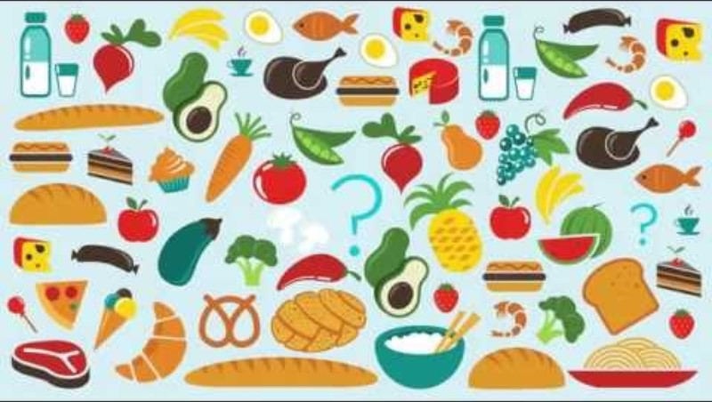
What is celiac disease? (youtube.com)

Slide 31
Food related causes of ill health
Food allergies
An allergic reaction is a response from the body’s immune system, which usually occurs within minutes of eating or touching the food.
Some people can have a delayed allergic reaction which can take hours to develop.
When a person has encountered a certain food or eaten a certain food, this reaction can cause severe symptoms and anaphylaxis and, in some cases, can be fatal.

Slide 32
Food related causes of ill health
Common food allergens
ACTIVITY: THINK, PAIR, SHARE
……………………………………………………………………………………………………………………………………………………..……………
Think of as many allergens as possible.
Discuss you answers with a peer/in a small group.
Share your findings with the class.

Slide 33














GLUTEN
PEANUTS
MUSTARD
TREE NUTS
CELERY
Food related causes of ill health
Common food allergens
MILK
EGGS
FISH
CRUSTACEANS
MOLLUSCS:
Clams, scallops, oysters, squid, snails and cockles
SOYA
SESAME
SULPHITES
LUPIN

Slide 34
Food related causes of ill health
Symptoms of food allergies
ACTIVITY
…………………………………………………………………………………………………………………………………………………………..………
Swelling of the face, lips and throat
Breathing difficulties and wheezing
Dry tongue and throat
Swollen tongue
Itchy tongue and throat
Bloated stomach
Rash
Nausea
Vomiting
Coughing
Painful stomach cramps
Feeling faint or lightheaded
Chills
From the list of food allergy symptoms provided, note which symptoms are visible and non-visible.
Visible signs of food allergies | Non-visible signs of food allergies

Slide 35
Food related causes of ill health
Food allergies: anaphylaxis
Anaphylaxis: life threatening
Confusion
Difficulty breathing
Wheezing
Fast heart rate
Feeling faint
Clammy, sweaty skin
Fainting or losing consciousness
An EpiPen is a self-injecting device used in an emergency to treat life-threatening allergic reactions.
ACTIVITY ……………………………………………………………………………………………………………………………………
Watch the video, and in your own words, write step-by-step instructions for treating someone suffering from anaphylaxis.

Slide 36
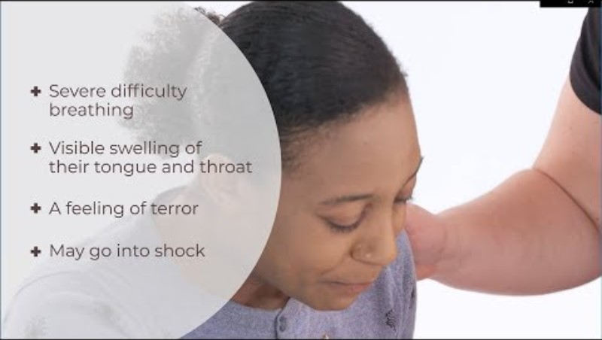
What is anaphylaxis? | Anaphylactic shock | First Aid | iHASCO (youtube.com)

Slide 37
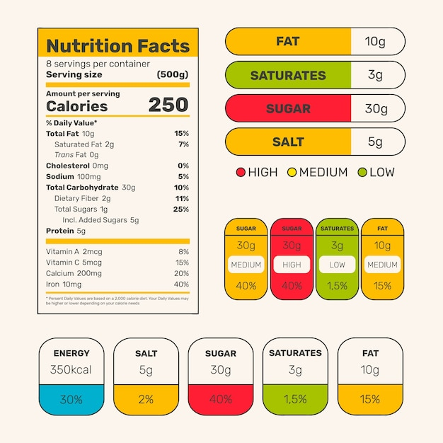
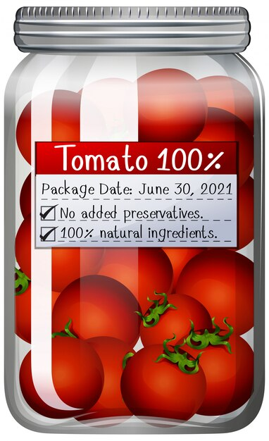
Food related causes of ill health
Food Labelling Regulations
ACTIVITY ………………..…………………………..…………….……………………………………………………………………………………………………………………………………………………………………………………………..…………………………………
The purpose of food labelling is to inform and educate consumers about the food product they choose to buy. The label also protects the consumer, manufacturer and retailer by requiring certain information to be shown on the label. Study a food label and identify and explain why the information is shown on the label.
Component 1 Principles of Food Preparation and Nutrition

Slide 38
The name of the manufacturer
The name of the food must not be misleading to the consumer
If there is a picture of the food product, the product inside must look the same and not be misleading
The net weight/quantity of the food product
Food and drink labelling is extremely important in order to manage food safety. The labelling must be permanent, clear and easy to read.
There are several legal requirements in place when it comes for food labelling:
Food related causes of ill health
Food Labelling Regulations

Slide 39
Information about nutrition
Contact details of the manufacturer, distributor or retailer of the food product
Foods with 'use by' and 'best before' dates cannot be sold past the dates displayed
List of ingredients (in descending order) with allergens in bold, italics or in different colour
Cooking and heating instructions
Storage advice
A food label should also state:
the place of origin and the percentage of alcohol it contains
warnings: noting if the product contains aspartame, additives (E numbers), caffeine, skimmed milk, polyols or sweeteners.
Food related causes of ill health
Food Labelling Regulations

Slide 40

ACTIVITY……………………………………………………………………………..………………………………………………………….…………………………………………………………………………………………………………………….....
You work in a small bakery and the safety of its customers is of the utmost importance. They have asked you to provide food labelling training to all new members of staff. Watch the video and read the newspaper article before creating a training resource suitable for the new employees.
Calls for Better Food Labelling at Pret A Manger as Teenager Dies From Allergic Reaction | GMB (youtube.com)

Slide 41
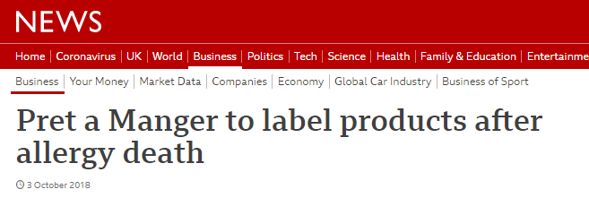
Pret a Manger will list all ingredients, including allergens, on its freshly made products following the death of a teenager who had an allergic reaction after eating a Pret sandwich.
Natasha Ednan-Laperouse, 15, went into cardiac arrest on a flight after buying a sandwich at Heathrow Airport in 2016.
Theresa May called for a review of food labelling laws on Tuesday in the wake of her death.
Clive Schlee, Pret chief executive, said again the firm was "deeply sorry". "I said we would learn from this tragedy and ensure meaningful changes happen," he said.
You can read the full article here: Pret a Manger to label products after allergy death - BBC News
In October 2021, new legislation called Natasha’s Law was passed; this law came into force following an extensive petition campaign by the parents of Natasha Ednan-Laperouse. Food labelling regulations and Natasha's law are in place to prevent food-induced ill health.
Did you know?

Slide 42
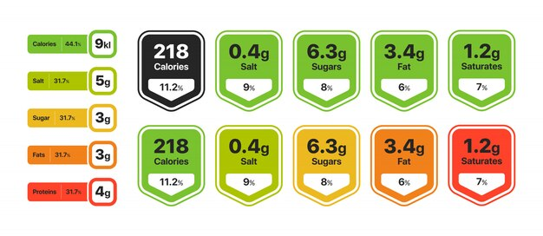
Food related causes of ill health
Nutritional information enables customers to make informed choices about the foods they eat.
The product's nutritional information is displayed in a specific order: energy per 100g or ml (calories and kilojoules), fat, saturates, carbohydrates, sugars, protein, salt, vitamins and minerals.
Many companies have made the nutrition list easier by using the ‘traffic light’ labelling system.
The red, amber and green traffic light system helps the customer to identify whether there are high, medium or low levels of one or more of the following: fats, saturates, sugars and salt.
Food Labelling Regulations
WATCH ME!

Slide 43
STARTER/PLENARY ACTIVITY
…………………………………………………………………………………………………………………………...
Food poisoning
Instructions: Work from the bottom upwards to
answer the questions.
Explain how food poisoning could be prevented.
4 points
Name three pathogenic bacteria.
Name four conditions that bacteria need to grow and reproduce.
3 points
Name two foods that may contain a pathogenic bacteria.
What is the process called when a single-celled bacterium divides into two identical daughter cells?
Name two groups of people for whom food poisoning is particularly dangerous.
2 points
Name one LOW RISK food.
State one visible symptom of food poisoning.
State one non-visible symptom of food poisoning.
What is a pathogenic micro-organism?
1 point

Slide 44
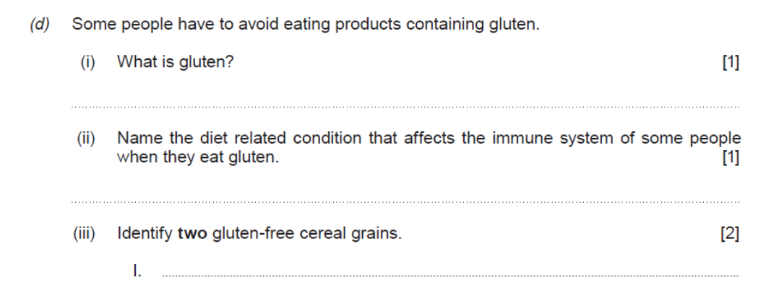
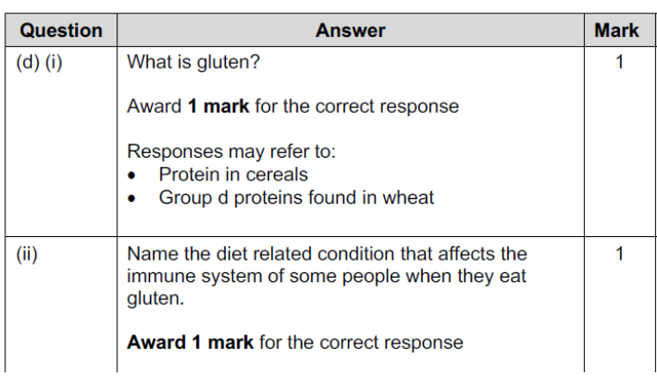
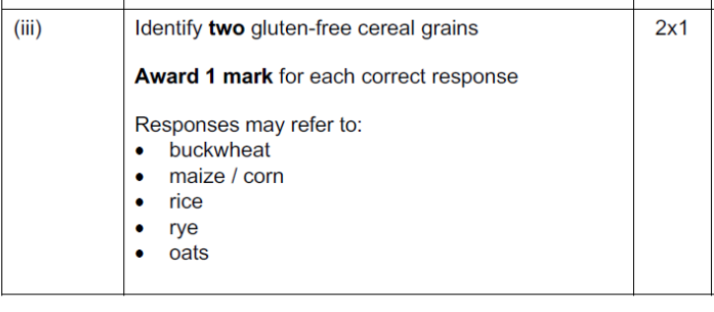
STARTER/PLENARY ACTIVITY: PAST PAPER QUESTION

Slide 45
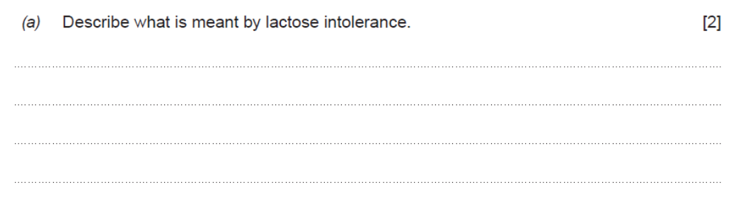
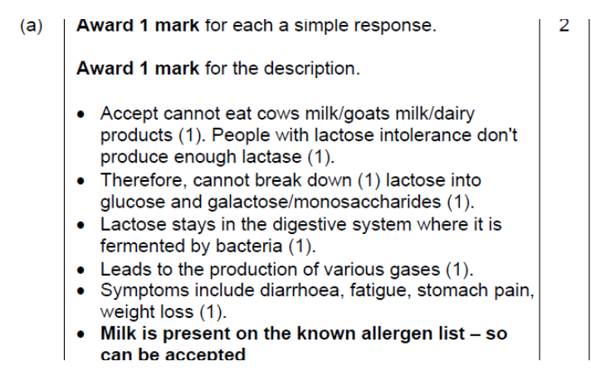
STARTER/PLENARY ACTIVITY: PAST PAPER QUESTION

Slide 46
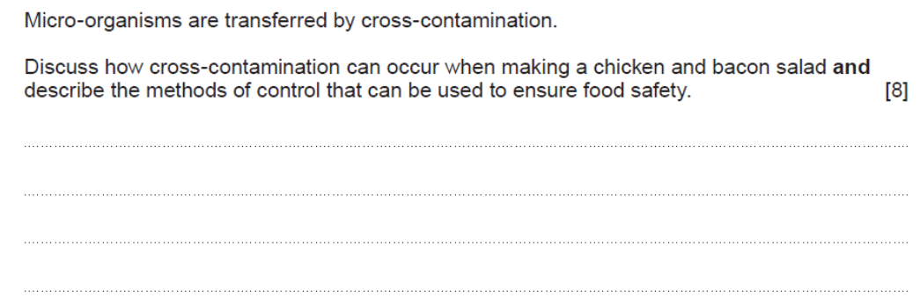
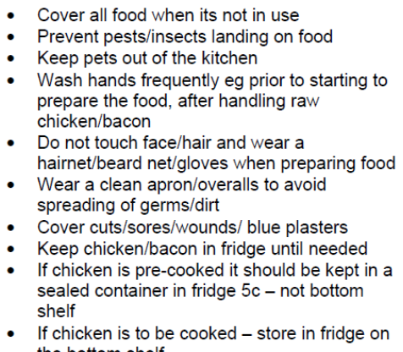
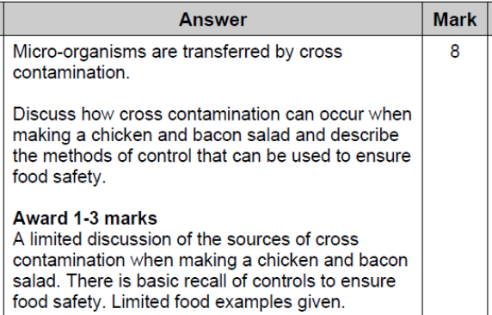
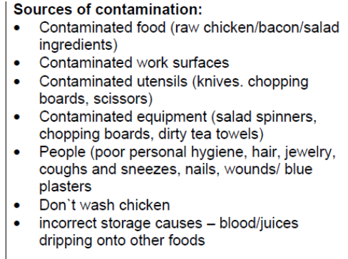
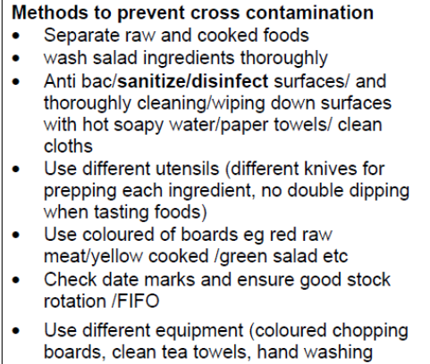
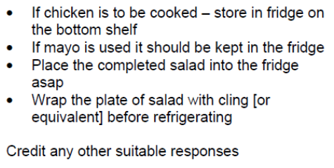
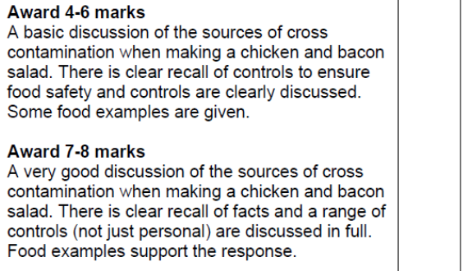
STARTER/PLENARY ACTIVITY: PAST PAPER QUESTION

Slide 47
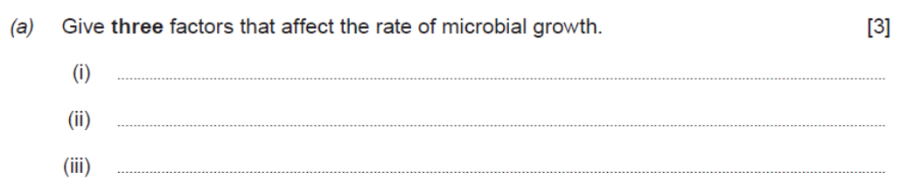
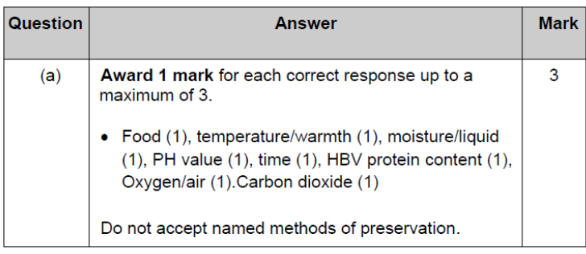
STARTER/PLENARY ACTIVITY: PAST PAPER QUESTION

Slide 48
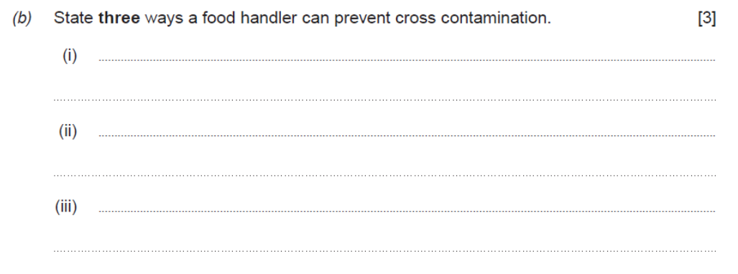
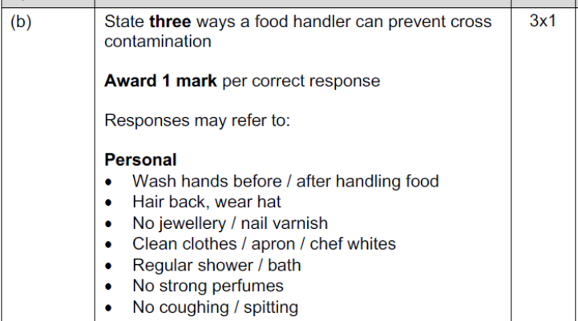
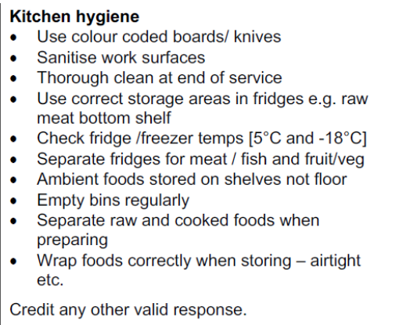
STARTER/PLENARY ACTIVITY: PAST PAPER QUESTION

Slide 49
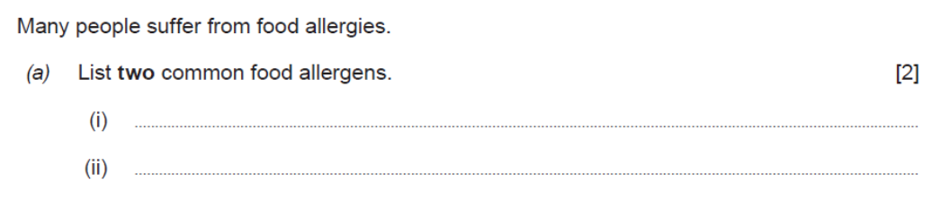
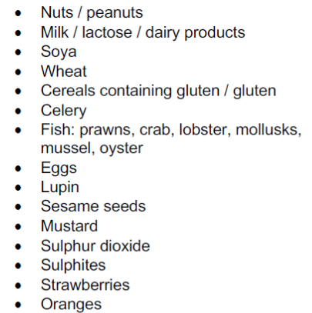
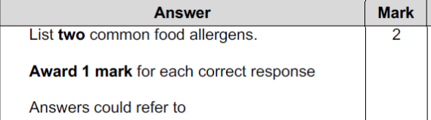
STARTER/PLENARY ACTIVITY: PAST PAPER QUESTION

Slide 50
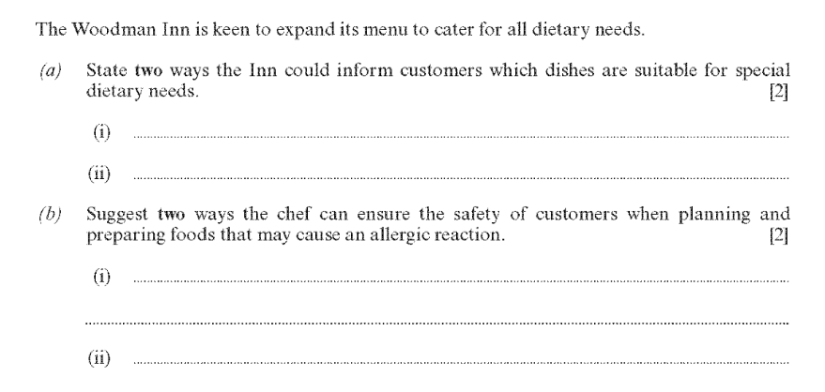
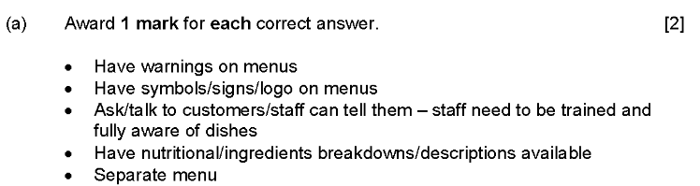
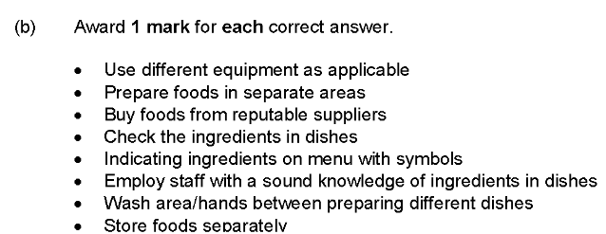
STARTER/PLENARY ACTIVITY: PAST PAPER QUESTION

Slide 51
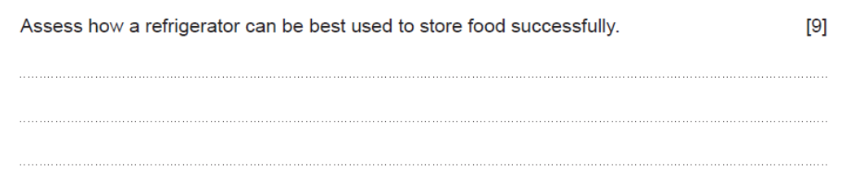
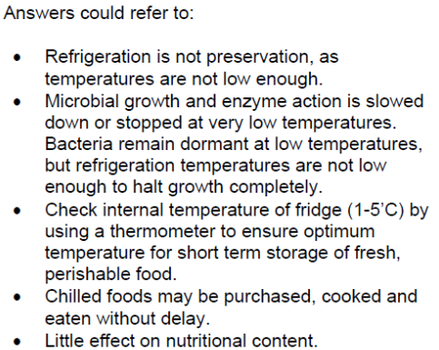
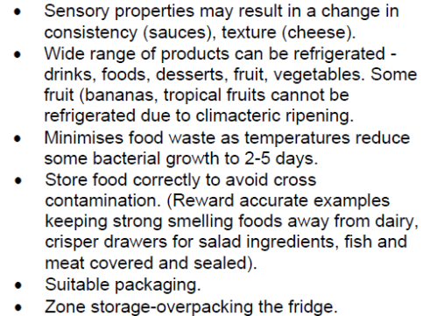
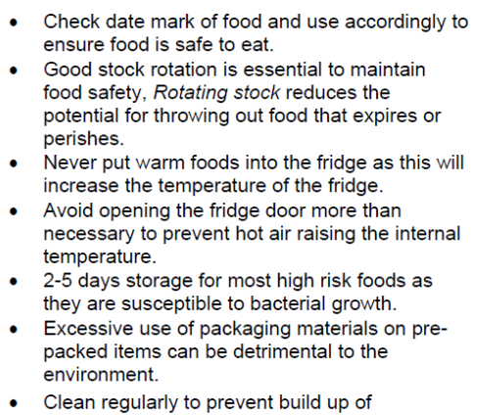
STARTER/PLENARY ACTIVITY: PAST PAPER QUESTION

Slide 52
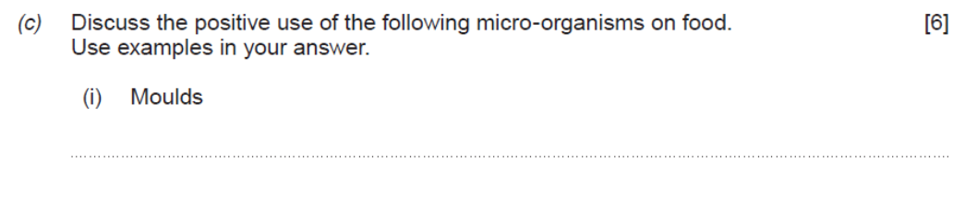
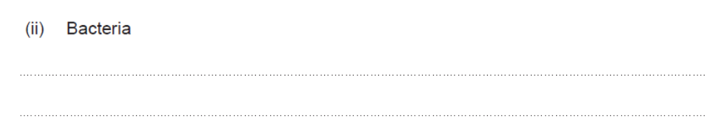
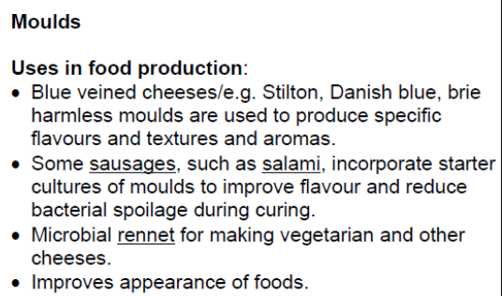
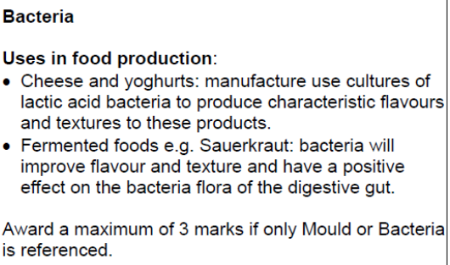
STARTER/PLENARY ACTIVITY: PAST PAPER QUESTION

Slide 53
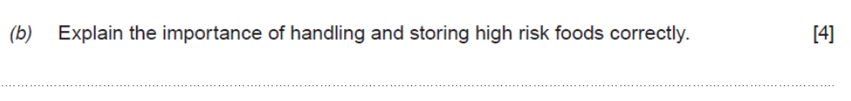



STARTER/PLENARY ACTIVITY: PAST PAPER QUESTION

Slide 54
A
Glossary
Allergic reaction – How the body responds when an allergen has been eaten; for example, rash.

Slide 55
A
Glossary
Allergen – Food that can cause an allergic reaction.

Slide 56
A
Glossary
Anaphylaxis – A severe reaction to eating an allergen that can lead to death.

Slide 57
F
Glossary
Food Labelling Regulations – Includes the information that must be shown on a food label.

Slide 58
F
Glossary
Food spoilage – When something happens that makes food unfit and unsafe to eat.

Slide 59
I
Glossary
Intolerance – Not being able to digest certain foods without feeling ill; examples include wheat (gluten) and milk (lactose).

Slide 60
M
Glossary
Micro-organism – Tiny plants and animals that are only clearly visible under a microscope.

Slide 61
N
Glossary
Non-visible symptoms – Symptoms of food-induced ill health that cannot be seen, including nausea (feeling sick) or headache.

Slide 62
P
Glossary
Pathogenic – Something that can cause illness in people.

Slide 63

Glossary
V
Visible symptoms – Symptoms of food-induced ill health that can be seen, including vomiting or a rash.

Slide 64
Acknowledgements
Slide 1 Image by storyset / Freepik.com; Slide 5 Image by Freepik, Image by Freepik, Image by Freepik, Image by OpenClipart-Vectors / Pixabay.com; Slide 6 Image by Freepik; Slide 7 Image by Freepik; Slide 8 Image by Freepik; Slide 9 Image by OpenClipart-Vectors / Pixabay.com; Slide 12 Image by peperompe / Pixabay.com, Image by 41330 / Pixabay.com, Image by congerdesign / Pixabay.com, Image by Alexas_Foto / Pixabay.com, Image by Einladung_zum_essen / Pixabay.com, Image by Wounds_and_Cracks / Pixabay.com, Image by FineArtFortress / Pixabay.com; Slide 13-22 Image by OpenClipart-Vectors / Pixabay.com, Image by OpenClipart-Vectors / Pixabay.com; Slide 29 Image by 1306029 / Pixabay.com, Pixabay.com, Image by Freepik, Image by inspire-studio / Pixabay.com, Image by MabelAmber / Pixabay.com, Image by stockking / Freepik, Image by OpenClipart-Vectors / Pixabay.com, Image by OpenClipart-Vectors / Pixabay.com, Image by Mohamed_hassan; Slide 30 Image by Freepik; Slide 32 Image by Freepik; Slide 36 Image by Freepik, Image by Freepik, Image by Freepik, Image by rawpixel.com / Freepik.com, Image by Freepik, Image by Freepik, Image by Freepik, Image by Freepik, Image by Freepik, Image by Freepik, Image by Freepik, Image by Freepik, Image by Gstudioimagen / Freepik.com, Image by Freepik; Slide 41 Image by Freepik, Image by brgfx / Freepik.com; Slide 46 Image by pch.vector / Freepik.com; Slide 50 Image by OpenClipart-Vectors / Pixabay.com, Image by CatsWithGlasses / Pixabay.com, Image by rawpixel.com / Freepik.com, Image by Clker-Free-Vector-Images / Pixabay.com, Image by OpenClipart-Vector, Image by juicy_fish / Freepik.com.
The images within this resource are used for educational (non-commercial) purposes only, to facilitate learning and to further explain concepts. Appropriate acknowledgement has been provided to all images. To the best of our knowledge, all images are being used in compliance with the Fair Use Policy; if there are omissions or inaccuracies, please inform us so that any necessary corrections can be made: resources@wjec.co.uk.

