Slide 1
Eduqas GCE Geography
Information for new centres

Slide 2
Aims of Eduqas GCE Geography
To highlight the relevance and importance of geography in our daily lives.
To promote learning opportunities that focus on current and topical issues/examples, encouraging teachers to use the latest resources/examples – drawing on a variety of sources (constantly evolving).
To encourage learners to ‘think like a geographer’ by engaging them with the enquiry process
To provide opportunities for co-teachability with GCE AS Geography, both in terms of content and the required days of fieldwork

Slide 3
Fieldwork Requirements
A level students must complete the equivalent of four days of fieldwork (AS two days)
Fieldwork must be carried out equally in relation to both physical and human geography topics
Centres are required to sign a fieldwork declaration form to verify that these requirements have been met

Slide 4
A level Summary of Assessment

Slide 5
A level Summary of Assessment

Slide 6
Overview of the A level
The course is divided into four components, each of which cover specific themes as well as geographical skills and mathematical techniques:
Component 1: Changing Landscapes and Changing Places
Component 2: Global Systems and Global Governance
Component 3: Contemporary Themes in Geography
Component 4: Independent Investigation
https://www.eduqas.co.uk/media/ln4locyz/eduqas-a-level-geography-spec-from-2016-e-24-01-2020.pdf

Slide 7
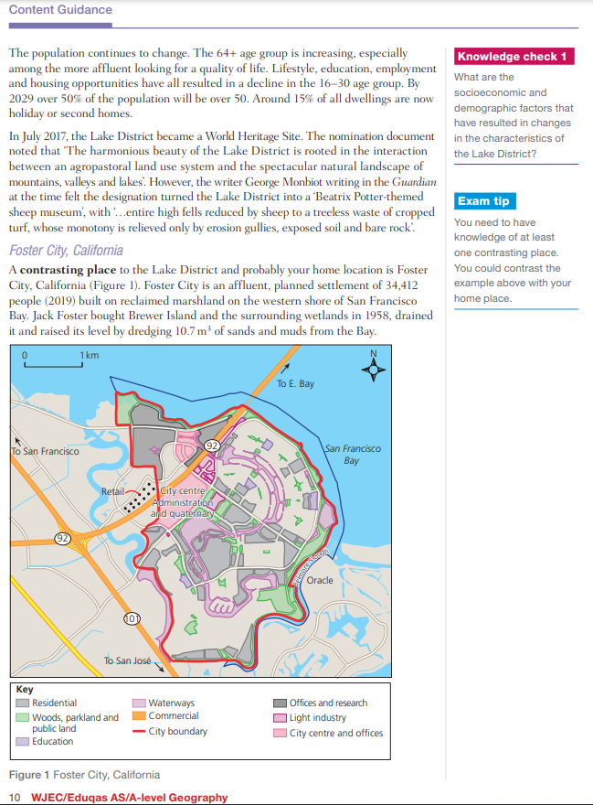
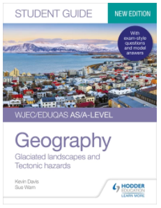
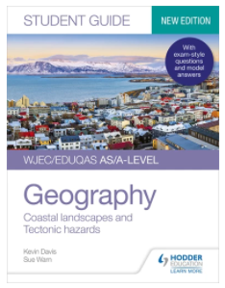
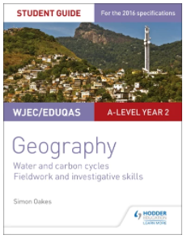
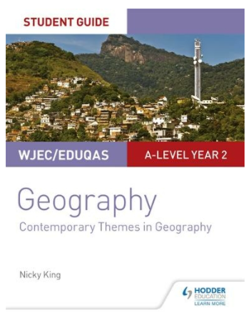
Student and revision guides to support each component……
https://www.hoddereducation.co.uk/

Slide 8
Component 1 –
Changing Landscapes and Changing Places
SECTION A – Changing Landscapes Learners should study one of the optional themes opposite | 1.1 Coastal Landscapes | 1.2 Glaciated Landscapes
SECTION B – Changing Places | 1.3 Changing Places
Past Papers:
2018 http://pastpapers.download.wjec.co.uk/s18-8111-01.pdf
2019 http://pastpapers.download.wjec.co.uk/s19-8111-01.pdf

Slide 9
Component 1 –
Changing Landscapes & Changing Places
SECTION A:
Changing Landscapes
Either:
Coastal Landscapes
The operation of the coast as a system
Landforms and landscape systems, their distinctive features and distribution
Factors affecting coastal processes and landforms
Processes of coastal weathering, mass movement, erosion, transportation and deposition and the characteristics and formation of associated landforms
The impact of human activity on coastal landscape systems

Slide 10
Component 1 –
Changing Landscapes & Changing Places
Changing Landscapes
Or:
Glaciated Landscapes
The operation of the glacier as a system
Climate change and the glacier budget over different time scales
Processes of glacial weathering, erosion and the characteristics and formation of associated landforms
Periglacial processes and the formation of associated features
Glacial processes are a vital context for human activity

Slide 11
SECTION B:
Changing Places
Changing place; changing places – relationships and connections
Changes over time in the economic characteristics of places
Economic change and social inequalities in de-industrialised urban places
The 21st Century knowledge economy (quaternary) and its social and economic impacts
Urban management and the challenges of continuity and change (including rebranding)
Rural management and the challenges of continuity and change (including rebranding)

Slide 12
Component 2 –
Global Systems and Global Governance
SECTION A – Global Systems | 2.1 Water and Carbon Cycles
SECTION B – Global Governance: Change and Challenges | 2.2.1 – 2.2.5 Processes and Patterns of Global Migration 2.2.6 – 2.2.10 Global Governance of the Earth’s Oceans
SECTION C – 21st Century Challenges
Past Papers:
2018 http://pastpapers.download.wjec.co.uk/s18-8111-02.pdf
2019 http://pastpapers.download.wjec.co.uk/s19-8111-02.pdf

Slide 13
SECTION A:
Global Systems
Water and Carbon Cycles
Inputs, outputs, stores and flows in the water cycle
Catchment hydrology – the drainage basin as a system
Precipitation and excess runoff within the water cycle
Deficit within the water cycle
The global carbon cycle
Carbon stores in different biomes
Links between the water and carbon cycles

Slide 14
SECTION B:
Global Governance: Change & Challenges
Processes and Patterns of Global Migration
Globalisation, migration and a shrinking world
Causes of international economic migration
Consequences and management of international economic migration
Causes, consequences, and management of refugee movements
Causes, consequences, and management of rural-urban migration in developing countries

Slide 15
Global governance: Change & Challenges
Global Governance of the Earth’s Oceans
Global flows and governance - including people trafficking and piracy
Sovereignty of the ocean resources - including geopolitical tensions and contested ownership, such as Arctic Ocean resources
Managing marine environments – exploitation and sustainability
Causes and consequences of ocean pollution
Managing ocean pollution – including Arctic Ocean conservation, or a UNESCO marine heritage site

Slide 16
SECTION C:
21st Century Challenges
One compulsory extended response question drawing on both Component 1 and Component 2 content. Resource material will be provided as stimulus

Slide 17
Component 3 – Contemporary Themes in Geography
SECTION A – Tectonic Hazards | 3.1 Tectonic Hazards
SECTION B – Contemporary Themes in Geography Learners should study 2 of the 4 themes opposite: | 3.2 Ecosystems
 | 3.3 Economic Growth and Challenge: India or China or Development in an African Context
 | 3.4 Energy Challenges and Dilemmas
 | 3.5 Weather and Climate
Past Papers:
2018 http://pastpapers.download.wjec.co.uk/s18-8111-03.pdf
2019 http://pastpapers.download.wjec.co.uk/s19-8111-03.pdf

Slide 18
SECTION A:
Tectonic Hazards
Tectonic processes and hazards
Volcanoes - processes, hazards and their impacts
Earthquakes - processes, hazards and their impacts
Human factors affecting risk and vulnerability
Responses to tectonic hazards

Slide 19
SECTION B:
Contemporary Themes in Geography
Either
Ecosystems
or
Economic Growth and Challenge in India or China
or
Energy Challenges and Dilemmas
or
Weather and Climate

Slide 20
Component 4 – Independent Investigation (NEA)
Independent Investigation (NEA) | Each learner undertakes an independent investigation which involves, but need not be restricted to, fieldwork. This investigation must be linked to an aspect of the Specification, and based on a question or issue defined and developed by the individual learner.
The mandatory four days of fieldwork can be used to prepare students for Independent Investigation, but can also contribute to data collection
Data collection in groups is permitted but titles and write-ups must be completed individually
Full guidance is available on our website https://www.eduqas.co.uk/qualifications/geography-as-a-level/?sub_nav_level=course-materials#tab_resources
Free Title Advice Service wjeceduqasnea@outlook.com

Slide 21
Factors to consider:
Recommended word length 3000-4000 words
Structure the work as illustrated on the following slide
20% of the marks, so should take up 20% of study time
Titles are best phrased as evaluative questions: “Too what extent does…?”, “How far can…?”, etc. This allows for an enquiry-based approach
Investigations must be linked to an aspect of the Eduqas specification. The student/centre need not be studying the particular aspect chosen
Consider the scale and focus of the study
Consider the need to access and visit the study site(s) a sufficient number of times to collect meaningful data

Slide 23
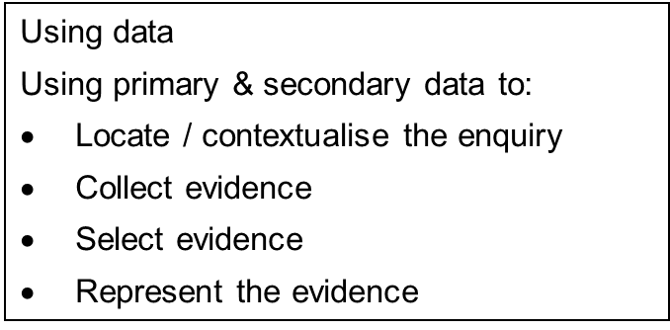
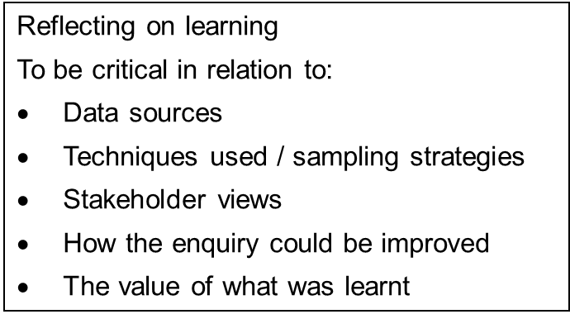
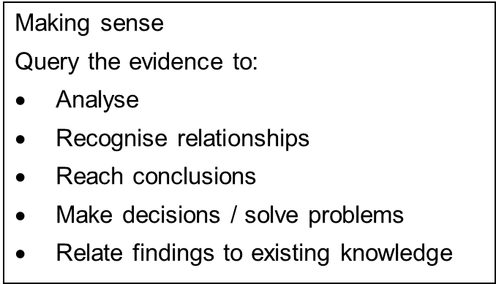
The Fieldwork Enquiry Process

Slide 24
Assessment objectives
AO1
Demonstrate knowledge and understanding of places, environments, concepts, processes, interactions and change, at a variety of scales
AO2
Apply knowledge and understanding in different contexts to interpret, analyse and
evaluate geographical information and issues
AO3
Use a variety of relevant quantitative, qualitative and fieldwork skills to:
investigate geographical questions and issues
interpret, analyse and evaluate data and evidence
construct arguments and draw conclusions

Slide 25
Assessment objectives across the
4 components
 | AO1 | AO2 | AO3 | Total
Component 1 | 9% | 6.5% | 5% | 20.5%
Component 2 | 9.5% | 10.5% | 7.5%. | 27.5%
Component 3 | 13.5% | 15% | 3.5% | 32%
Component 4 | 2.5% | 5% | 12.5% | 20%
Overall | 34.5% | 25% | 35% | 100%

Slide 26
The Online Exam Review (OER)
The Online Exam Review (OER) allows teachers and students to look at actual responses to past examination questions. It can be accessed at: https://oer.eduqas.co.uk/Pages/ProjectByArgs.aspx?subId=28&lvlId=1
The Principal Examiner has provided these responses with detailed annotation in order to demonstrate how the mark scheme has been applied
Responses can be viewed with or without this annotation
The OER is best viewed using Internet Explorer, but has most centres now use Chrome or Edge, it is recommended that it is downloaded as a pdf and opened in Adobe

Slide 27
Bespoke Teaching and Learning Resources
e.g. AO3: Developing data analysis skills

Slide 28
Teaching and Learning Resources
We have a large number of free resources designed to help students and teachers: https://resources.eduqas.co.uk/Pages/ResourceByArgs.aspx?subId=13&lvlId=1
Past Papers & Mark Schemes can be found here:
https://www.eduqas.co.uk/qualifications/geography-as-a-level/#tab_pastpapers
Other key documents for both A & AS level can be found here:
https://www.eduqas.co.uk/qualifications/geography-as-a-level/?sub_nav_level=course-materials#tab_resources

Slide 29
Any Questions?
Please feel free to contact our very helpful GCE Geography team:
GCEGeography@eduqas.co.uk
029 2240 4281
@eduqas
eduqas.co.uk

