Slide 1
Eduqas GCSE (9-1) in
HISTORY
Introduction for New Centres

Slide 3
The Eduqas GCSE History Structure
Component 1:
Studies in Depth 50% of qualification
2 hours split into two papers:
British Study in Depth 1 hour (five questions)
Non-British Study in Depth 1 hour (five questions)
Component 2:
Studies in Breadth 50% of qualification
2 hours split into two papers:
Period Study 45 minutes (five questions)
Thematic Study 1 hour 15 minutes (seven questions)

Slide 4
Component 1 - Studies in Depth
British Study in Depth (select one from four options)
Non-British Study in Depth (select one from four options)
Each study in depth must come from different historical eras (Medieval,500-1500; Early Modern,1450-1750 and Modern,1700-present day)

Slide 5
Component 1 Options
This component is in two parts and offers a choice of eight Studies in Depth - four British and four non-British.
Centres choose one British Study in Depth from the following:
1A. Conflict and Upheaval: England, 1337-1381 *
1B. The Elizabethan Age, 1558-1603 **
1C. Empire, Reform and War: Britain, 1890-1918 ***
1D. Austerity, Affluence and Discontent: Britain, 1951-1979 ***
Centres choose one non-British Study in Depth from the following:
1E. The Crusades, c.1095-1149 *
1F. The Voyages of Discovery and Conquest of the Americas, 1492-1522 **
1G. Germany in Transition, 1919-1939 ***
1H. The USA: A Nation of Contrasts, 1910-1929 ***
The British and non-British Studies in Depth must be from different historical eras.
Medieval *
Early Modern **
Modern ***

Slide 6
Component 2 – Studies in Breadth
Period Study (select one from four options)
Thematic Study (select one from four options)
(The Thematic Study includes the study of an historic site)

Slide 7
Component 2 Options
This component is in two parts and offers a choice of four Period Studies and four Thematic Studies.
Centres choose one Period Study from the following:
2A. The Development of the USA, 1929-2000
2B. The Development of Germany, 1919-1991
2C. The Development of the USSR, 1924-1991
2D. The Development of the UK, 1919-1990
Centres choose one Thematic Study from the following:
2E. Changes in Crime and Punishment in Britain, c.500 to the present day
2F. Changes in Health and Medicine in Britain, c.500 to the present day
2G.The Development of Warfare in Britain, c.500 to the present day
2H. Changes in Entertainment and Leisure in Britain, c.500 to the present day
The requirement to study an historic site is part of the Thematic Study.

Slide 8
Prohibited combinations due to content overlap
1D. Austerity, Affluence and Discontent: Britain, 1951-1979 and
2D. The Development of the UK, 1919-1990
1G. Germany in Transition, 1919-1939 and
2B. The Development of Germany, 1919-1991
1H. The USA: A Nation of Contrasts, 1910-1929 and
2A. The Development of the USA, 1929-2000

Slide 9
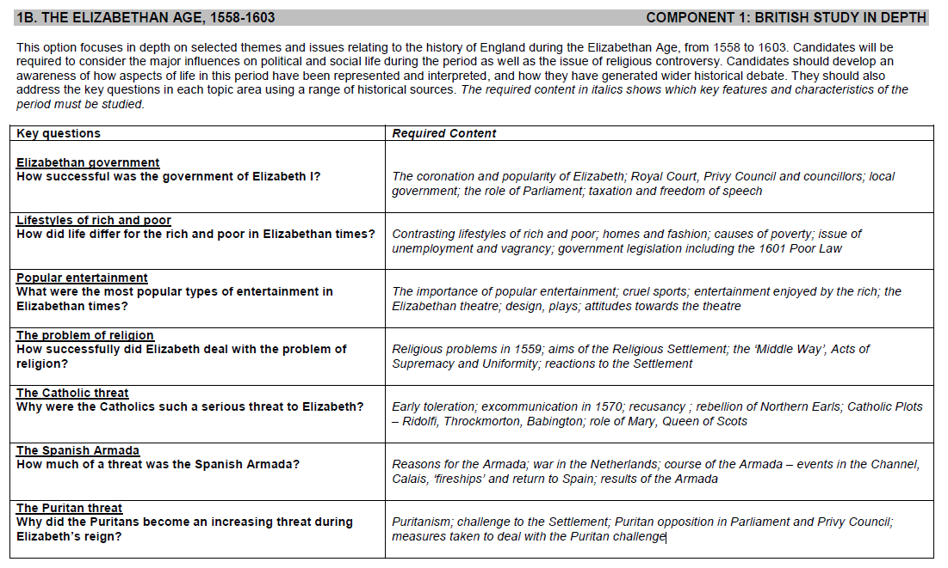

Slide 10
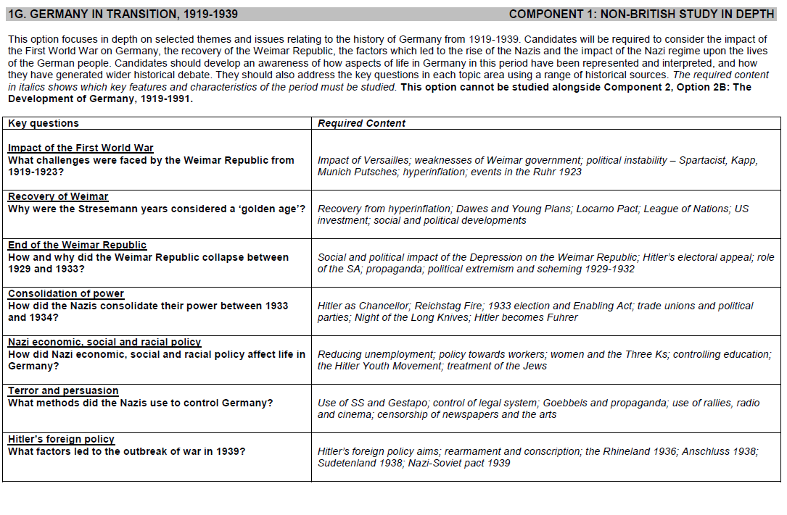

Slide 12
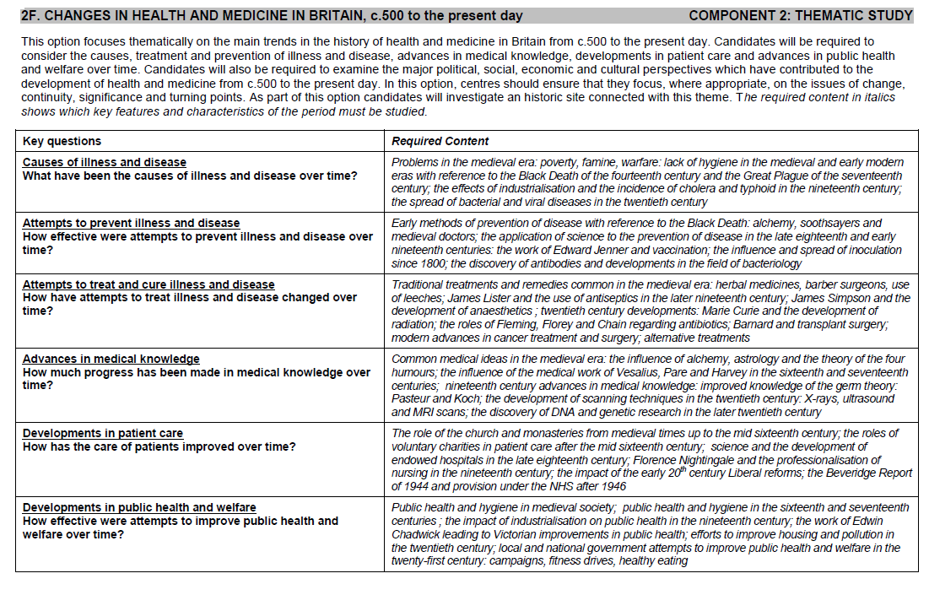

Slide 13
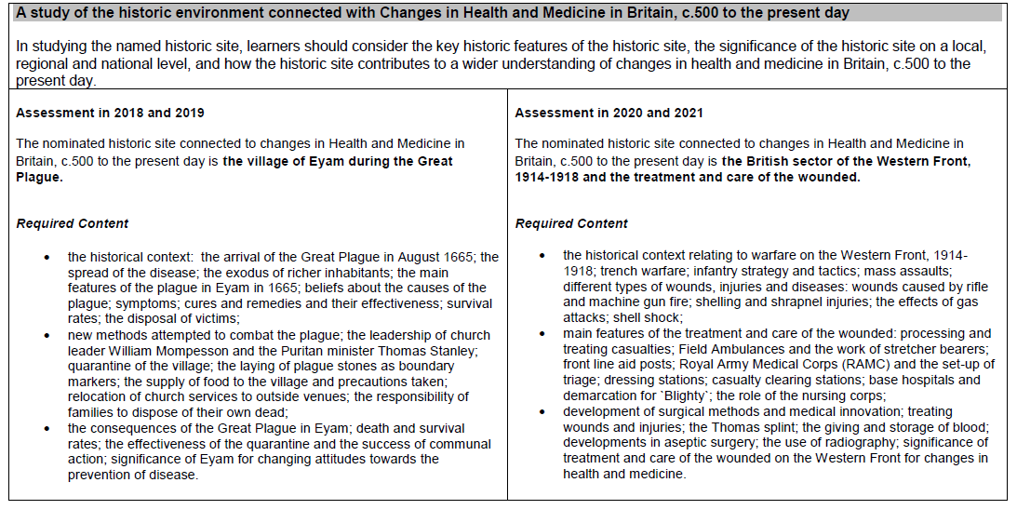

Slide 14
COMPONENT 1 – BRITISH STUDIES IN DEPTH Papers for Component 1 will focus mainly on the evaluation of historical sources and interpretations of the past.
All questions must be answered.
Question | Style of question | Mark
1. | Selection of information from two sources | 4
2. | Source evaluation – single source contemporary to the period | 8
3. | Significance question | 12
4. | Connections question | 10
5. | Interpretation question | 16+3 SPaG
Total |  | 53

Slide 15
Question 1
This question will contain two sources [A and B] connected with an issue that will have been studied.
This question is worth 4 marks and targets AO3.
The question will ask candidates to outline what Sources A and B suggest / show about an issue.
The focus of this question is being able to understand and extract from a variety of source materials.
There are no marks awarded for own knowledge in this question.
Question 2
This question will contain one source [C] connected with an issue that will have been studied.
This question is worth 8 marks and targets AO1 and AO3.
The question will ask candidates to analyse and evaluate the accuracy of the source.
The aim of the question is to encourage candidates to reach a substantiated judgement about the accuracy of the source set within its historical context.
Candidates will be rewarded for discussing the strengths and limitations of the source material.

Slide 16
Question 3
This question will ask about the significance of an identified issue which will have been studied.
This question is worth 12 marks and targets AO1 and AO2.
The question will ask candidates to provide a reasoned and supported explanation of the significance of the identified issue set within the relevant historical context.
Candidates will be rewarded for demonstrating contextual understanding and providing a fully developed and focused explanation.
Question 4
This question will contain four identified features taken from the specification which are all interrelated.
This question is worth 10 marks and targets AO1 and AO2.
The question will ask candidates to identify and explain the connections between TWO of the identified features set within the correct historical context.
Candidates will be rewarded for demonstrating contextual understanding and providing a full explanation of the relevant connections.

Slide 17
Question 5
This question will contain one interpretation connected with the wider historical debate over an issue that will have been studied.
This question is worth 16 marks plus 3 SPaG and targets AO1 and AO4.
The question will ask candidates to reach a substantiated judgement about the accuracy of the interpretation.
Candidates will need to analyse and evaluate how and why interpretations of the issue differ. Candidates should focus on and discuss the authorship of the interpretation in reaching their judgement.
Candidates will also be rewarded for demonstrating understanding of the key feature in the question.

Slide 18
COMPONENT 1 – NON-BRITISH STUDIES IN DEPTH Papers for Component 1 will focus mainly on the evaluation of historical sources and interpretations of the past.
All questions must be answered.
Question | Style of question | Mark
1. | Use of source material and knowledge to describe an aspect of history | 5
2. | Purpose of source contemporary to the period | 8
3. | Evaluation of different interpretations | 10
4. | Utility of two sources | 11
5. | Evaluation of single sentence interpretation | 16+3 SPaG
Total |  | 53

Slide 19
Question 1
The question will utilise a single piece of source material [A].
This question is worth 5 marks and targets AO1 and AO3.
The question will ask candidates to use the source and their own knowledge to describe an historical issue.
Candidates will be rewarded for demonstrating understanding of the key feature in the question and analysing the source in its historical context.
Question 2
The question will utilise a single piece of source material [B].
This question is worth 8 marks and targets AO1 and AO3.
The question will ask candidates to analyse and evaluate the purpose of the source in order to reach a substantiated judgement.
Candidates will be rewarded for demonstrating understanding of the historical context and undertaking full consideration of the authorship.

Slide 20
Question 3
This question will contain two interpretations connected with the wider historical debate over an issue that will have been studied.
This question is worth 10 marks and targets AO1 and AO4.
The question will ask candidates to reach a substantiated judgement about the extent to which the interpretations support a particular view.
Candidates will need to analyse and evaluate how and why interpretations of the issue differ. Candidates should focus on and discuss the authorship of the interpretation in reaching their judgement.
Candidates will also be rewarded for demonstrating understanding of the key feature in the question.
Question 4
The question will utilise two pieces of source material [C and D].
This question is worth 11 marks and targets AO1 and AO3.
The question will ask candidates to analyse and evaluate the relative usefulness of the source material to an historian studying the issue.
Candidates will need to analyse and evaluate the content and authorship of the source material to reach a substantiated judgement set within the appropriate historical context.
Candidates will be rewarded for demonstrating understanding of the historical context.

Slide 21
Question 5
This question will contain one single sentence interpretation connected with the wider historical debate over an issue that will have been studied.
This question is worth 16 marks plus 3 SPaG and targets AO1 and AO4.
The question will ask candidates to reach a substantiated judgement about the accuracy of the interpretation set within its wider historical context.
Candidates will need to analyse and evaluate how and why interpretations of the issue differ. Candidates should focus on and discuss the authorship of the interpretation in reaching their judgement.
Candidates will also be rewarded for demonstrating understanding of the key feature in the question.

Slide 22
COMPONENT 2 – PERIOD STUDIES Papers for Component 2 will focus mainly on key features and key concepts of history.
All questions must be answered.
Question | Type of question | Mark
1. | Description of an historical issue/event/policy | 5
2. | Extent of change | 6
3. | Order of importance/significance | 9
4. | Explanation of an historical development | 8
5. | Evaluative essay | 12
Total |  | 40

Slide 23
Question 1
This question is worth 5 marks and targets AO1.
The question will ask candidates to describe an historical issue.
The focus of this question is being able to demonstrate detailed and accurate knowledge of an issue set within its historical context.
Question 2
This question will ask about the nature and extent of change of an identified issue which will have been studied.
This question is worth 6 marks and targets AO1 and AO2.
The question will ask candidates to provide a reasoned and well supported judgement on the extent of change set within the relevant historical context.
Candidates will be rewarded for demonstrating contextual understanding and providing a fully developed and focused explanation of change.
Question 3
This question will ask about the relative significance/importance of three historical features.
This question is worth 9 marks and targets AO1 and AO2.
The question will ask candidates to provide a reasoned and well supported explanation regarding the relative significance/importance of three features set within the relevant historical context.
Candidates will be rewarded for demonstrating contextual understanding and providing a fully developed justification of their chosen order of importance.

Slide 24
Question 4
This question is worth 8 marks and targets AO1 and AO2.
The question will ask candidates to provide a reasoned, focused and well supported explanation of the issue set within the relevant historical context.
Candidates will be rewarded for demonstrating detailed contextual understanding.
Question 5
This question is worth 12 marks and targets AO1 and AO2.
The question asks candidates to analyse and evaluate the importance of a key issue against other factors.
Candidates will be rewarded for demonstrating detailed contextual understanding and for reaching a reasoned and well supported judgement.
There will be a statement giving some advice about what should be discussed in the answer.

Slide 25
COMPONENT 2 – THEMATIC STUDIES Papers for Component 2 will focus mainly on key features and key concepts of history.
All questions must be answered.
Question | Type of question | Mark
1. | Similarity and difference | 4
2. | Evaluation of two sources | 6
3. | Description of an historical event | 5
4. | Explanation of an historical development | 9
5. | Written narrative covering three historical eras | 16+4 SPaG
6a | Description of two features of an historic site | 8
6b | Explanation of the significance of an historic site | 12
Total |  | 64

Slide 26
Question 1
This question will contain three visual sources [A, B and C] connected with an issue that will have been studied.
This question is worth 4 marks and targets AO2 and AO3.
The question will ask candidates to identify one similarity and one difference.
The focus of this question is being able to understand and extract from the source material.
Question 2
The question will utilise two pieces of source material [D and E].
This question is worth 6 marks and targets AO1 and AO3.
The question will ask candidates to analyse and evaluate the relative reliability of the source material to an historian studying the issue.
Candidates will need to analyse and evaluate the content and authorship of the source material to reach a substantiated judgement set within the appropriate historical context.
Candidates will be rewarded for demonstrating understanding of the historical context .

Slide 27
Question 3
This question is worth 5 marks and targets AO1.
The question will ask candidates to describe an historical issue.
The focus of this question is being able to demonstrate detailed and accurate knowledge of an issue set within its historical context.
Question 4
This question is worth 9 marks and targets AO1 and AO2.
The question will ask candidates to provide a reasoned, focused and well supported explanation of the issue set within the relevant historical context.
Candidates will be rewarded for demonstrating detailed contextual understanding.

Slide 28
Question 5
This question is worth 16 marks plus 4 marks for SPaG.
The question assesses the ability to produce an extended narrative discussion of an issue studied across three historical eras.
Candidates will be expected to analyse the nature and extent of change or continuity across the three historical eras.
Candidates will be rewarded for demonstrating understanding of the historical context .
There will also be a statement giving advice about what should be discussed in the answer.

Slide 29
Question 6a
This question is worth 8 marks and targets AO1.
The question will ask candidates to describe two features of an historic site.
The focus of this question is being able to demonstrate detailed and accurate knowledge of the historic site set in its context.
Question 6b
This question is worth 12 marks and targets AO2.
The question will ask candidates to provide a reasoned, well supported explanation and analysis of the way in which the historic site demonstrates continuity and/or change in a particular theme over time. Responses need to be set within the relevant historical context.

Slide 30
The On-line Exam Review (OER)
https://oer.eduqas.co.uk/Pages/ProjectByArgs.aspx?subId=34&lvlId=2
Candidate responses with marks and comments from the senior examining team.
Best accessed via Internet Explorer, or saved and then viewed using Adobe

Slide 31
The On-line Exam Review (OER)
If navigating from the Eduqas Homepage click on the Online Exam Review icon (or from a browser enter https://oer.eduqas.co.uk/ )

Slide 32
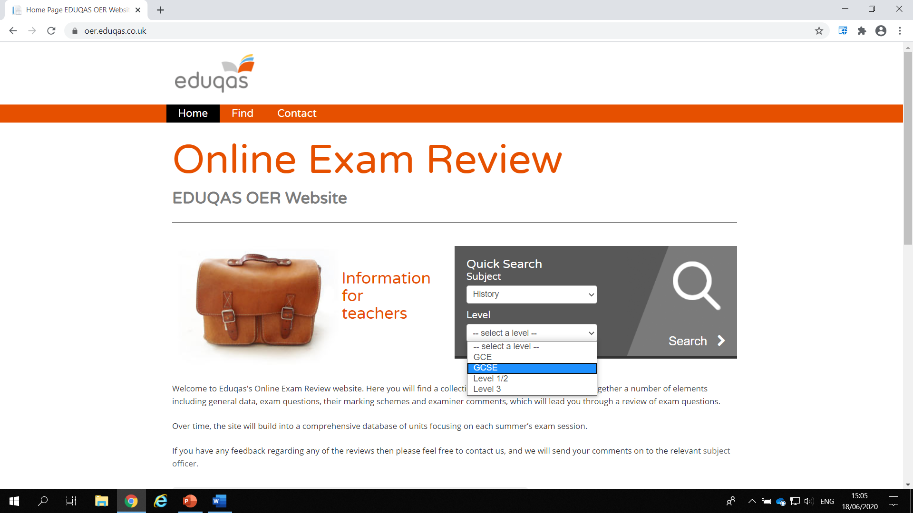
The On-line Exam Review (OER)
Populate the drop-down boxes: History & GCSE

Slide 33
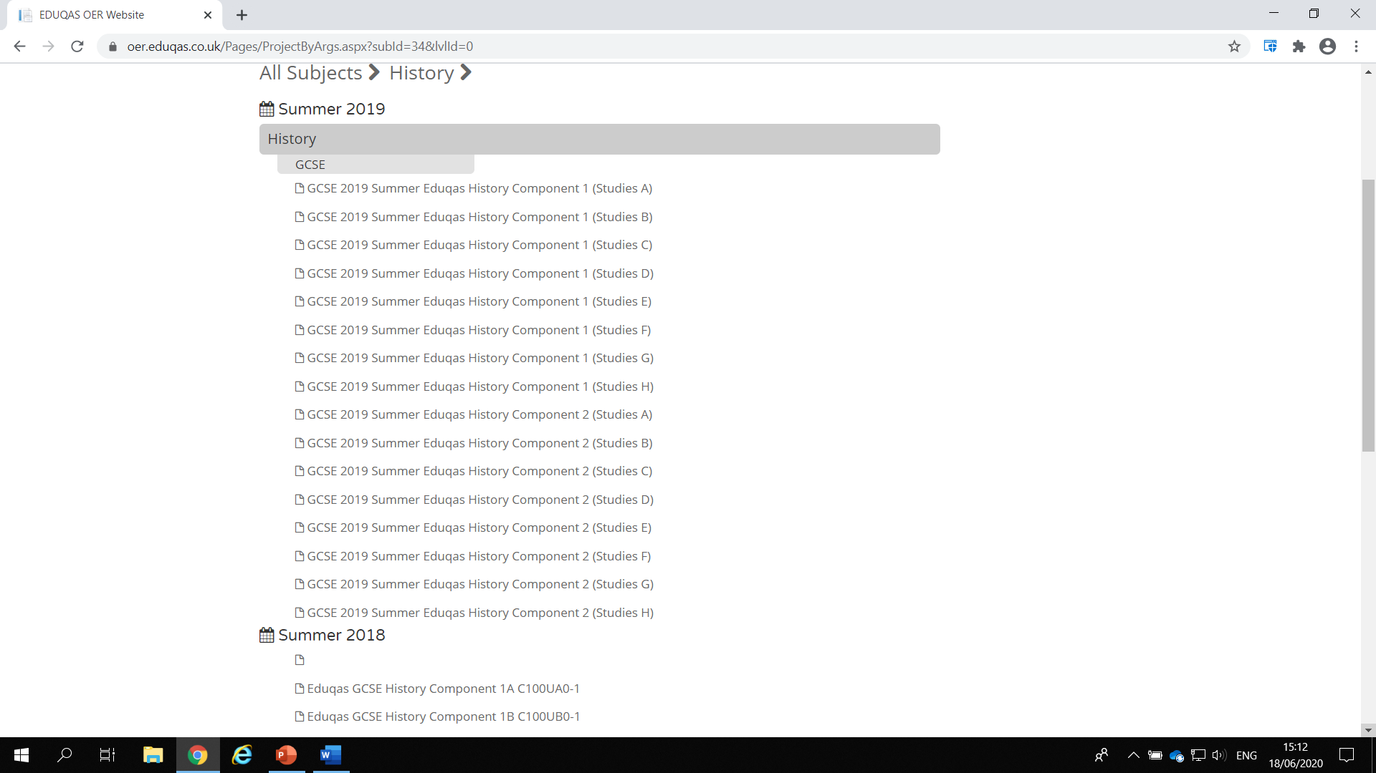
The On-line Exam Review (OER)
This brings up the options of all of the 2018 & 2019 examinations. (If you navigate directly from the History Subject Page you’ll get straight to this screen)

Slide 34
The On-line Exam Review (OER)
Click on one of the options, and this screen opens
On the right is the national Item Level Data for the option sected
From the menu on the left, it is possible to view the question, the mark scheme and various candidate responses, both annotated and unannotated

Slide 35
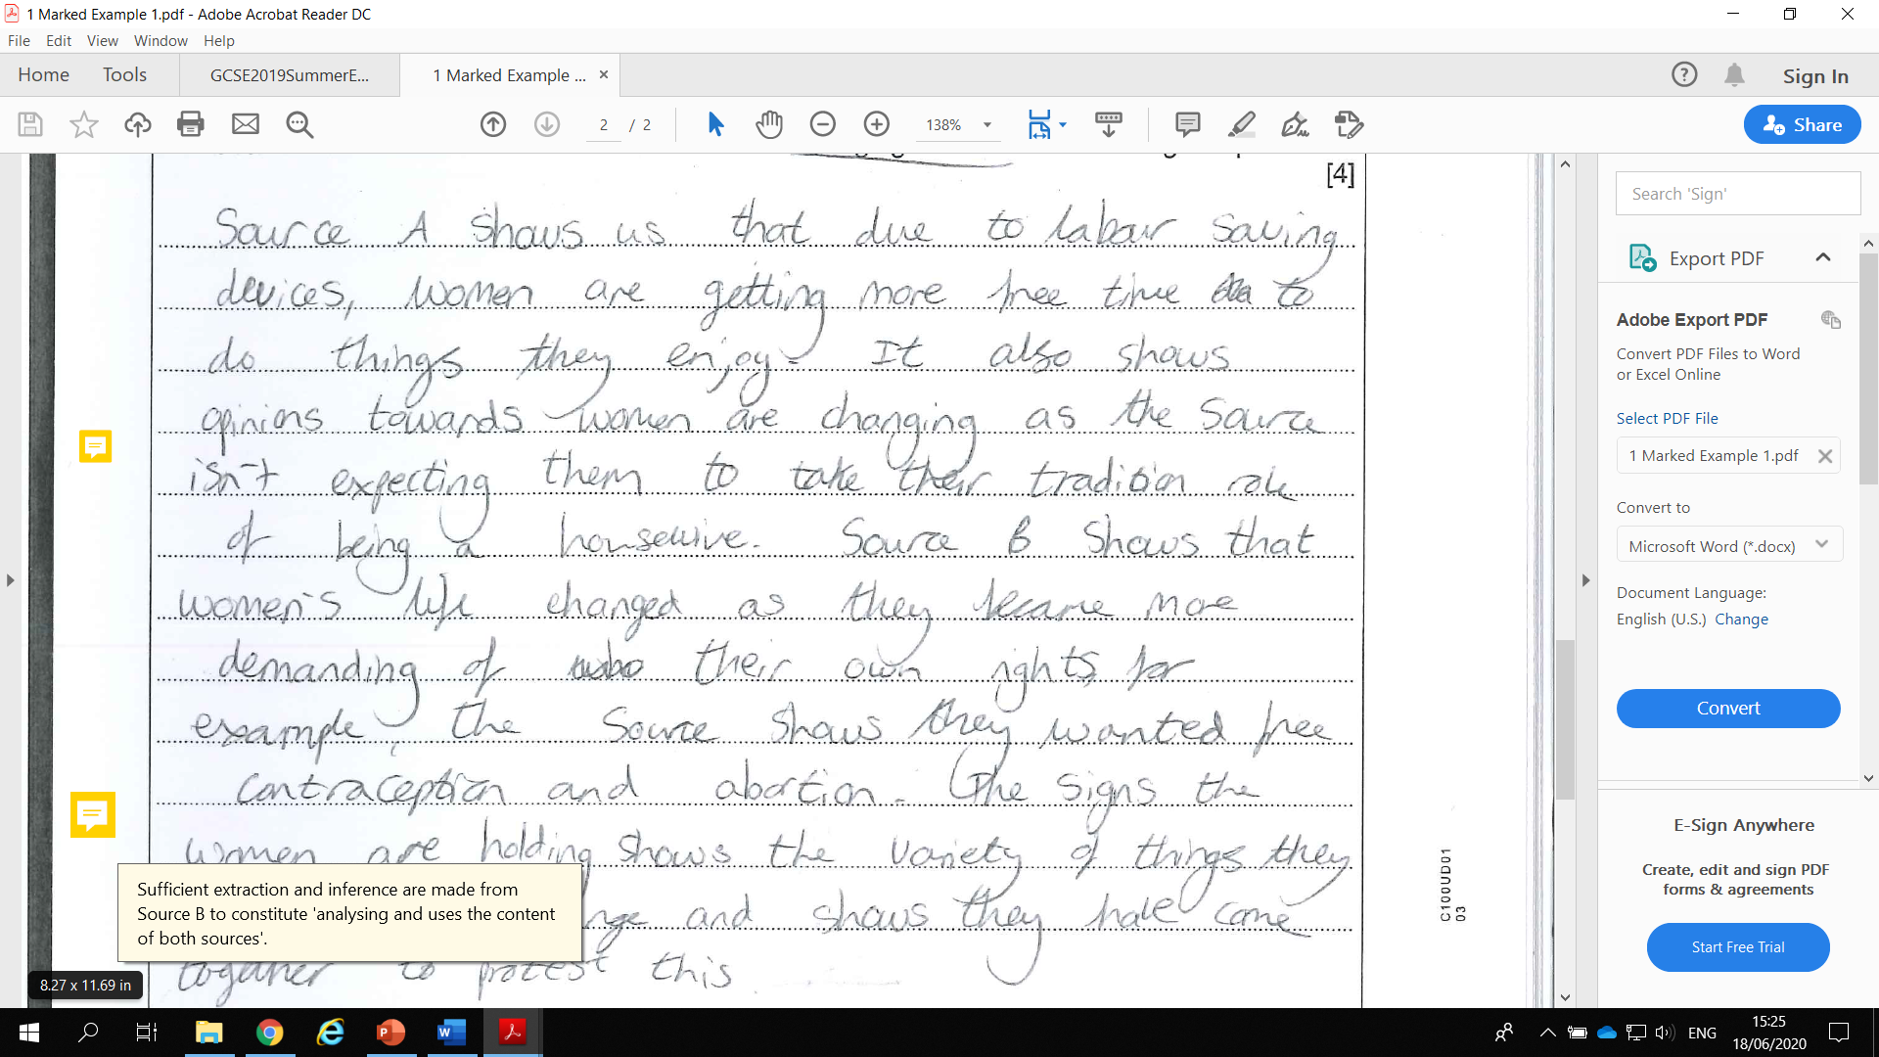
The On-line Exam Review (OER)
Clicking on the yellow icons opens up comments from the senior examining team

Slide 36
Key Documents & Resources
History subject page: https://www.eduqas.co.uk/qualifications/history-gcse/#tab_overview
Specification: https://www.eduqas.co.uk/media/vzupipk4/eduqas-gcse-history-spec-from-2016-e-20-12-2019.pdf
Past papers & mark schemes: https://www.eduqas.co.uk/qualifications/history-gcse/#tab_pastpapers
Free digital resources: https://resources.eduqas.co.uk/Pages/ResourceByArgs.aspx?subId=17&lvlId=2

Slide 37
Key Documents & Resources (cont.)
Endorsed text books: https://www.eduqas.co.uk/qualifications/history-gcse/?sub_nav_level=books#tab_resources
Guidance for Teaching: https://www.eduqas.co.uk/media/ysvp4vlr/eduqas-gcse-history-guidance-for-teaching.pdf
CPD materials: https://www.eduqas.co.uk/qualifications/history-gcse/?sub_nav_level=training-materials#tab_training

Slide 38
Examiner Vacancies
https://www.eduqas.co.uk/home/appointees/

Slide 39
For more information:
GCSE History Team: GCSEHistory@eduqas.co.uk
029 2240 4278
@eduqas
eduqas.co.uk

