Slide 1



Welcome to our online meeting
GCSE Religious Studies
ROUTE B
New Centre Introduction
#eduqasrepteam

Slide 2

Welcome
Thank you for attending the Eduqas regional team online session today.Please remember to turn your audio and video off.
If you have questions, please use the Chat function or, if this is not available on your device, email us on hugh.lester@wjec.co.uk . We will answer as many as we can in the second half.
Sessions on a variety of qualifications and topics continue until December. Follow the Twitter hashtag #eduqasrepteam to find out more.
Eduqas regional team: here to support you
Email hugh.lester@wjec.co.uk to be put in touch with the rep for your area.

Slide 3
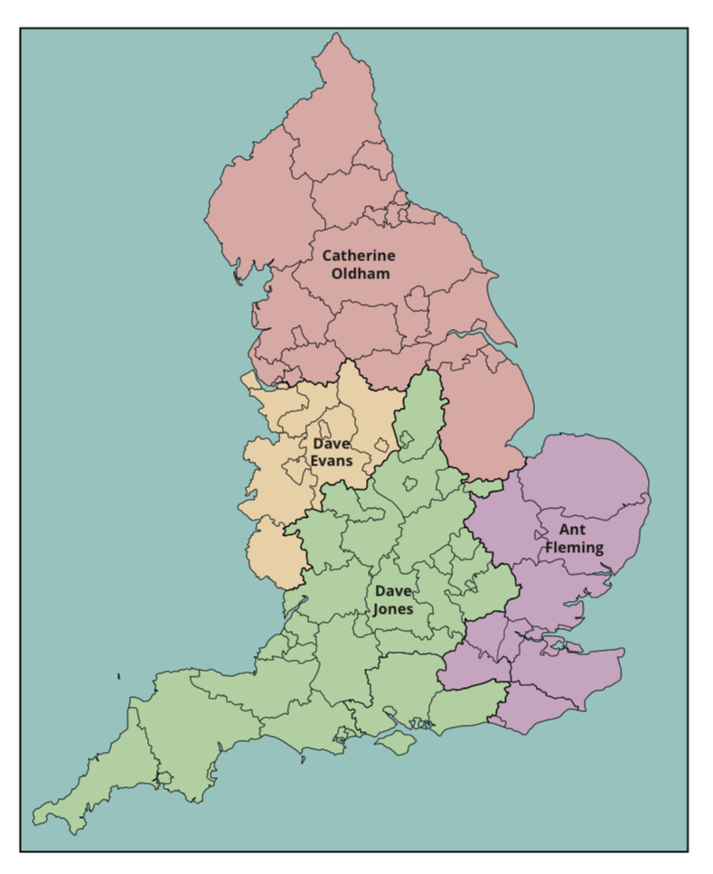

Slide 4
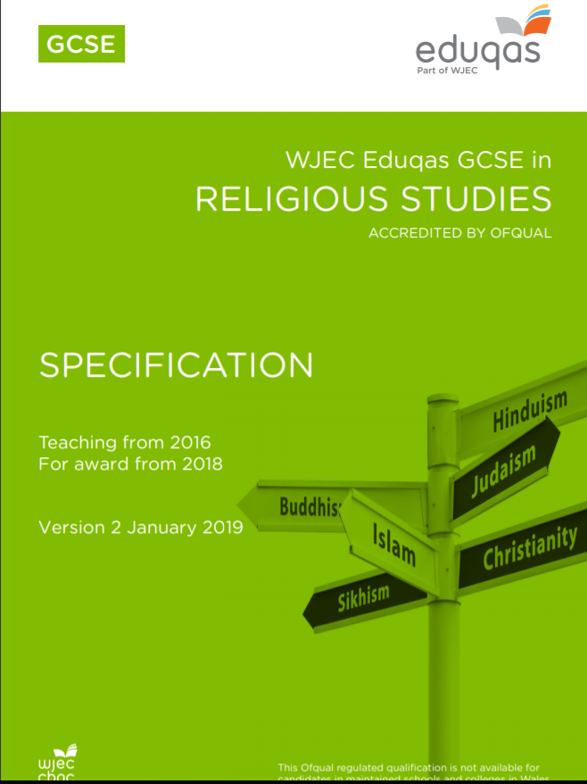

Slide 5
Summary of assessment
Component 1:Foundational Catholic Theology
Written examination: 1 hour 30 minutes 37.5% of qualification
Candidates will study the following two themes. All questions are compulsory.
Theme 1: Origins and Meaning
Theme 2: Good and Evil
This component will be assessed by compulsory questions focusing on knowledge, understanding and evaluation of the identified themes.

Slide 6
Summary of assessment
Component 2: Applied Catholic Theology
Written examination: 1 hour 30 minutes 37.5% of qualification
Candidates will study the following two themes. All questions are compulsory.
Theme 1: Life and Death
Theme 2: Sin and Forgiveness
This component will be assessed by compulsory questions focusing on knowledge, understanding and evaluation of the subject content.

Slide 7
Summary of assessment
Component 3: Study of a World Faith (Judaism)
Written examination: 1 hour 25% of qualification
Candidates will study the following two themes in respect of Judaism. All questions are compulsory.
Theme 1: Beliefs & Teachings
Theme 2: Practices
This component will be assessed by compulsory questions focusing on knowledge, understanding and evaluation of the subject content.

Slide 8
Summary of assessment
Spelling, Punctuation & Grammar (SPaG)
The qualification has twelve marks for SPaG
Six in Component 1. Always in Question 1 (d) Theme 1: Origins and Meanings
Six in Component 2. Always in Question 1 (d) Theme 1: Life and Death
There are no marks awarded for for SPaG in Component 3

Slide 9
Breakdown of the questions
The assessment of this qualification is through structured questions with a straightforward allocation of marks per question type.
2 marks AO1 - Define
5 marks AO1 - Describe
8 marks AO1 - Explain
15 marks AO2 - Discuss
The marks work out at one content mark per minute

Slide 10
Questions by component
Component 1: Foundational Catholic Theology | Component 2: Applied Catholic Theology | Component 3: Judaism
Q1 Origins and meanings a i (2) ii (2) b i (5) ii (5) c i (8) ii (8) d (15 & 6 SPG) Q2 Good and evil a (2) b (5) c (8) d i (15) ii (15) | Q1 Life and death a (2) b (5) c (8) d i (15 & 6 SPG) ii (15) Q2 Sin and forgiveness a i (2) ii (2) b i (5) ii (5) c i (8) ii (8) d (15) | Q1 Beliefs and teachings a (2) b (5) c (8) d (15) Q1 Practices a (2) b (5) c (8) d (15)

Slide 11
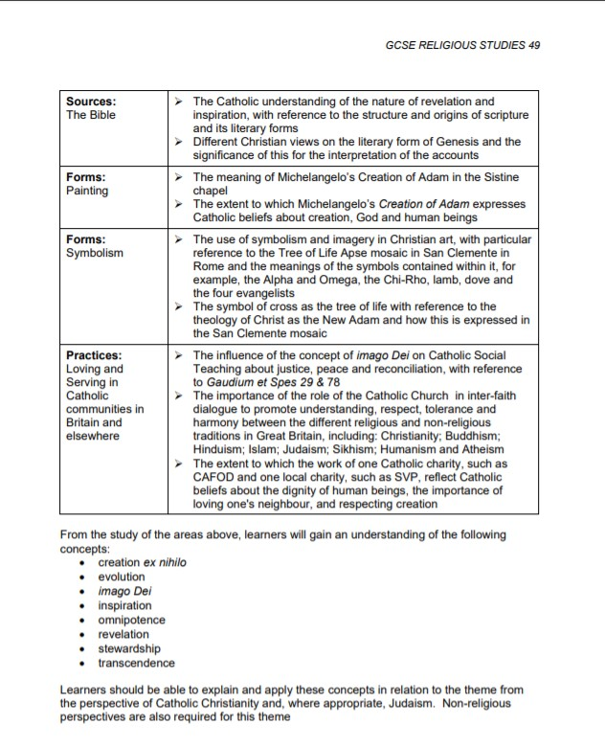
Command words
 | Meaning
Part (a) Question: What is meant by… Define…. AO1 In C1 and C2 the questions will ask, ‘What do Catholics mean by…’ In C3 the questions will ask, ‘What do Jews mean by…’ | Definition of a key term linked to one of the eight key terms. (These are listed in the Specification as bullets at the end of each Theme)

Slide 12
Command words
 | Meaning
Part (a) Question: What is meant by… Define…. AO1 | Example questions: Component 1: (i) What do Catholics mean by ‘inspiration’? [2] Component 2: What do Catholics mean by the ‘soul’? [2] Component 3: (a) What do Jews mean by ‘kosher’? [2] For all (a) questions, credit 1 mark for a very simple definition and 2 marks for a developed definition and/or an example. The glossary of key concepts can be found here on the Eduqas Digital Resources website.

Slide 13
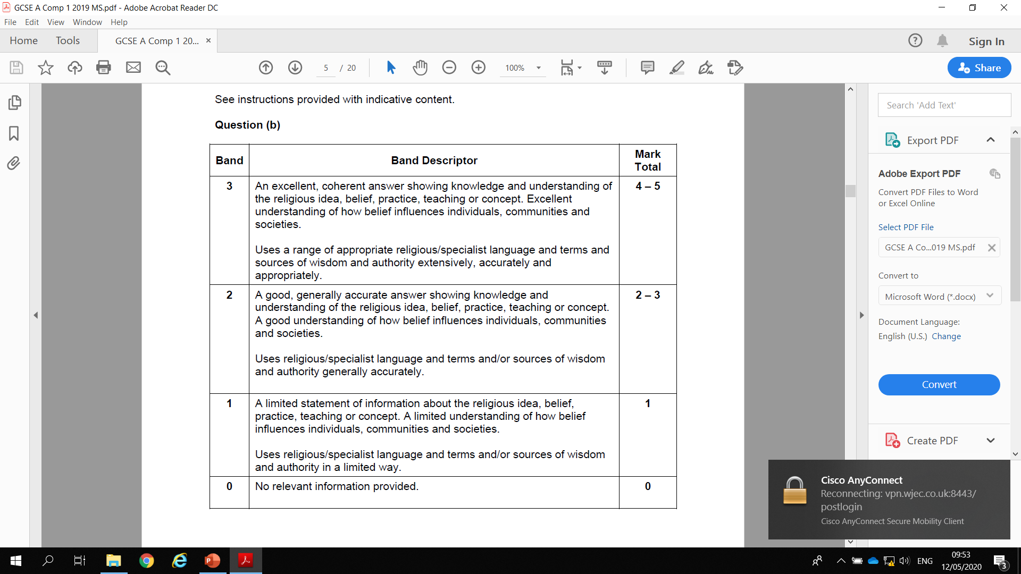
Command words
 | Meaning
Part (b) Question Describe… AO1 | Demonstrate knowledge and understanding by describing a belief, teaching, practice, event etc. Example questions: Component 1: (b) (i) Describe St Augustine’s teaching about the origin of the universe. [5] Component 2 (b) Describe Catholic teaching about the importance of dying well. [5] Component 3: (b) Describe the Abrahamic Covenant. [5]

Slide 14
Command words
 | Meaning
Part (c) Question Explain…. AO1 | Demonstrate knowledge and understanding of a topic by explaining the statements made with reasoning and/or evidence e.g. Explain why .. Explain the main features of .. Explain the importance/significance of .. Explain teachings/beliefs/attitudes about.. Example question: Component 1: (c) (i) Explain from either Catholic Christianity and Judaism or two Christian traditions, beliefs about abortion. [8] Explain questions for qu.(c) in Component 1 ONLY, ask for TWO RELIGIOUS perspectives The two views can come from traditions WITHIN Christianity OR from Catholic Christianity and Judaism. Non-religious beliefs are NOT appropriate here. Candidates will not gain available marks if they do not offer TWO RELIGIOUS responses to these questions. TWO perspectives is enough. Candidates should not try to do more.

Slide 15
Command words
 | Meaning
Part (c) Question Explain…. AO1 | Demonstrate knowledge and understanding of a topic by explaining the statements made with reasoning and/or evidence e.g. Explain why .. Explain the main features of .. Explain the importance/significance of .. Explain teachings/beliefs/attitudes about.. Example questions: Component 2: (c) Explain why the death of Jesus is important to Catholics. [8] Component 3: (d) Explain why the synagogue is important in Judaism. [8]

Slide 16
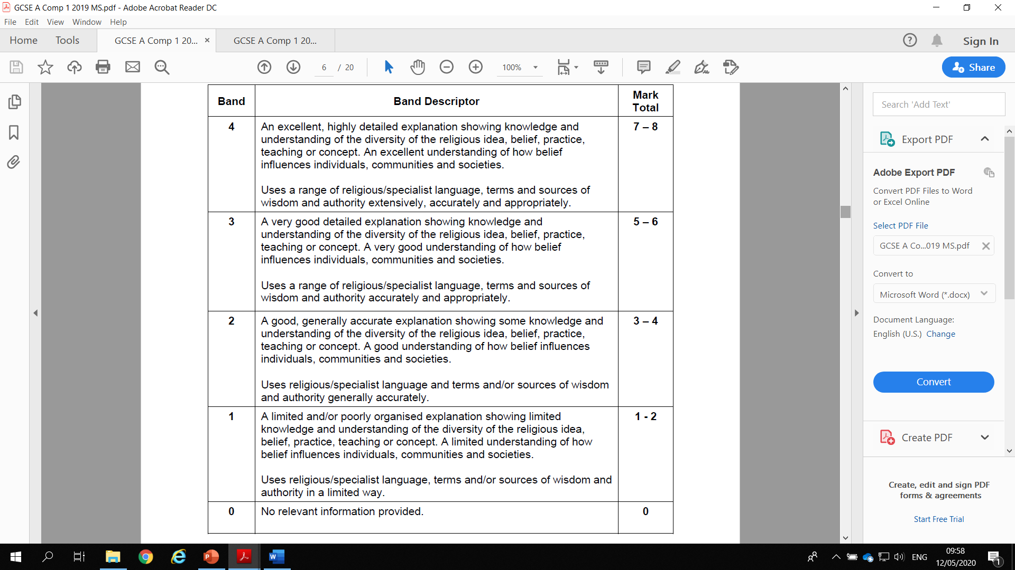
Command words
 | Meaning
Part (c) Question Explain…. AO1

Slide 17
Command words
 | Meaning
Part (d) Question Discuss… AO2 | Discuss this statement showing that you have considered more than one point of view (you must refer to religion and belief in your answer). Evaluation of a view from more than one perspective. These perspectives can all be ‘for’ the statement, all be ‘against’ the statement or be a mixture of both ‘for’ and ‘against’. N.B: ‘Belief’ can also mean non-religious belief and non-religious beliefs can be (but don’t have to be) included in all (d) questions that lend themselves to such a response – so, for example, non-religious beliefs may be relevant to a question such as ‘Marriage should be a lifetime commitment’’, but they would not be appropriate for a specific question like ‘You have to go to Church to be a Christian’, where the focus is narrower and very specific to that religion. HOWEVER, Qu. 1(d) in Route B of Component 1 ONLY (Origins and Meanings) demands that specific non-religious beliefs are included. Candidates will not gain available marks if they do not include non-religious beliefs in their response to this question Across all d. questions, personal responses per se (i.e. unsubstantiated/unsupported personal views) will not be credited but personal responses that link to one or more of the banding criteria WILL be credited.

Slide 18
Command Words
 | Meaning
Part (d) Question Discuss… AO2 | Example questions: Component 1 Theme 1 Question 1d: (d) ‘The Theory of Evolution is the best explanation for the origin of humans.’ Discuss this statement showing that you have considered more than one point of view. (You must refer to religious and non-religious beliefs, such as those held by Humanists and Atheists, in your answer.) [15] Component 1 Theme 2 and Component 2 Themes 1 and 2: (d) ‘There is life after death.’ Discuss this statement showing that you have considered more than one point of view. (You must refer to religion and belief in your answer.) [15] Component 3 Themes 1 and 2: (d) ‘Shabbat is the most important celebration for Jews.’ Discuss this statement showing that you have considered (You must refer to religion and belief in your answer.) [15]

Slide 19
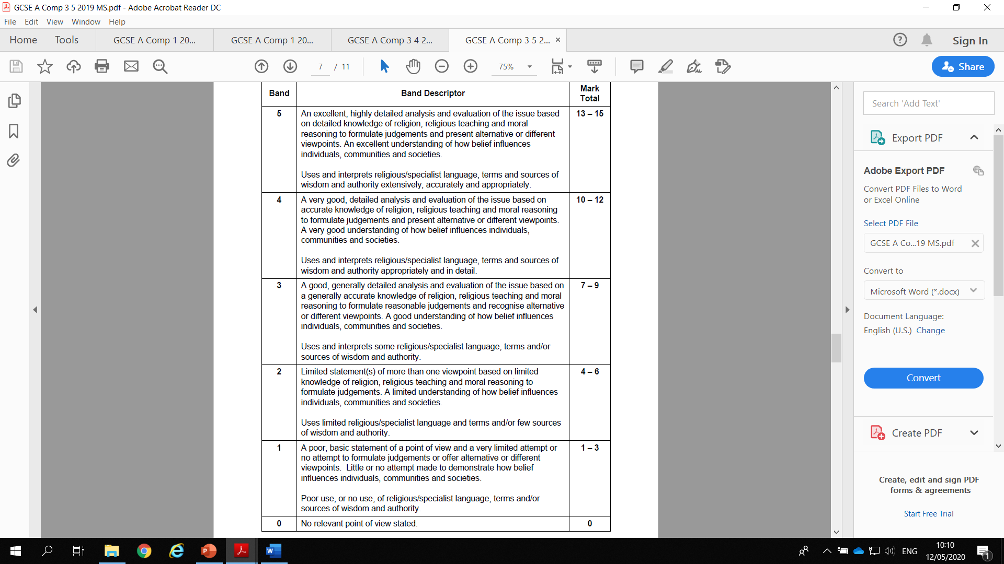
Command words
 | Meaning
Part (d) Question Discuss… AO2

Slide 20
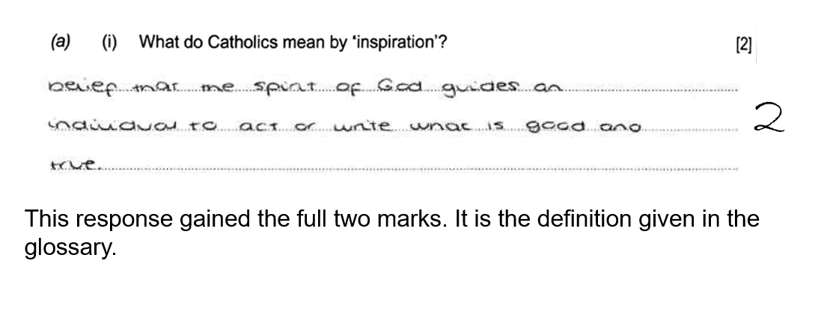
Expectations
This is an example of a 2/2 (a) response:

Slide 21
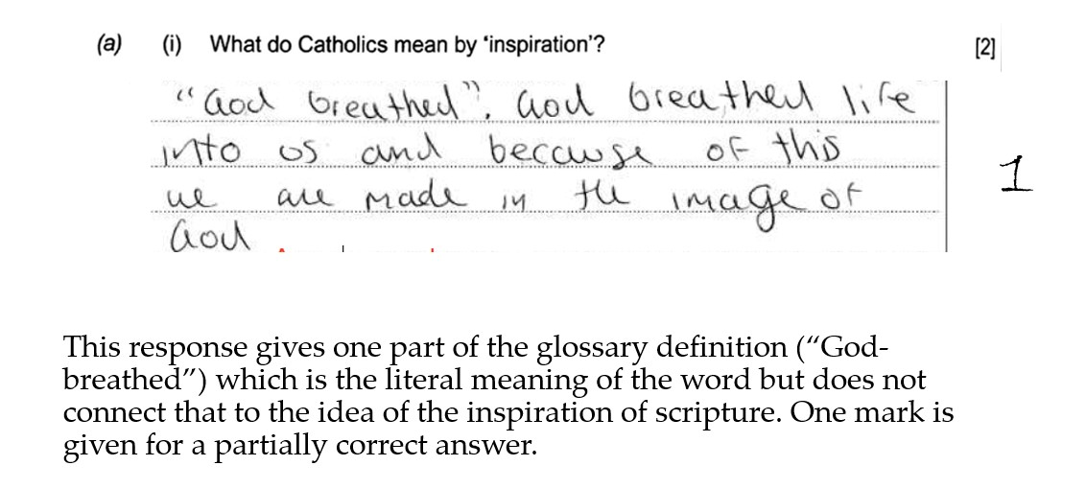
This is an example of a 1/2 (a) response:

Slide 22
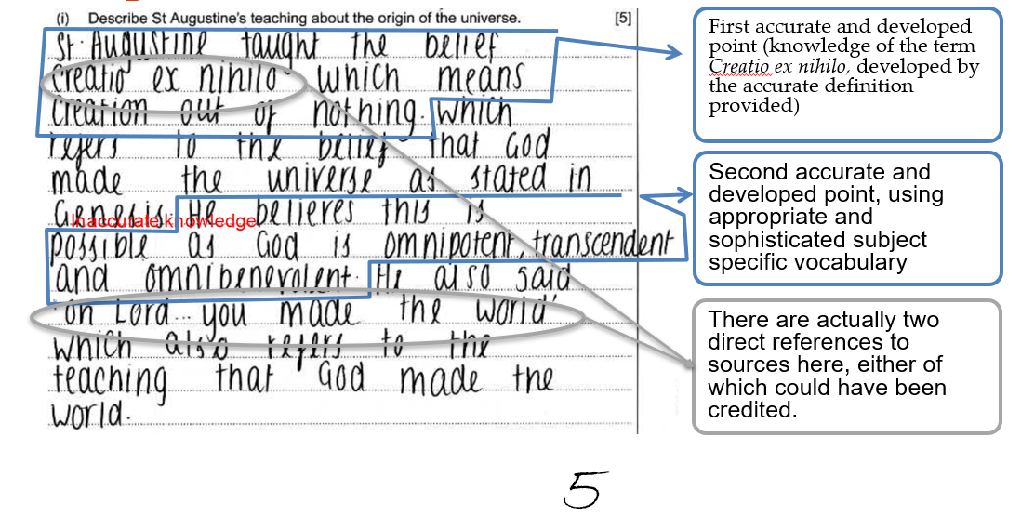
Expectations
This is an example of a 5/5 (b) response:

Slide 23
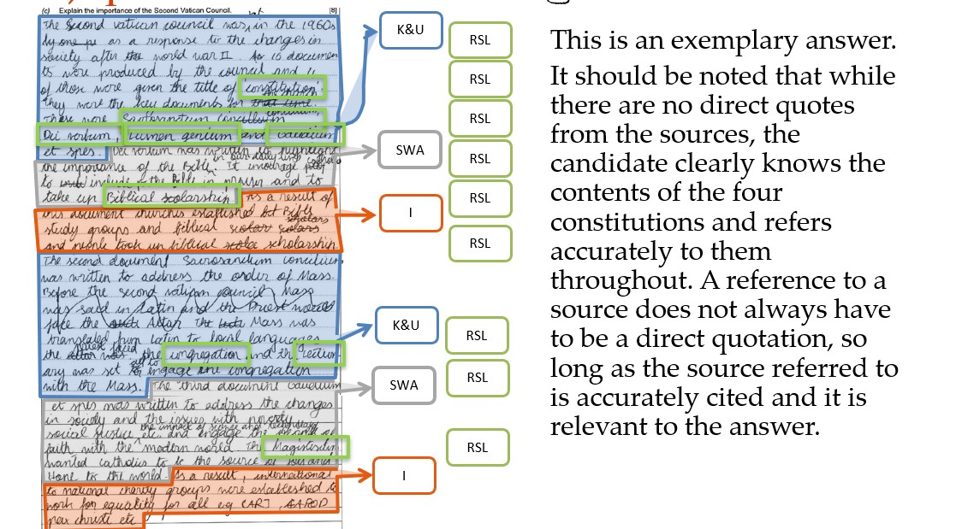
Expectations
This is an example of a 8/8 (c) response (Component 2):

Slide 24
‘c’ questions [8 marks] on Component 1
Part c) questions for Component 1 are always comparison questions, where the candidates have to give a response that either compares two different Christian denominations or compares Catholicism with Judaism.
It should be remembered that a comparison question like this can be asked about any part of the relevant parts of the specification. However, it is also equally clear that are some areas where the comparison is more legitimate, allowing for both of the kinds of comparison allowed by the question structure.
We have a resource that picks out numerous topics where there is legitimate diversity both within Christianity and between Catholicism and Judaism. Take a look at this comparison document here.
Candidates need to be careful to include both points of the comparison in equal depth. When marks are lost on these questions it is often because they have only written about one half of the comparison.
Also please remember that comparisons with non-religious worldviews cannot be credited in answer to these questions.

Slide 25
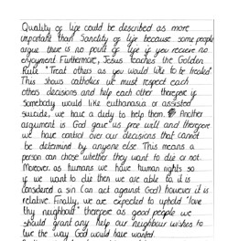
Expectations
This is an example of a 14/15 (d) response:

Slide 26
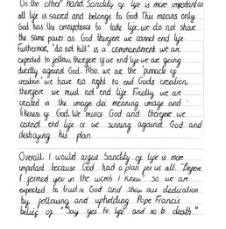
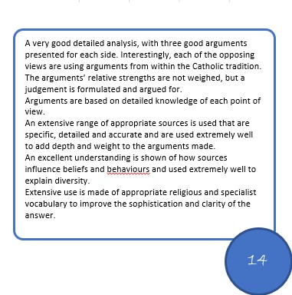
Expectations

Slide 27
Website & Resources
Here are some useful links
GCSE RS website: https://www.eduqas.co.uk/qualifications/religious-studies-gcse/#tab_overview
Free on-line resources: https://resources.eduqas.co.uk/Pages/ResourceByArgs.aspx?subId=26&lvlId=2
On-line exam review (OER): https://oer.eduqas.co.uk/
Guidance for Teaching: https://www.eduqas.co.uk/media/nk4l5fjr/wjec-eduqas-gcse-9-1-religious-studies-b-guidance-for-teaching.pdf
Past Papers & Mark Schemes: https://www.eduqas.co.uk/qualifications/religious-studies-gcse/#tab_pastpapers

Slide 28
Regional representatives:
Dave Jones (South, South West and Midlands)
davidr.jones@eduqas.co.uk
Catherine Oldham (North)
catherine.oldham@eduqas.co.uk
Ant Fleming (South East)
anthony.fleming@eduqas.co.uk
Dave Evans (North West)
david.evans@wjec.co.uk
Eduqas GCSE Religious Studies team:
GCSEReligiousStudies@eduqas.co.uk

Slide 29
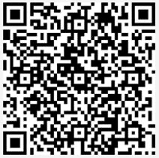
Thank you
Thank you for attending the Eduqas regional team online session today. It would be very helpful if you could let us know your thoughts on the event by responding to the very brief survey here:
Find out about future sessions by following the Twitter hashtag #eduqasrepteam
Eduqas regional team: here to support you
Email hugh.lester@wjec.co.uk to be put in touch with the rep for your area

